Slide 1

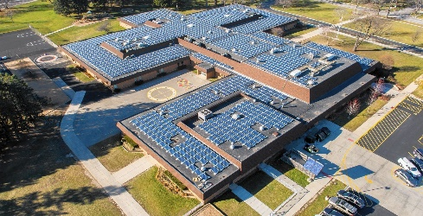


Marion County School District South Carolina:
Empowering Education, Energizing Tomorrow
2024 Renew America's Schools Prize
Summary of our school district’s needs (Facilities and Communities)
  A funding gap exists in our school system for access to energy saving and renewable energy technologies in our school district and communities. By reducing energy consumption, implementing renewable energy, and improving our learning environments, we will provide a better education for our students and create economic benefits for our community.
  Adding Electric EV Charging Station for new fleet
  Solar PV Arrays at the community shelter critical sites
  Smart LED lighting in all school and auxiliary buildings
  Building automation and energy management upgrades
  High efficiency HVAC upgrades
  Weatherization & building envelope improvements
Addressing Infrastructure and Energy Efficiency
Project Goals
Reducing Energy Costs
Improving Air Quality
Engaging students in the building of our project
Creation of local work opportunities within the community
Utilizing Renewable Energy Technologies
Educational Growth in the Clean Energy Industry
U.S. DEPARTMENT OF ENERGY OFFICE OF STATE & COMMUNITY ENERGY PROGRAMS

