Slide 1

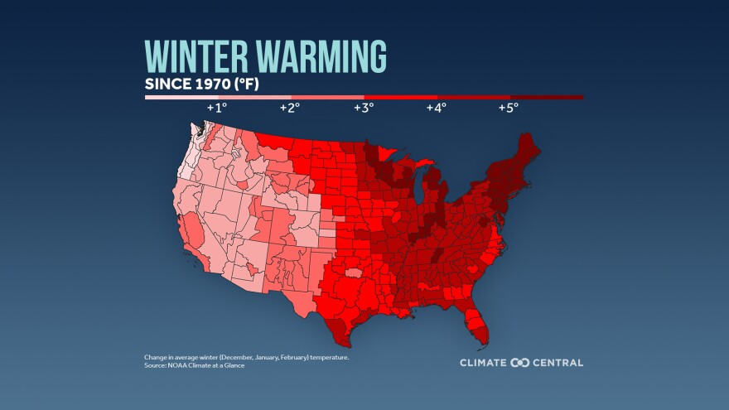
Cooperative Education Service Agency 10
2024 Renew America's Schools Prize
Decarbonizing Wisconsin Rural Schools
  Project Description
  CESA 10 will partner with Focus on Energy, KEEP, Solar Connection, and the Wisconsin Building Trades Council to decarbonize 13 rural schools in western Wisconsin.
  Summary of Need (Community, Facility)
  Wisconsin is experiencing some of the fastest-warming winters in the country. The aging school buildings and outdated equipment are struggling to keep pace with these rising temperatures, resulting in increased utility bills and deteriorating indoor air quality. Funding is needed to decrease emissions, enhance learning environments, and foster economic growth.
  Project Goals
  Reduce energy usage by 20% or 160,000 kilowatt-hours.
  Decrease greenhouse gas emissions by 112 metric tons of CO₂.
  Educate five key stakeholder groups.
  Offer three long-term community benefits.

