Slide 1
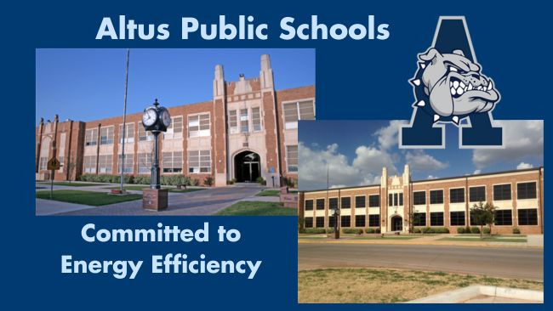
Altus Public Schools
2024 Renew America's Schools Prize
Energy Efficiency to Empower Education in Altus
Project Team: Altus Public Schools & CWA Group
The project aims to conduct ASHRAE Level 2 energy audits and develop a strategic plan for energy improvements.
  Conducting site visits and inspections
  Analyzing energy consumption data
  Developing a financial strategy utilizing IRS Elective Pay tax credits
  Designing energy-efficient solutions
  Implementing physical upgrades and retrofits
  Engaging with stakeholders to ensure community support and involvement
Altus Public Schools faces significant socio-economic challenges, including high percentages of students eligible for free or reduced lunch, outdated infrastructure, and high energy costs. The need for energy-efficient upgrades is critical to reduce operational costs, improve air quality, and create a better learning environment. The goal is to achieve long-term sustainability and financial savings that can be redirected to educational resources.
Goals:
  Reduce Energy Consumption: Implement energy-efficient upgrades to significantly lower energy usage across Altus Public Schools.
  Improve Learning Environments: Enhance indoor air quality, lighting, and temperature control to create a healthier and more conducive learning environment for students.
  Decrease Operational Costs: Achieve cost savings on energy bills, allowing the district to reallocate funds to educational programs and resources.
  Community Benefits: Support the community by reducing the district's carbon footprint, promoting sustainability, and fostering local job creation through project implementation.

