Slide 1
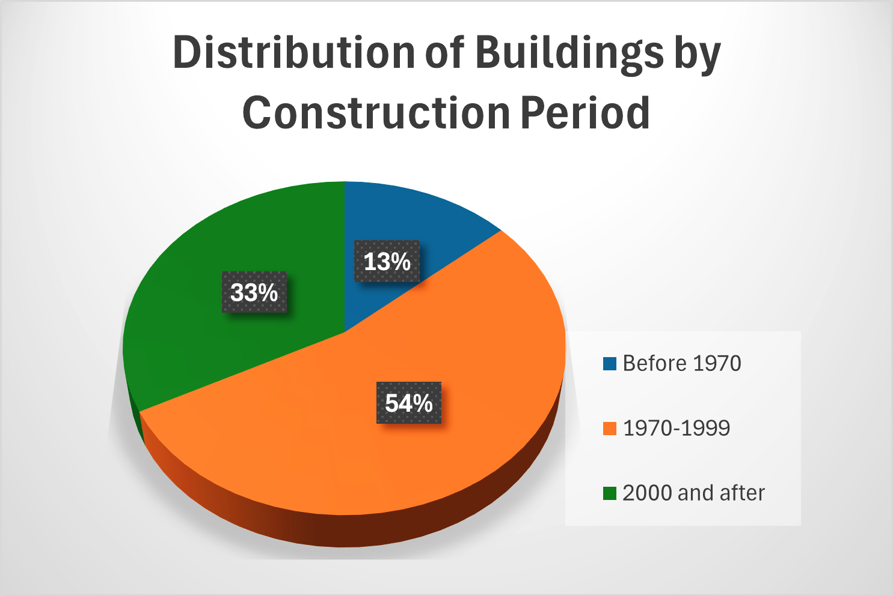
Flour Bluff Independent School District
2024 Renew America's Schools Prize
Building and Advancing Sustainability Initiatives for our Schools (BASIS)
  Project Description: Flour Bluff Independent School District (FBISD) is in Corpus Christi, Texas, and serves the Flour Bluff community on a peninsula between Corpus Christi proper and North Padre Island. Today the district is composed of 7 schools, a natatorium, athletic filed, auditorium, and environmental educations area, among other facilities. The BASIS team represents engineers, facilities managers, financial and policy advisors, a facilitator, and community members that are skill and ready to address the challenges facing FBISD in build sustainable process and resiliency.
  Project Goals:
Enhancing Energy Efficiency in School Facilities:. BASIS aims to reduce overall energy consumption by 25% within the next five years.
Promote Environmental Sustainability: BASIS aims to achieve a 30% reduction in waste sent to landfills by 2030.
Improve Student and Staff Well-being: BAISIS wil create healthier learning environments by improving indoor air quality, increasing natural lighting, and incorporating green spaces
Educational Integration and Community Engagement: FBISD will integrate sustainability into the curriculum through hands-on learning experiences and projects that will be highlighted throughout the school year in social media posts, news articles, and community outreach events.
Summary of Need : FBISD needs to improve energy –efficiencies across the district due to because aging buildings, budget limitations and competing priorities, as well as failing systems such as HVAC systems, inefficient lighting, and outdated insulation. Our Title 1 district serving disadvantaged students aims to improve learning conditions for students, working conditions for teachers and help ensure the sustainability of our coastal community so it can thrive.

