Slide 1

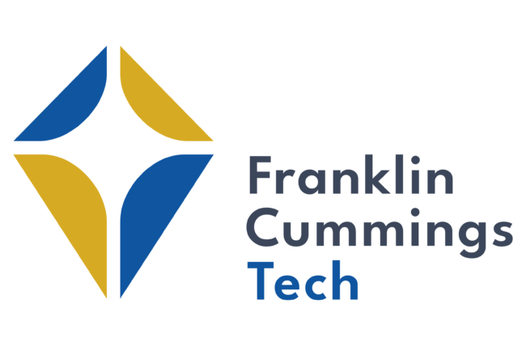
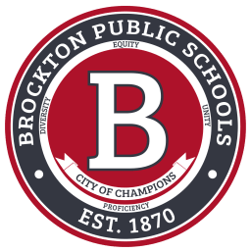
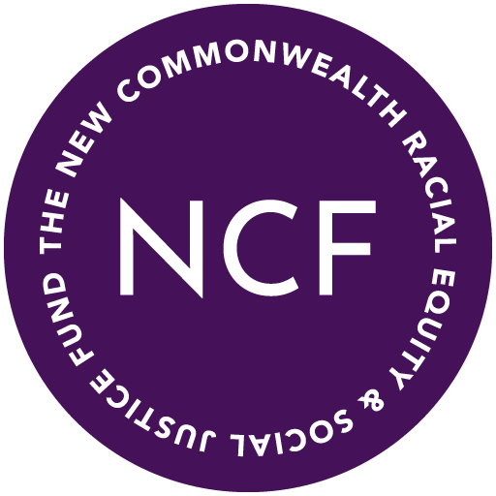


Gateway Cities Decarbonization Consortium
Justice 40 Communities, Go Further Together!
  Brockton, Chelsea, and Everett Public Schools, Environmental Justice 40 communities, teamed with
  Ameresco, Inc., the New Commonwealth Racial Equity and Social Justice Fund, a Local Union Workforce, and Franklin Cummings Tech.
  Project Impact: 200,000 residents; 28,700 students of which 91% Black, Latino, Native American, and Asian; 93% receive a free and reduced lunch. 23 school buildings identified provide critical municipal services, shelters for inclement weather, host community events, training facilities for adult learning.
  New Commonwealth Fund will lead our strategic community impact plan(s); Franklin Cummings Tech will lead internships and Co-Ops focused on construction management, building energy management, and renewable energy. 48 students from the Brockton, Chelsea, and Everett High Schools have already applied to the fall class.
  Grant Funding WILL GO FURTHER! Leverage private investment and deliver HIGH-IMPACT Diversity and Inclusion Plan laser focused on minority, women-owned, and other under-represented businesses.
  Construction – Local highly skilled and highly trained Union Workforce. Drawing on local joint labor-management apprenticeship programs hiring individuals from each of our EJ communities.
  All have persistent poverty, profound health and environmental vulnerabilities. A healthy learning environment
  is fundamental to student and community success. We will be taking proactive steps to create a safe, healthy,
  and sustainable educational setting. These efforts will not only benefit the physical health of students and staff but also foster a positive school culture and enhance academic achievement. A healthy learning environment promotes better concentration, attendance, and overall student engagement, contributing to improved educational outcomes.
  Workforce Development & Educational Enrichment Opportunities. These projects are living laboratories, and tools available to engage students and promote collaboration and curiosity about their own future!
  Project and Community Development
  Team Goals:
  Transform schools into high-quality educational facilities which foster a Healthy Learning Environment with Building Improvements, Efficiency & Indoor Air Quality
  Youth Development and STEM Education & (K-12 & Adult Learners)
  Build & Support Community Based Organizations
  Economic & Workforce Development
  High Impact Diversity and Inclusion Plan; Good Paying Jobs; Union Workforce
  Health Equity, Identity and Culture
  Leverage Private Sector Investment
  Carbon Reduction

