Slide 1

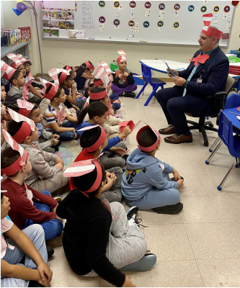
Hazleton Area Cougars
LEA-wide HVAC and Energy–Efficiency Improvements
Project Description
13 submitted schools and school facilities within the Hazleton Area School District need HVAC upgrades, roof and building envelope repairs, fire alarm system upgrades, air conditioning additions and overall energy-efficiency upgrades.
Summary of Need
The district currently has more than $30,000,000 of immediate capital repair needs for aging facilities across over 1,400,000 square feet of building area. Only 5 of the 13 schools have air-conditioning in the classrooms, with the remaining 8 schools in need of adding air-conditioning. 70% of the 12,000 students district-wide are non-white and approximately 95% of all students qualify for free or reduced-price lunch.
Project Goals
Reduce building energy usage and source carbon emissions
Replace equipment past useful life expectancy
Evaluate renewable and geothermal options for future energy resilience
Improve indoor air quality through CO₂ monitoring and improved ventilation
Improve building envelope to eliminate water and air leakage

