Slide 1

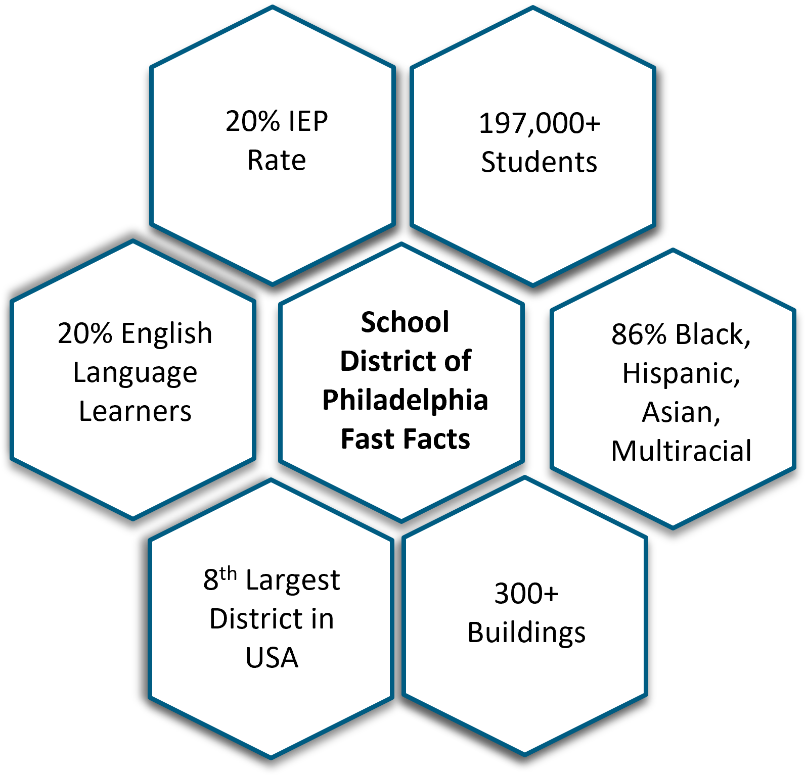
2024 Renew America's Schools Prize
Fostering a Healthier Learning Environment for our Youngest Students
  Portfolio of Schools
20 Elementary Schools serving nearly 11,000 students
100% economically disadvantaged, 80% POC
  Project Team
School District of Philadelphia: Principal Investigator/Prime Applicant
Philadelphia Energy Authority: Technical Advisor/Partner
  Proposed Plan
Retrofit 20 schools with high-efficiency HVAC
Cut energy use by 50% and CO2 emissions by 95%
Save 2.36 million metric tons of CO2 annually
Integrate clean energy & environmental literacy into STEAM curricula
  Summary of Need
Deteriorating buildings with outdated HVAC and deferred maintenance
Existing building improvement plans do not include GHG emission savings
Extreme heat and insufficient cooling lead to absences and closings
Outdated HVAC exacerbates asthma and impacts air quality
  Project Outcomes
High-efficiency electrification and vastly reduced GHG emissions
Ease the burden on facilities staff by simplifying mechanical systems and ensuring continued maintenance of building systems
Prepare school buildings to go net-zero in anticipation of rooftop solar
Prioritizes student education by improving learning environments while empowering students and teachers to engage with clean energy technologies through hands-on STEM programs.

