Slide 1
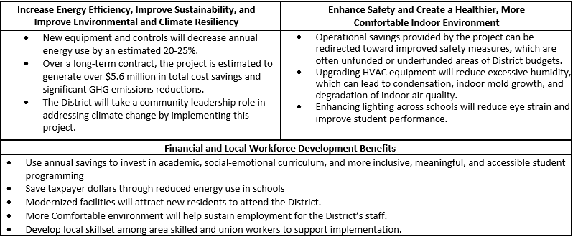
Hoke EcoEquity Squad
2024 Renew America's Schools Prize
Hoke County Schools: A Blueprint for Sustainable Schools and Communities
Project Description
The proposed project will be implemented in Hoke County, North Carolina and will revitalize and restore 12 of Hoke County School’s (HCSD) school buildings. HCSD struggles with funding large-scale infrastructure projects, resulting in antiquated equipment that causes student discomfort, high energy consumption, and unnecessary greenhouse gas emissions. This project provides HCSD the opportunity to drastically overhaul the district’s equipment, allowing HCSD to focus on student health and energy efficiency by installing new HVAC equipment and energy efficient technology.
Summary of Need (Community, Facility)
HCSD is a high-need school district. All schools are located within a Disadvantaged Community and over 80% of the students in the district are free and reduced-price lunch eligible. In order to maintain important student programs, HCSD has not been able to find the funding needed to undergo large-scale infrastructure improvements. Across the district, much of the equipment has not been upgraded since the 1980s. The only options our district has to upgrade our buildings would be to either sacrifice our mission of upholding educational quality, or to scour for external funding sources, which are rare and difficult to win. We have been able to make do for now, but without grant funding, we will soon have to cut educational programs to make room in the budget for necessary facility upgrades out of concern for student and staff health, a trade-off that no school district should have to choose between.
  Project Goals
  Goal 1: Infrastructure: To revitalize and restore the infrastructure of 12 school buildings in Hoke County by implementing energy-saving measures and creating safe and healthy environments for students, staff, and community members.
  Goal 2: Skilled Workforce and Improving the Local Talent Pipeline: To support the development of a local and skilled workforce by providing training and education programs in clean energy and sustainability as part of the project.
  Goal 3: Energy Justice and Health and Safety: To implement critical upgrades ensuring energy justice and enhanced health and safety standards for all Hoke County students, teachers, and staff, as well as community members and visitors using school facilities.
  Goal 4: Community Benefits: To develop and execute a comprehensive Community Benefits Plan (CBP) for upcoming facility improvement project that aligns with the Justice40.
  Goal 5: Replicable and Scalable Financial Model for School Districts in DACs: To implement ECMs that will result in cost savings and allow HCSD to create a scalable business model to replicate within their facilities and to support best practices for other local educational agencies (LEAs) to follow.

