Slide 1



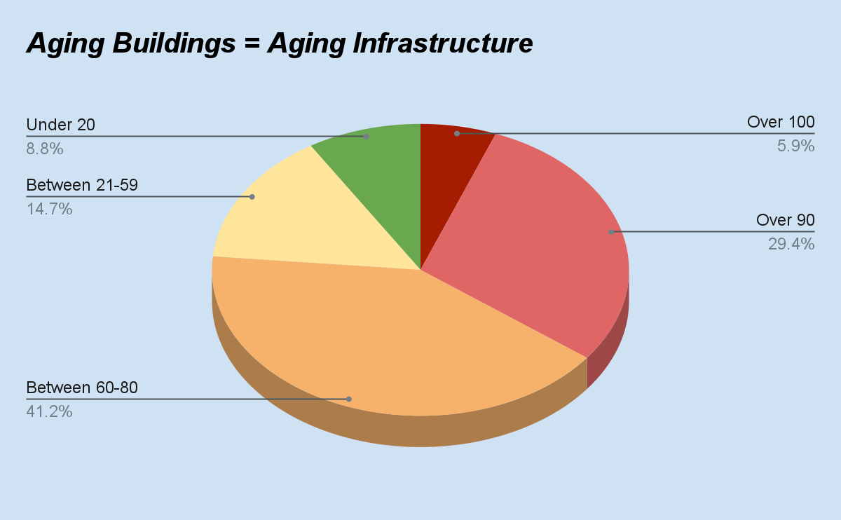
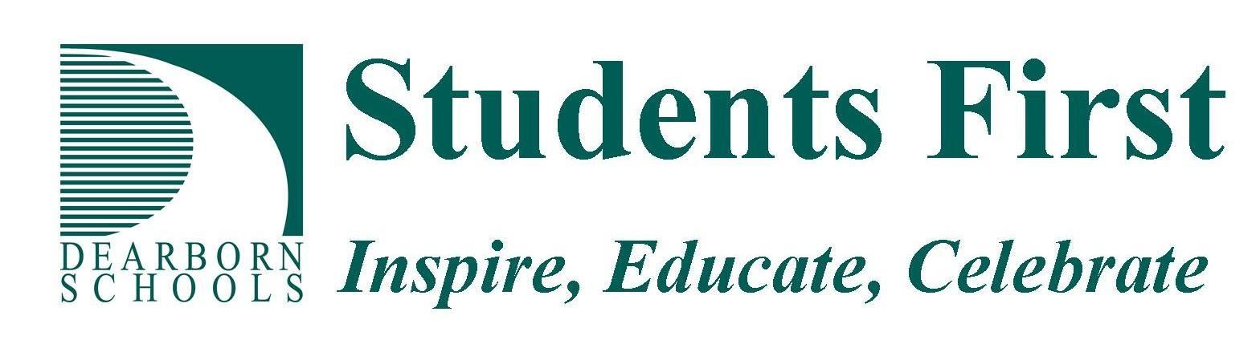
  PROJECT GOALS
  The Dearborn Public Schools will use funding from the Renew America’s Schools program in two ares.
Create a modern automotive technology learning space that will expand opportunities for students to obtain the knowledge, skills, and certifications needed to begin careers in the growing automotive service industry.
Enhance and modernize environmental systems including HVAC, lighting, and other building improvements to create safe and healthy learning spaces throughout the district.
A vital component to these projects will be maintaining and improving both indoor and outdoor facilities so they can continue to be used by the entire community before, during, and after school for learning, recreational, and emergency use. The longstanding partnership between city and schools has always been and continues to be a vital part of the success of the larger Dearborn community.
Thinking S.M.A.R.T.
Sustainability, Modifications, Air Quality, Reduce, & Technology
Increase Sustainability through system Modifications that will improve Air Quality and Reduce environmental footprint through improved Technology.
PROJECT DESCRIPTION
The Dearborn Public Schools will address infrastructure needs at several aging schools to positively impact climate change and create a more energy efficient and healthier school environment. The plan includes:
Replacing outdated and inefficient equipment such as boilers, ventilation dampers, and other HVAC related equipment.
Replacing parking lots that will include underground stormwater retention systems. This project complements current efforts by the City of Dearborn to prevent stormwater runoff from overwhelming the natural ecosystem during severe weather.
A new state of the art centrally located automotive learning lab will ensure equity of access for all students interested in pursuing high-skilled, high-demand and high-paid careers in the automotive service industry.
Summary of Need
  With an overall average age of 69 years for all district buildings, and 12 schools over the age of 90, dollars received through the Renew America’s Schools program would provide the funding needed to address some of the most critical infrastructure needs of our schools and limit school closures due to system failures. The district was able to leverage one time funding during the pandemic to address learning loss and provide social emotional support for students. In addition, some HVAC improvements were completed. The loss of these funds, and a narrowly defeated infrastructure ballot proposal in 2019, has created a funding need in the district.
3
2
5
10
14

