Slide 1
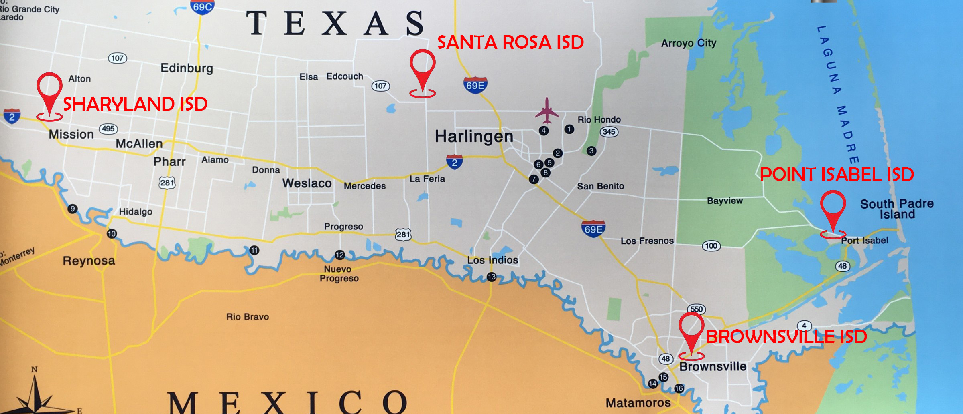
Rio Grande Valley (RGV) United
2024 Renew America's Schools Prize
Ayuda! A Call for Need-Based Grants
  Project Description
  Four LEAs in South Texas spanning two DAC counties are collaboratively seeking grants to improve energy efficiency, lower operational costs, and create healthier learning environments. The Project aims to modernize schools, enhance sustainability, reduce energy burdens, and positively impact the economy of this disadvantaged community. Ethos Engineering, an award-winning HUB firm, will leverage utility rebates, free preliminary audit services, and low-cost loan programs offered by the Texas State Energy Conservation Office.
  Summary of Need (Community, Facility)
  The Title 1 schools serving very low-income DACs are plagued by critical budget deficits resulting in deteriorating MEP infrastructure. Aging HVAC and electrical systems create unsafe conditions for students. Frequent climate disasters exacerbate building deterioration and increase energy costs. Although these LEAs are too small or need more resources to apply for grants individually, they aim to collaborate and secure grants to create positive community impact.
  Project Goals
  At 20 schools, replace and modernize aging HVAC, lighting, electrical, and control systems. Accelerate the adoption of emerging green technology by electrifying facilities and repairing/adding solar PV, EVs, and charging stations.
  Improve IEQ, health, and safety to reduce absenteeism, enhance learning, and promote equity.
  Make schools resilient to serve as community shelters.
  Greatly surpass DOE targets for DEIA and EJ40.
  Reduce energy cost by $2,500,000/year.
  Reduce emissions by 17,500 metric tons/year.
  Add 300,000 person-hours of high-paying jobs to the DAC economy.
  Accelerate training of the local workforce in jobs of the future.

