Slide 1
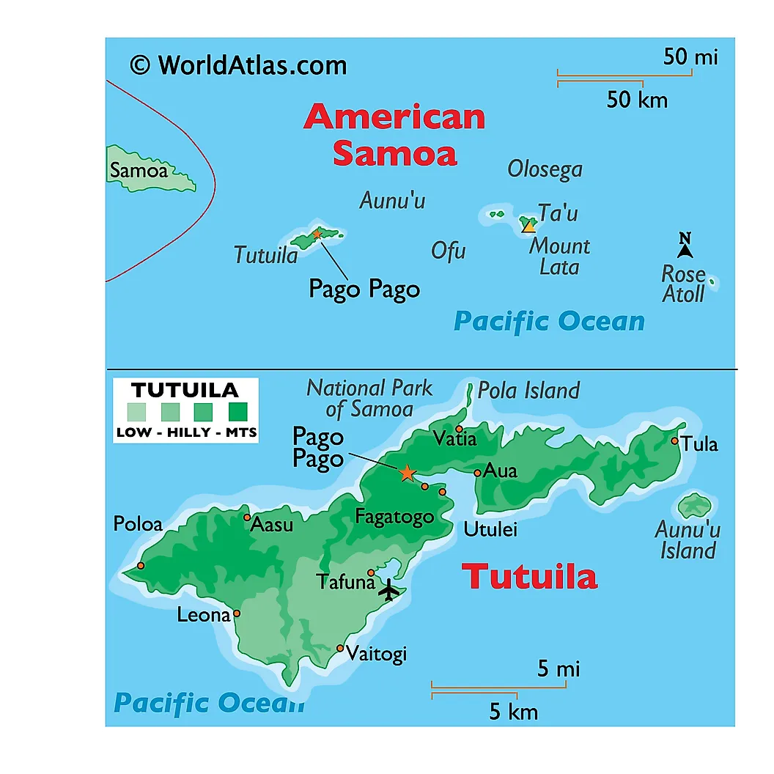
American Samoa
2024 Renew America's Schools Prize
Island Renewal: Energizing American Samoan Schools
  Project Description
  This project aims to upgrade electrical infrastructure for 12 schools on 3 different islands in American Samoa to increase safety measures and accommodate the need for more power supply as well as promote energy efficiency by replacing old electrical wiring and retrofitting windows, lights, and making other envelope improvements.
  Summary of Need (Community, Facility)
  Schools in American Samoa have been identified as being in disadvantaged areas due to their significant distance and geographic isolation from the mainland United States. Aged electrical infrastructure poses safety concerns due to old, exposed wiring and pervasive effects of salt spray as many schools sit on the coastal line of the island. Six of the 12 schools are considered rural in areas 41, 42, or 43 of the NCES tool. Due to climate change and rising temperatures, the need for air conditioning in classrooms has become mandatory, thus causing a need for greater power supply and more modern electrical upgrades to school infrastructure.
  Project Goals
  Goal 1: Conduct Energy Audits, Modernize Electrical Infrastructure, and Implement Energy Efficiency Upgrades
  Goal 2: Enhance Indoor Environmental Quality and Comfort for Students and Teachers
  Goal 3: Foster Workforce Development

