Slide 1
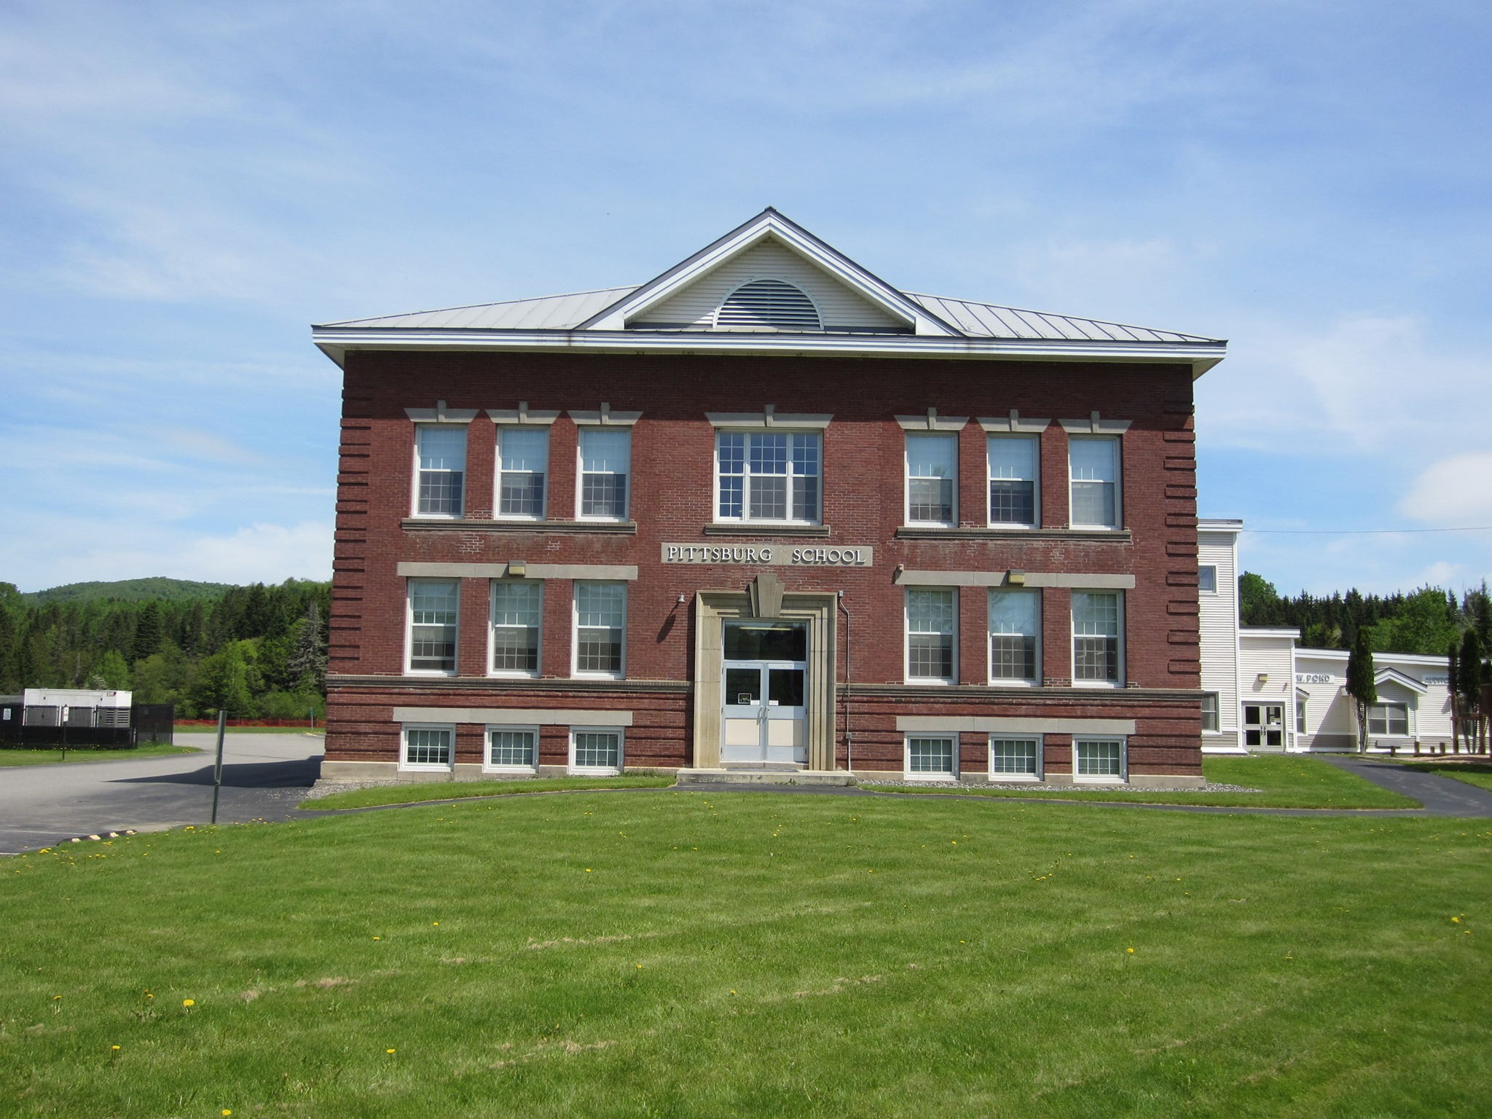
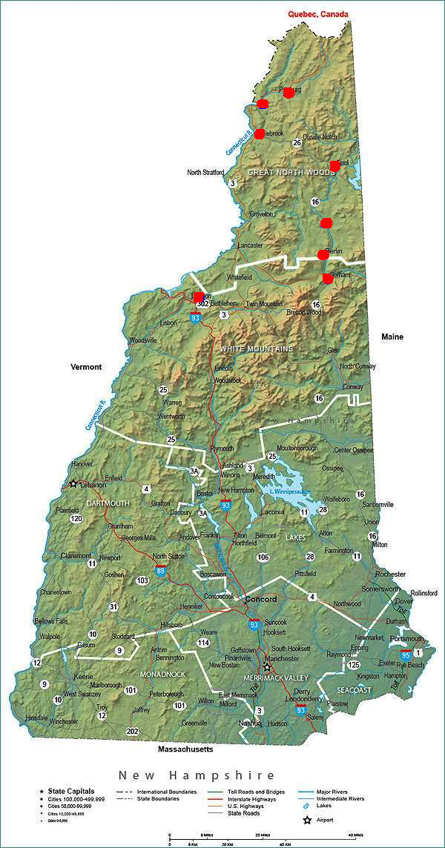
New Hampshire North Country Energy Alliance
2024 Renew America's Schools Prize
Northern New Hampshire Schools
Project Description: The consortium of Northern New Hampshire public schools aims to reduce energy consumption, cut operational costs, and create a healthier, more sustainable learning environment. A collaborative effort involving technical assistance experts, energy auditors, energy workforce trainers, energy education providers, and energy contractors is pivotal to ensuring successful energy efficiency projects in our Northern New Hampshire public schools.
Summary of Need: “It’s more than a school–it’s the heart of the community.”
These communities are rural and/or remote and 48% of the residents live in Disadvantaged Communities, while 50% of students live in Disadvantaged Communities. All schools qualify for Title 1 School-Wide Programming. The schools host voting, town meetings, local events (e.g. craft fairs, police and fire department trainings), and local programming for all ages (e.g. civic/social clubs, summer school, and afterschool). Many serve as community emergency shelters.
Project Goals
Decreasing energy usage.
Lowering operational costs to allocate more resources to education.
Enhancing environmental sustainability and reduce carbon footprint.
Improving school resilience by stabilizing energy budgets and enhancing capacity to serve the community during power outages.
Pittsburg School, Pittsburg NH
https://www.facebook.com/p/Pittsburg-School-100034819972115/
https://www.visit-newhampshire.com/state/nhmap/

