Slide 1
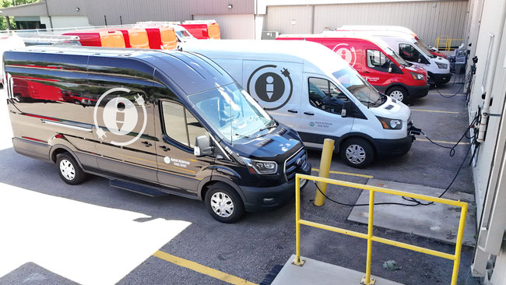
Madison Metropolitan School District
2024 Renew America's Schools Prize
MMSD Fleet Electrification
  Project Description
  Electrification of MMSD’s vehicle fleet will impact all 54 school buildings by reducing emissions, cutting costs, lowering noise, boosting energy efficiency, and creating jobs. The team implementing the project: Svetlin Borisov, CFM, CSRM; Mike MacDonald, Mechanical Engineer; Nick Guerra, Project Manager; Dean Kunz, Assistant Director Facilities Maintenance; and Cory DeGroff, Manager of Electric and Technology.
  Summary of Need (Community, Facility)
  New, electric vehicles boast improved safety features, lower emissions, and require less maintenance compared to their older counterparts.
  Project Goals
  Reduce Greenhouse Gas Emissions & Dependency on Fossil Fuels
  Improve Community Access to Charging Stations & Air Quality

