Slide 1

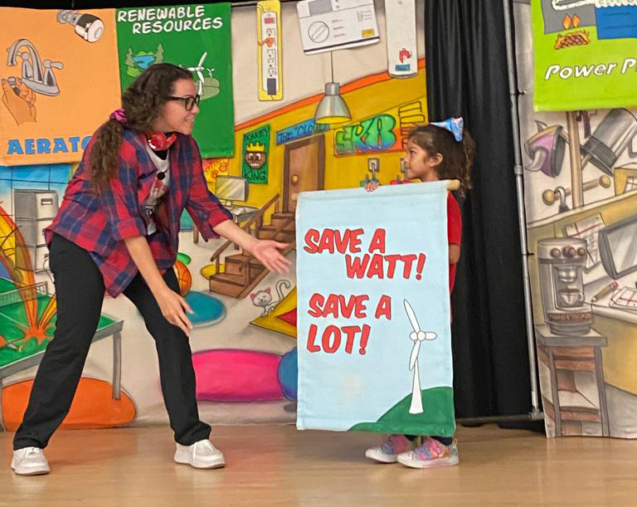
^{RENEW M-DCPS}
^{2024 RENEW AMERICA’S SCHOOLS}
RETROFITTING EDIFICIOS FOR NEIGHBORHOOD ENERGY WEALTH
PROJECT DESCRIPTION
INTENDED BENEFIT ENERGY CONSERVATION MEASURES
Miami-Dade County Public Schools (M-DCPS) has identified 74 school buildings across 10 campuses, 3 of which are emergency shelters. With improving energy efficiency and promoting renewable infrastructure we plan to secure funding for schools, in disadvantaged areas and create healthier learning spaces for 7,460 students. We will tackle these issues by implementing comprehensive energy audits, retrofits, and renewable energy solutions across the selected campuses. These efforts are crucial for reducing the district’s energy burden, enhancing the learning environment, promoting environmental justice and providing educational opportunities and workforce development for students and community members to ensure long-term sustainability and resilience for the district.
Reduce air leakage + promote performance
^{Enhance efficiency + reduce}
^{energy consumption}
^{Improve energy management}
^{+ indoor air quality}
^{Optimize system operations}
^{+ increase energy savings}
^{Reduce greenhouse gas}
^{emissions}
Install weatherstripping + seal roof
Upgrade or replace windows, roof, HVAC, + interior/exterior lighting
Modernize building BAS controls, sensors, + thermostats
Education + training on energy dashboards + sustainable practices
Onsite solar photovoltaic (PV) heat pump + water heater
SUMMARY OF NEED (COMMUNITY, FACILITY)
Schools selected for this project are in disadvantaged, under-represented, minority-majority communities that suffer historic inequities in school facilities investments. The schools and their communities face significant economic challenges and lack the necessary funding to upgrade aging equipment and facilities to reduce energy consumption and remove 2,431 tons of CO2e emissions, and to provide healthier learning environments for students.
PROJECT GOALS
Enhance energy efficiency and optimize building performance.
Increase renewable energy generation and reduce fossil fuel consumption.
Foster educational opportunities and workforce development in disadvantaged populations.
Promote environmental justice by strengthening community engagement and partnerships.

