Slide 1
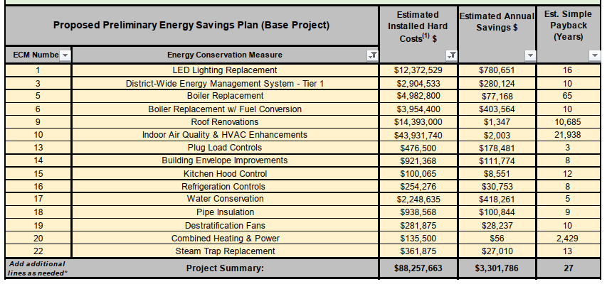
Jersey City Public Schools
2024 Renew America's Schools Prize
JCPS Environmental Equity Plan
  Project Description
  JCPS seeks to upgrade its infrastructure through the DOE’s Renew America’s School Grant. Current efforts include implementing an Energy Savings Plan that involves modernizing HVAC systems, improving energy efficiency, and enhancing overall building conditions.
  Summary of Need (Community, Facility)
  Improving school facilities, specifically adding mechanical ventilation and cooling systems, is essential for creating a healthy and conducive learning atmosphere. Modern, well-maintained buildings support student health, safety, and academic growth, ensuring that all students have access to a high-quality education.
  Project Goals
1. Improve indoor air quality (IAQ)
2. Improve indoor thermal comfort
3. Improve overall energy efficiency at all schools

