Slide 1

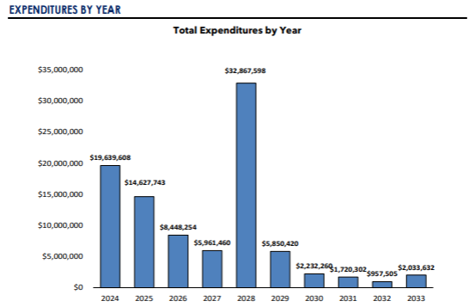

Transform with Transylvania County Schools
2024 Renew America's Schools Prize
Powering Education: Sustainable Energy Solutions for Transylvania County Schools
  Project Description
  Transylvania County Schools consists of 10 primary facilities serving a diverse and disadvantaged community in the Southern Appalachian region of Western North Carolina.
  The project team consists of key facilities and finance staff from the district, Waste Reduction Partners, the North Carolina Department of Environmental Quality (DEQ), Duke Energy, MSS Solutions, Blue Ridge Community College, and Big Mountain Impact.
  The district will leverage its well-established relationships with a local non-profit/DEQ, the electric utility, the local community college, key vendors, and an Asheville-based sustainability consultant to successfully implement Phases II & III.
  Summary of Need
  Transylvania County Schools faces significant challenges with funding gaps to address essential facility upgrades, deferred maintenance, faltering systems, and improved energy inefficiency across their facilities, some of which are up to 79 years old. Approximately 20% of residents under the age of 18 live in poverty.
  A 2024 facility condition assessment report noted that three school sites were considered 'below average condition' and three are in 'fair condition'. Five out of the nine schools received a disadvantaged community designation according to the energy justice mapping tool.
  Project Goals
  Enhance energy efficiency with a geothermal electrification project, replicable across the district at several other facilities
  Address deferred maintenance
  Significantly improve learning environments
  Reduce carbon emissions by 23%
  Leverage funding with strategic planning and partnerships
  Replicate successes across the portfolio and beyond

