Slide 1
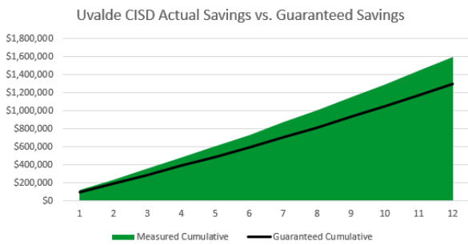
Uvalde Consolidated Independent School District
2024 Renew America's Schools Prize
Submission or Entry Title
  Project Description
  UCISD’s energy efficiency project aims to modernize outdated school facilities with upgrades in HVAC systems, lighting, and building automation. Our project will reduce energy costs, improve air quality, and lower emissions, serving as a replicable and scalable model for other schools.
  Summary of Need (Community, Facility)
  UCISD’s facilities, with many buildings nearly 100 years old, face significant deferred maintenance. Outdated HVAC systems, inefficient lighting, and the harsh Texas climate exacerbate deterioration. High energy costs and equipment failures highlight the urgent need for comprehensive energy upgrades to ensure safe, efficient, and sustainable learning environments.
  Project Goals
  Goal 1: Reduce energy expenditures
  Goal 2: Resolve critical deferred maintenance
  Goal 3: Improve the financial resiliency
  Goal 4: Improve indoor air quality

