Slide 1
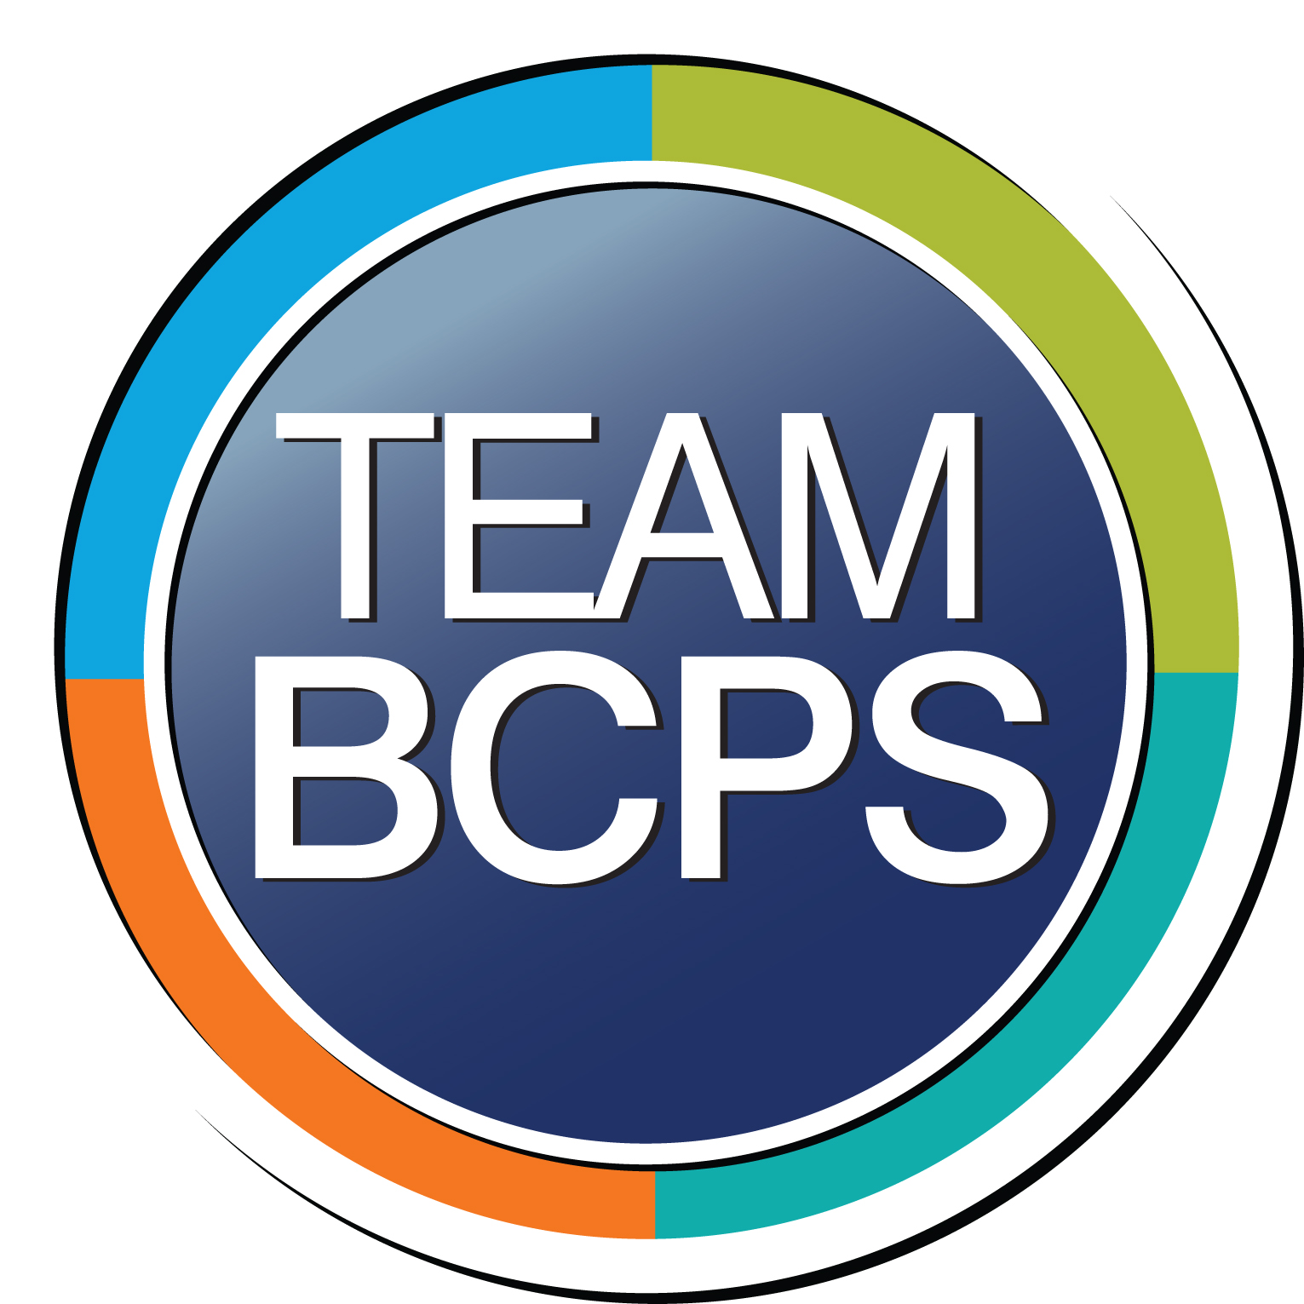
Baltimore County Public Schools
2024 Renew America's Schools Prize
Facility Lighting Upgrade Proposal
  Project Description
  The proposed project is to provide high-efficiency LED lighting upgrades, along with the installation of lighting controls, to fourteen schools. The project team is comprised of five, highly qualified individuals with decades of experience in the HVAC, energy management, and construction industries, including extensive experience implementing Energy Performance Contracts.
  Summary of Need (Community, Facility)
  Of the identified schools, one school is located within and adjacent to an identified disadvantaged community (DAC), four schools are located where the DAC is within the school attendance area that determines where a student is enrolled, five are Title I schools, and eight are BCPS Community Schools. These schools currently have 100 percent, or majority, linear fluorescent interior lighting fixtures.
  Project Goals
  To reduce annual facility electricity consumption, annual facility electricity expenditures, and the associated carbon footprint at each school facility.
  To improve the overall lighting efficiency and quality of each identified school and provide a better learning environment for students and staff.
  To engage with local lighting contractors and providing quality jobs for local community members, contributing to our local economy.

