Slide 1
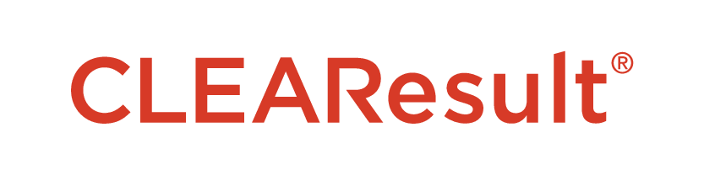
Power Up U-46
2024 Renew America's Schools Prize
Partnership for Safe, Accessible, and Energy Smart Learning Environments
  Project Description CLEAResult combines the strength of energy experts with innovative technology to help change the way people use energy. CLEAResult has extensive schools experience and is partnering with the U-46 School District to identify and implement energy savings projects that receive incentives from local utility companies. The U-46 School District is a community leader with strong community ties that serves over 35,000 students across 57 buildings comprising 5.7M square feet of facilities and has a staff of 6,000 community members. Together, our team is ready to develop a strategic plan for transitioning the District toward a cleaner energy future and implement projects that contribute to a healthier and more energy efficient learning environment.
  Summary of Need The District’s aging facilities require investment for maintenance and, in some cases, replacement. Although many schools have critical needs for infrastructure, efficiency and IAQ upgrades, the 10 schools were prioritized based on location within disadvantaged communities, Title 1 Eligibility, proportion of the student body eligible for free lunch, and designation as a community shelter.
  The DOE Renew America funding will be a critical component to achieving its vision of creating learning environments that are safe, accessible to all, and energy efficient. With this funding opportunity, the U-46 can make deeper investments in energy efficiency, renewable energy, and alternative fuel infrastructure that will benefit the students, teachers, staff, and community members.
  Project Goals
  Identify and prioritize improvements for reducing schools’ operating costs through utility savings and reduced maintenance
  Evaluate opportunities for energy transition to renewable energy and alternative fueled vehicles
  Enhance learning environments by increasing comfort and improving IAQ
  Measure and verify energy savings from implemented projects
  Raise awareness of the project’s benefits within the schools and surrounding communities.
  Engage students, staff, and local trades to improve understanding of the economics and benefits of energy efficiency, renewable energy, and alternative fuel upgrades
  Outline a process for repeatability by documenting steps, best practices, team member roles and responsibilities, benefits, and other key lessons to facilitate future replicability

