Slide 1

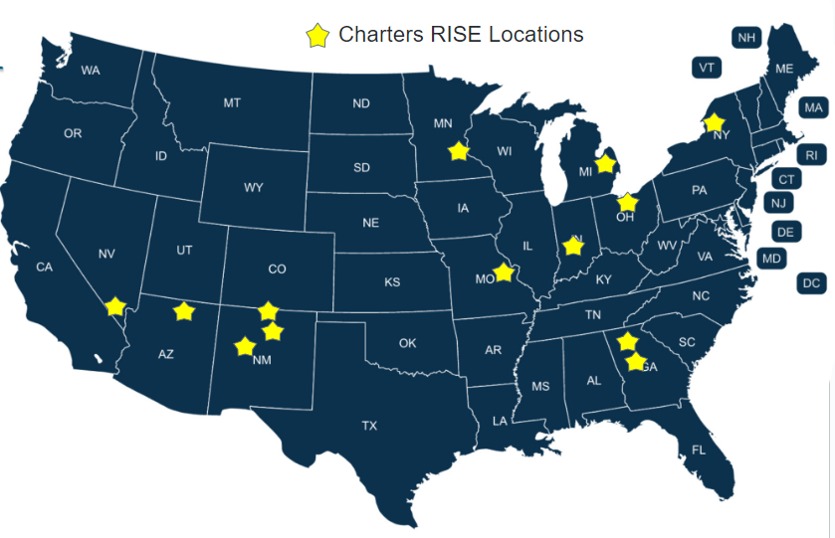
Charters RISE (Renovating for Innovative Sustainable Education)
2024 Renew America's Schools Prize
Project Description
Project Goals
Through renovation projects, CSDC, Ameresco, and LISC support 21 buildings at 13 Charter Schools across 10 states as they RISE to:
Renovate for healthy and welcoming school communities,
Become green education leaders,
Advance climate careers in their communities, and
Support access to equitable and efficient charter school facilities.
Unlock Funds for Student Learning:
Secure additional financing to minimize costs.
Decrease utility expenses, redirecting savings to educational programs.
Advance Equity:
Focus on projects in disadvantaged communities.
Support local workforce development, high quality jobs, and community partnerships.
Catalyze Sector-Wide Impact:
Promote replication of sustainable solutions.
Host webinars and present at conferences.
Summary of Need (Community/Facility)
Charter schools often lack adequate facilities funding, and scarce operational funds are redirected toward capital expenses and/or critical maintenance is deferred, reducing resources for the classroom and forcing subpar environments for learning.
The need is high among Charters RISE schools:
Every school chosen for participation in Charters RISE is either located in a Disadvantaged Community Zone (DAC Zone) or qualifies for Schoolwide Title I funding.
On avg, 80% of students qualify for Free/Reduced Lunch (FRL), with a majority of schools at > 90% FRL.
The average asset score is 2.1 out of 10, suggesting significant opportunity for facility improvement.

