Slide 1

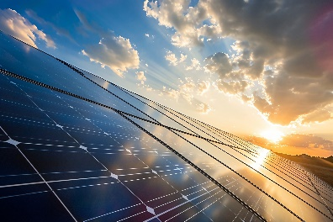
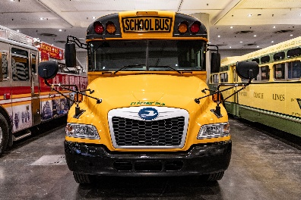

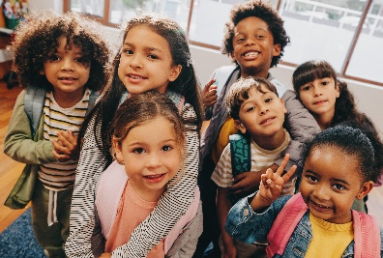
Roanoke City Public School’s Sustainable Scholars:
Empowering Education, Energizing Tomorrow
2024 Renew America's Schools Prize
Capturing Solar Energy and Utilizing Electric Buses for our Disadvantaged Communities Schools
  Project Description
  Installation of solar arrays, EV charging Stations and Electrification of our Bus Fleet for all Disadvantaged Communities Schools for RCPS District
Summary of Need (Community, Facility)
  A funding gap exists in our school system for access to clean energy technologies in our Disadvantaged Communities. Providing clean air, reducing energy costs, and providing educational opportunities within the renewable energy market should be equitable and fundamental for our students.
Project Goals
Reduce Energy Costs
Utilize Renewable Energy Technology
Improve Air Quality
Reduce Heat Island Effect in DACs
Creation of High-Quality, Good Paying Jobs
Educational Growth in Clean Energy Technology
U.S. DEPARTMENT OF ENERGY OFFICE OF STATE & COMMUNITY ENERGY PROGRAMS

