Slide 1
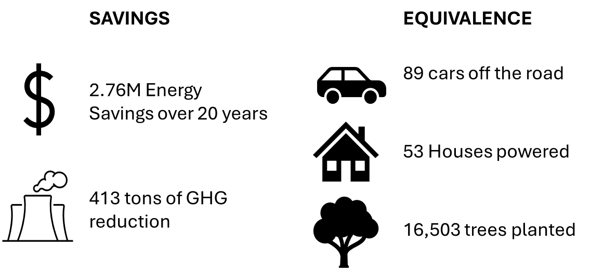
Rutherford County Schools (NC)
2024 Renew America's Schools Prize
Guaranteed Energy Savings Performance Contract
  Project Description
  The Rutherford County School District aims to achieve significant energy, financial, and environmental benefits through the Renew America's Schools program. Our project will reduce annual energy expenditures by $138,000 through comprehensive energy efficiency upgrades and renewable energy installations across our school facilities. These savings will allow us to redirect funds towards our core educational mission.
  Summary of Need (Community, Facility)
  Our district is mostly Title I, with a high percentage of students participating in the FRL program. A majority of our schools’ locale codes are 41, 42 or 43, and the community poverty rate is 24%.
  Project Goals
  1 - Reduce energy cost by $138,000 annually.
  2 - Resolve $10M in deferred maintenance needs through EPC.
  3 - Improve financial resiliency of the school system by lowering operating costs.
  4 - Improve indoor air quality and other health/comfort benefits for students and staff.

