Slide 1


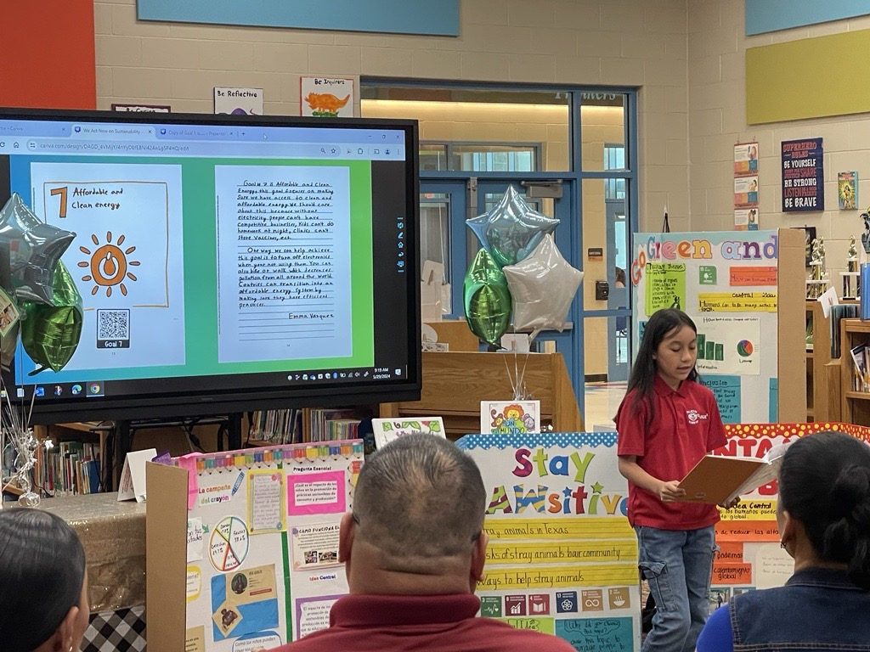

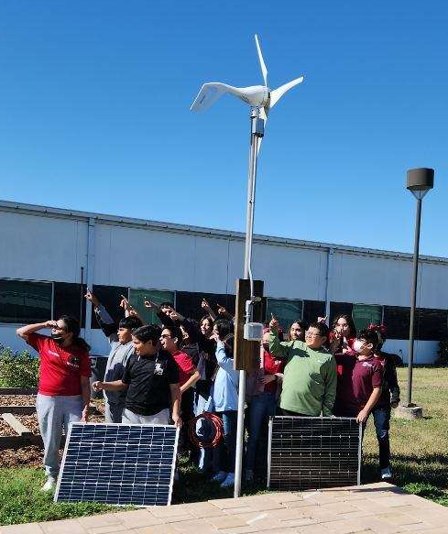
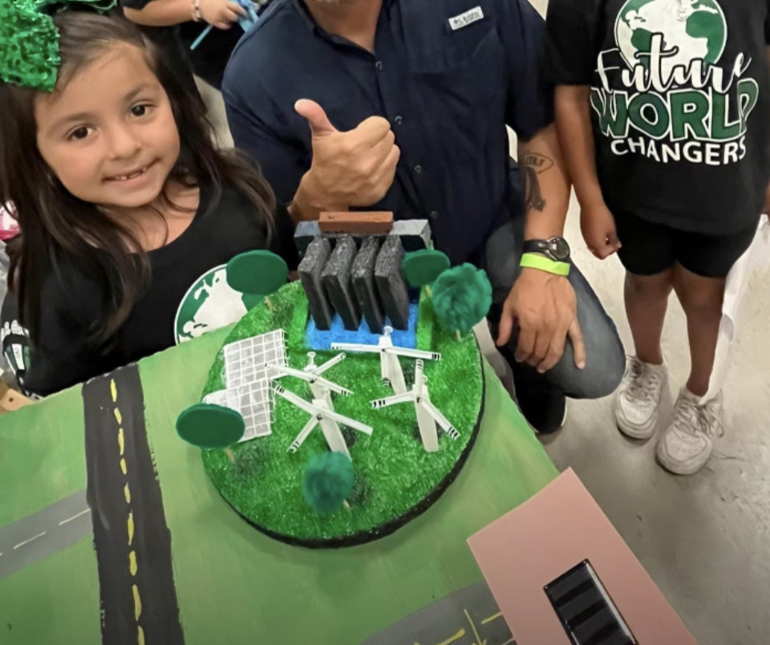
Pharr San Juan Alamo I.S.D.
Powering Progress: PSJA Sustainability Initiative
Project Description:
As stewards of both educational excellence and environmental responsibility, PSJA ISD enthusiastically embraces the opportunity to renew and revitalize our schools through the transformative provisions of the Renew Americas School Prize. By leveraging these resources to implement energy efficiency upgrades, integrate renewable energy systems, and expand educational opportunities, we will not only enhance the learning experience for our students but also leave a legacy of sustainability for future generations. Together, we can empower tomorrow by renewing America's schools today.
Summary of Need:
PSJA will strive to begin preparing and implementing energy efficient infrastructure upgrades to 11 of our buildings. Despite our commitment to excellence, PSJA ISD faces significant challenges in maintaining aging infrastructure, rising energy costs, and limited resources for modernization efforts. Our schools, many of which were built decades ago, struggle to meet the demands of a rapidly evolving educational landscape while simultaneously grappling with inefficiencies that strain operational budgets.
Project Goals:
PSJA ISD will work towards acquiring Solar energy for nine facilities to lower our energy consumption.
PSJA ISD will work towards replacing 30% of the HVAC units.

