Slide 1


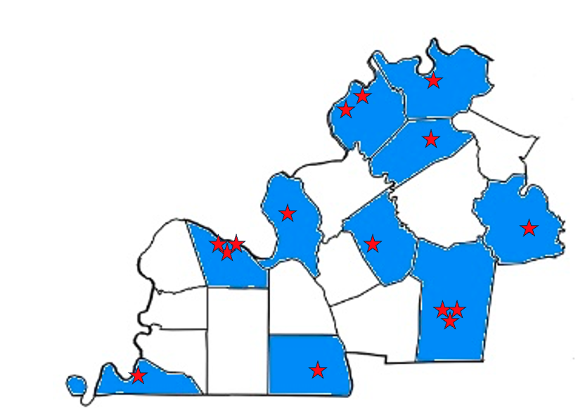

WKEC Renew E Team
2024 Renew America's Schools Prize
Enhancing Education through Energy Efficiency
  Project Description
  High-impact energy efficiency and health improvements for 6,273 students and 422 teachers at 15 rural and low income schools in 10 public school districts in western Kentucky that have partnered with the West Kentucky Educational Cooperative (WKEC) will be implemented in all classrooms to improve the health of students and staff, reading, math and science scores, and decrease chronic absenteeism by improving the indoor air quality through upgrading, replacing, and/or installing HVAC, LED lighting, and other energy saving measures. Solar energy and electric buses for renewable energy and energy savings as well as lesson plans for teachers and students to build an educated and energy saving consciousness are also a part of this project.
  Summary of Need (Community, Facility)
  The average age of the 15 buildings is 65 years old with poor or aging out HVAC system, inefficient lighting, and old or non-existent thermal controls. These disadvantaged communities use their schools as community centers for everything from Red Cross blood drives to after school tutoring programs, to food distribution centers and shelters during recent tornadoes.
  Project Goals
  Decrease energy consumption in the 15 schools to gain more funding for educational purposes.
  Improve indoor air quality allowing for a healthier and more comfortable learning environment to increase learning and reduce absenteeism.
  Increase the use of renewable energy projects such as use of solar panels and electric buses.
  Increase the number of high paying jobs, particularly for diversity and community, for an economic growth of these 15 rural and low-income communities.

