Slide 1
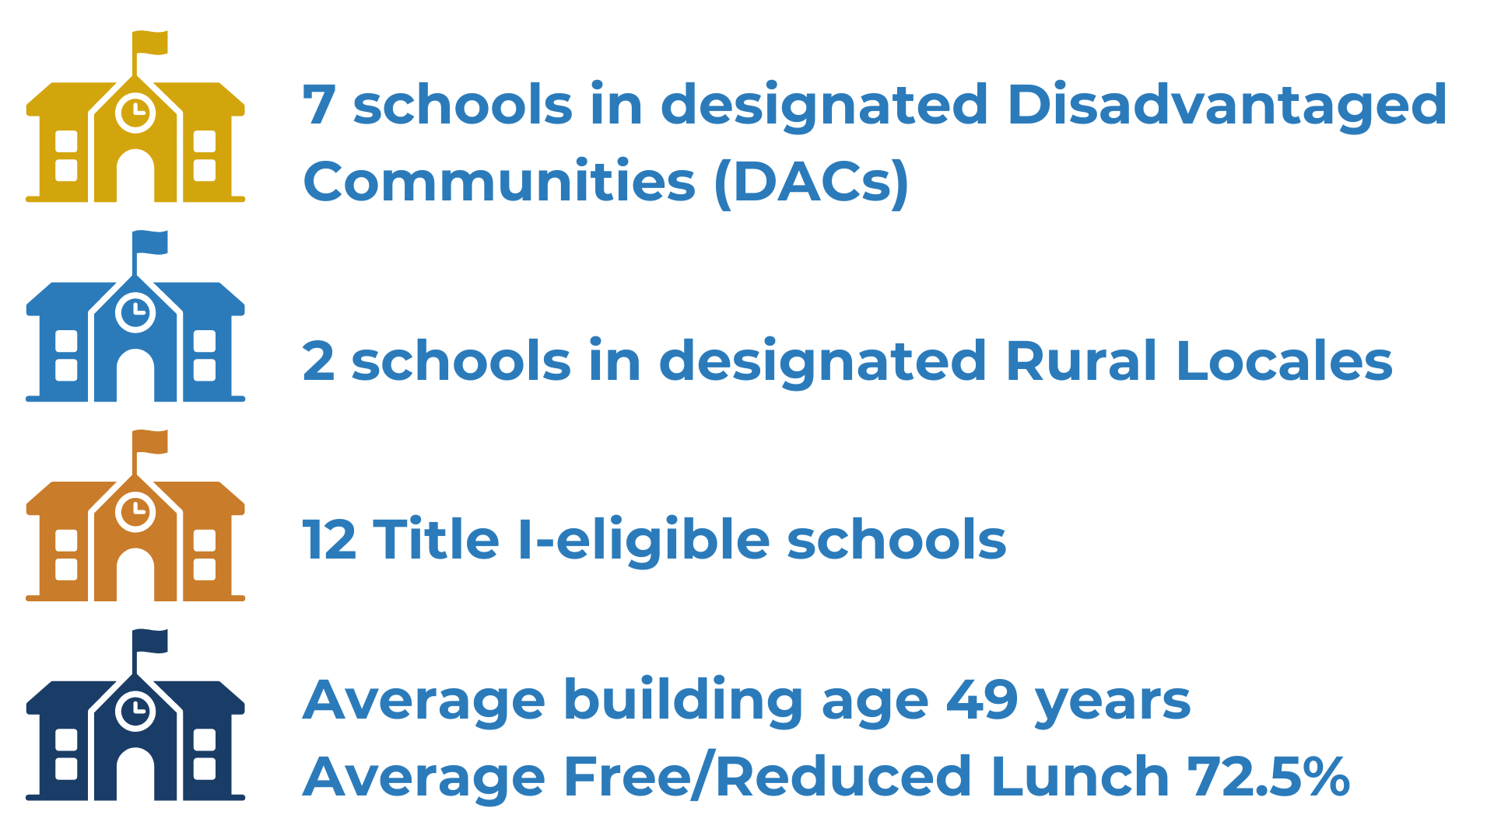
Hamilton County Schools
2024 Renew America's Schools Prize
HCS Energy Revitalization Project
  Project Description
  Hamilton County Schools will partner with EPB and the Tennessee Valley Authority to improve energy efficiency and install clean energy systems in sixteen urban, suburban, and rural school communities.
  Summary of Need
  The schools in the portfolio have all indicated significant need for energy related improvements, including systems nearing end of life, inconsistent temperatures and air quality, damaged or inefficient equipment, and other energy system repairs.
  Project Goals
  The goal of the project is save energy and reduce operating costs while improving student health outcomes and academic performance.

