Slide 1
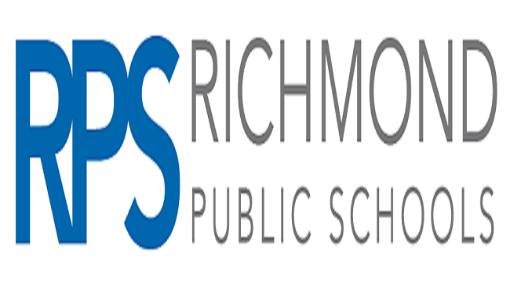
Richmond Public Schools
2024 Renew America's Schools Prize
Renew RPS 2024!
  Project Description
  We have identified 22 schools for this proposal. With infrastructure investments, these schools could reduce energy consumption by 28-43%, as indicated by QBAT scores. With asset scores of 2-5, our schools demonstrate the critical need for upgrades due to poor indoor air quality and structural issues. Our Finance and Facilities Team Leads, each with over 30 years of experience, are dedicated to reducing the energy burden through efficient upgrades. Leveraging tax credits, energy-supported lease purchasing, and performance contracting will allow us to redirect savings to educational programs. Trane, our ESCO partner and Virginia's top provider of performance contracting, brings extensive experience with DOE projects and compliance requirements. They will utilize local subcontractors and competitive bid processes to ensure success. Our Workforce and Community teams, along with clean energy training partners, are committed to creating sustainable partnerships that benefit RPS students and the broader community. This comprehensive approach aims to improve our schools' infrastructure, reduce energy costs, and foster educational and economic growth.
  Summary of Need (Community, Facility)
  Our school buildings, averaging nearly 90 years old, face significant challenges, including original windows, humidity issues, and outdated pneumatic controls. Essential upgrades like LED lighting are financially out of reach. Energy prices have surged by almost 25% in the past two years, worsening our financial strain, especially after losing nearly $7 million in funding due to changes in public school assistance formulas. The City of Richmond has a 19% poverty rate, with 37% of children living at or below the poverty line. All schools in our district are 100% free lunch eligible. The COVID-19 pandemic exacerbated existing hardships, as many students lacked access to the internet and technology, and faced eviction, homelessness, and unemployment, severely impacting their education. Our testing scores remain among the lowest in the state. Our schools are located in areas marked by historical and ongoing inequities, highlighted by historic redlining maps. These neighborhoods, designated as "Fourth Grade/Hazardous," indicate high risk for loans and continued underinvestment. Even schools not in disadvantaged areas primarily serve students from these communities, as wealthier families opt for private education. These neighborhoods suffer from environmental injustices, including a lack of green spaces and extreme urban heat, with a 16-degree difference between affluent, shaded areas and urbanized concrete zones. Environmental burdens are severe, with high levels of poverty, unemployment, and housing burdens, along with significant issues with air quality, lead paint, and hazardous waste facilities. Addressing these challenges requires substantial investment in our schools and community infrastructure to improve living conditions, educational outcomes, and overall well-being for our students and their families.
  Project Goals
  This project aims to upgrade facilities in a disadvantaged community to create a healthier, safer learning environment and reduce the energy burden on Richmond Public Schools (RPS). Partnering with Trane, we will utilize local energy expertise and performance contracting, providing student shadowing and internship opportunities. Collaboration with Communities In Schools (CIS) and Virginia Community Voice will engage students and the local community, ensuring equity is integral to our project. This will strengthen connections between health, climate, and the built environment, empowering citizens to pursue environmental justice. Addressing disparities in clean energy training, we will work with FLIPP, Inc. and Project Homes to provide training in residential weatherization, solar panel installation, and HVAC skills. This will help develop a “Green Collar” workforce with BPI and NC3/Trane decarbonization certificates. Financial tools such as tax-exempt energy efficiency savings-supported lease purchase, performance contracting, federal 179D and ITC credits, and PJM energy efficiency rebates will fund our investment. This project will enhance educational facilities while creating significant economic and environmental benefits for the community.

