Slide 1
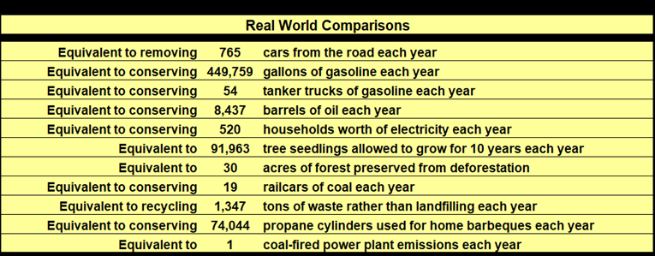
Wichita Public Schools (WPS)
2024 Renew America's Schools Prize
Energy Improvements, Future Ready Students, and Community Opportunities
  Project Description
  Approximately 12,000 students in 22 schools with an average of 84.3% students who qualify for free or reduced-price lunch, an average of 76% non-white students, disadvantaged community designation, and/or Title 1 Schoolwide programming will benefit from lighting, HVAC, and building envelope improvements and renewable solar projects. WPS facilities, finance, and grants departments; an experienced ESCO; and community benefits partners will work with Women, Minority, and Disadvantaged Business Enterprises and local labor unions to provide access to jobs, job training, vendor/supplier bidding, and oversee DEIA and Justice40 initiatives.
  Summary of Need (Community, Facility)
  WPS is the largest school district in Kansas with 80.1% of students coming from homes in poverty. Wichita has a median household income that is $15,028 lower than the U.S. average. The district is reconfiguring its portfolio of schools through consolidation, closure, and optimization so all capital funds and bond issuances are directed toward these projects. DOE funding is thus being sought to implement energy efficiency initiatives to install solar panels and modernize lighting, HVAC, and building envelopes.
  Project Goals
  Implement energy efficiency and renewable energy projects to achieve a sustained reduction in energy use and utility bills; improve the student classroom experience; and benefit the community through vendor, supplier, training, and job opportunities.
Potential Project Savings

