Slide 1
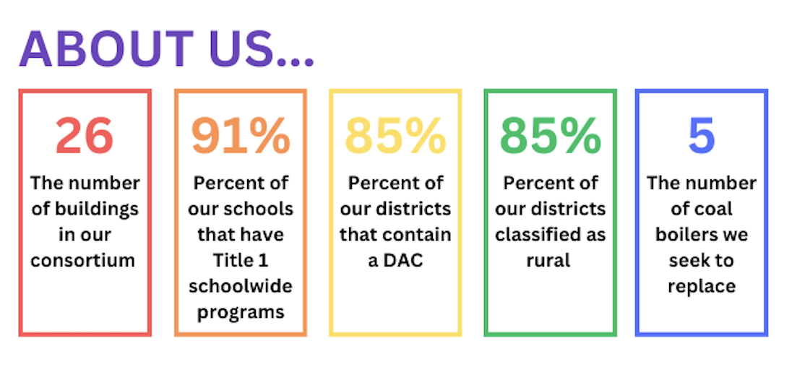
Renew Idaho’s Rural Schools
2024 Renew America's Schools Prize
Investing in Idaho Students and Their Futures
  Project Description
  We are a team of 13 LEAs from rural Idaho partnering with local businesses, utility companies, and the state’s land grant, public university – the University of Idaho – to invest in school infrastructure while reducing energy use and carbon emissions while providing educational opportunities to build rural Idaho’s workforce.
  Summary of Need (Community, Facility)
  Schools throughout Idaho are in disrepair. The state provides the lowest investment in school infrastructure per capita in the nation and is one of two states in which school bonds require a super majority for passage (making them extraordinarily difficult to secure).
  The schools in our consortium are a median age of 65 years old. Major investments have been delayed decades with no hope of having sufficient funds for such investments on the horizon. We routinely face avoidable crises such as heating failures leaving classrooms of kindergarteners bundled in coats and blankets; a lack of cooling systems that cause dehydration and heat stroke; and air quality that reaches hazardous levels due to coal boilers or forest fires and a lack of air filtration. These problems are so bad that, at times, we are forced to cancel school.
  Project Goals
  This project seeks to cut carbon emissions and energy costs at rural Idaho schools while improving school safety, educating students and community members, and building regional relationships. We will replace aging boilers (five of which are coal), HVAC, and electrical systems and make additional energy improvements (LED and window upgrades, solar) while partnering with local businesses and the local labor force. We also will use this opportunity to offer work force training for high school and college students and provide educational opportunities for K-12 students and community members.

