Slide 1
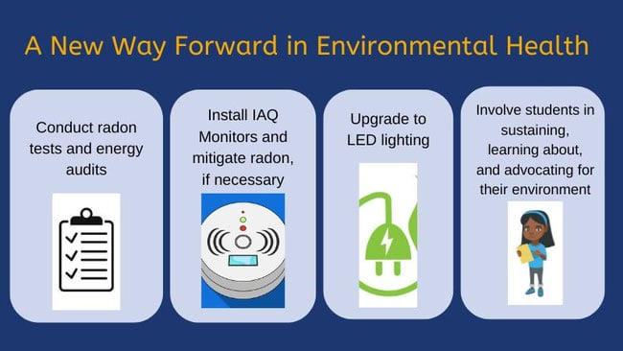
Fayette County Public Schools
2024 Renew America's Schools Prize
A New Way Forward in Environmental Health
  Project Description
  FCPS will test radon levels and install indoor air quality (IAQ) monitors and LED lighting in 11 school facilities. The IAQ monitoring technology will enable building occupants to adjust their air flow and ventilation in order to maintain health and comfortability, and the LED lighting will increase the energy efficiency of the selected schools and the district as a whole.
  Summary of Need (Community, Facility)
  Lexington, Kentucky is growing, thus the majority of Facility funding is being designated for new construction that can accommodate this change in population. We have selected 11 high-needs, Title I schools that would benefit from the installation of IAQ monitors and LEDs.
  Project Goals
  1) Improve school wellbeing in 11 school facilities
  2) Prepare youth for green careers and a sustainable way of life in the modern world
  3) Decrease district funding spent on energy costs

