Slide 1


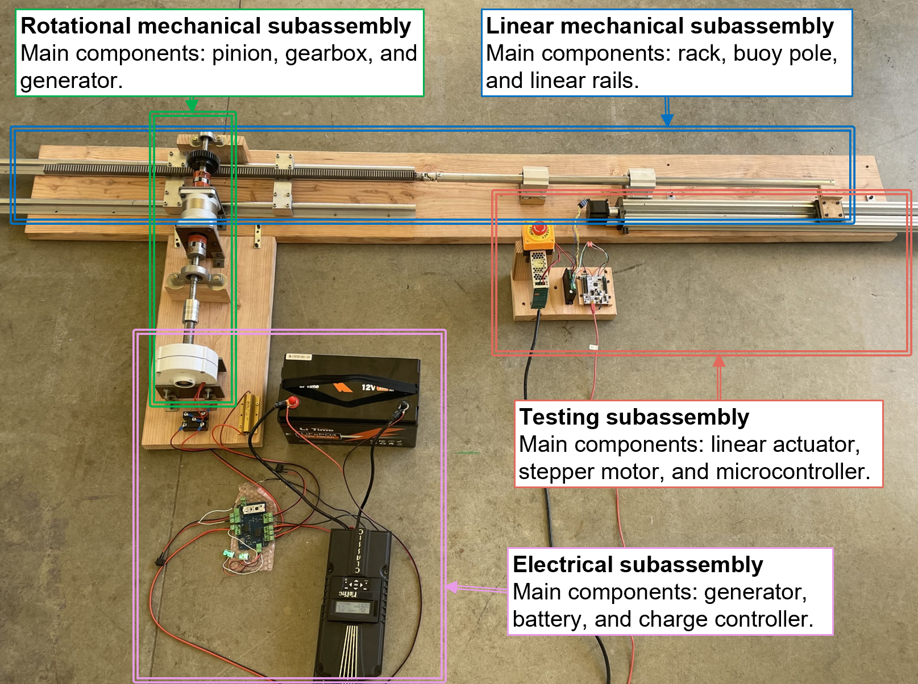
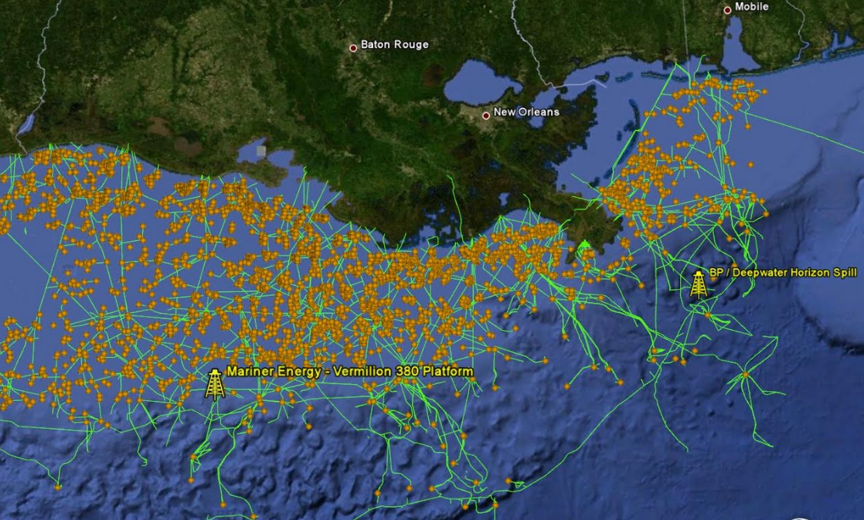
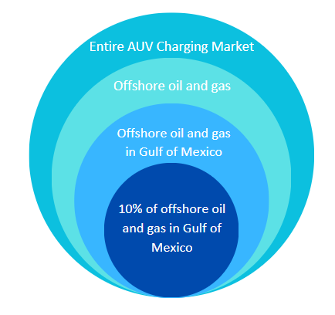
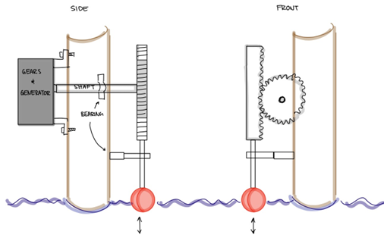
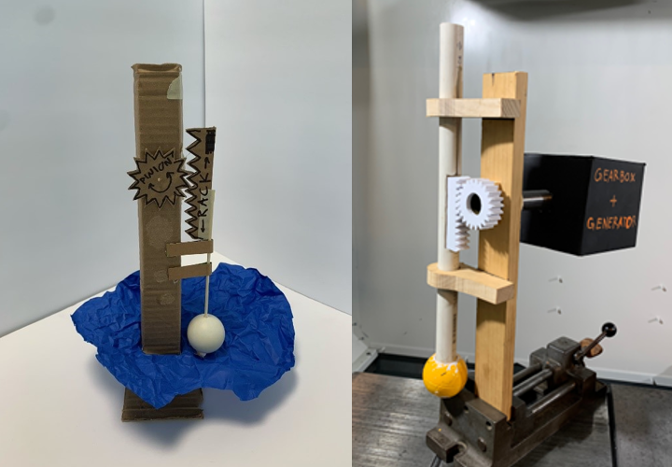


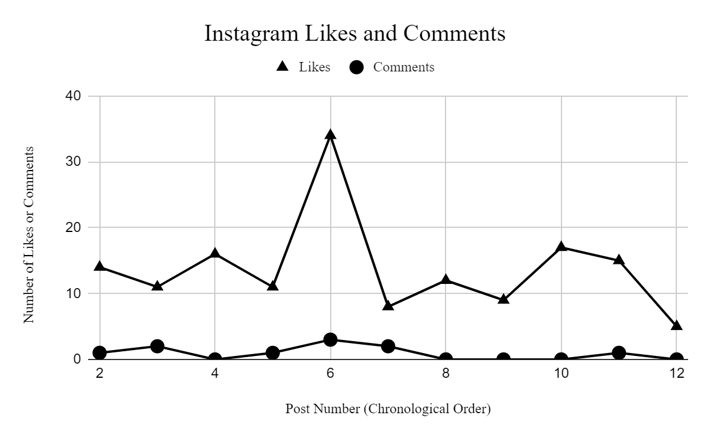
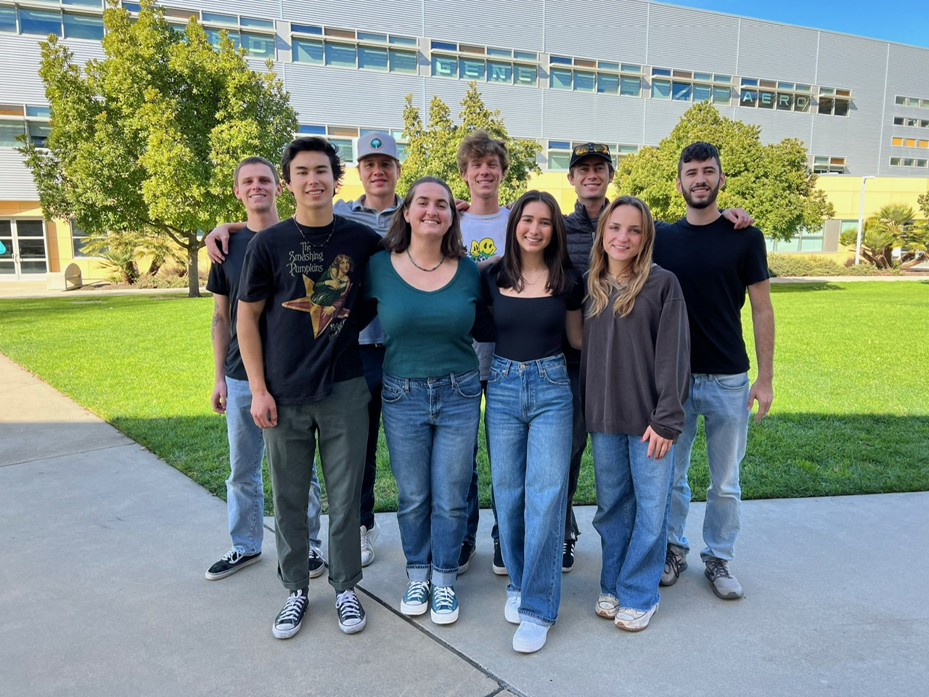
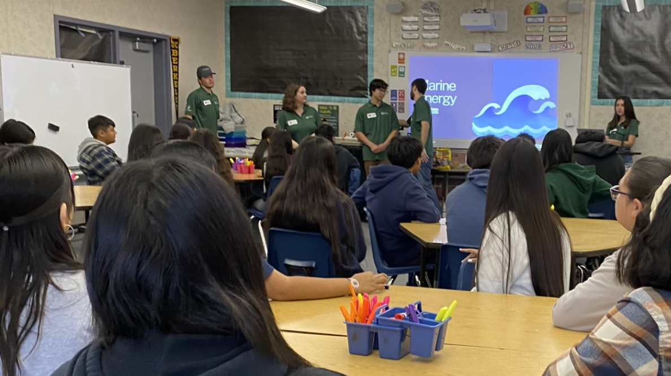
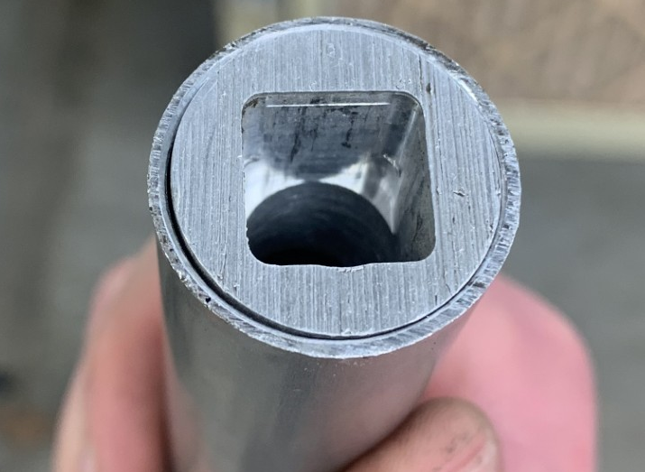
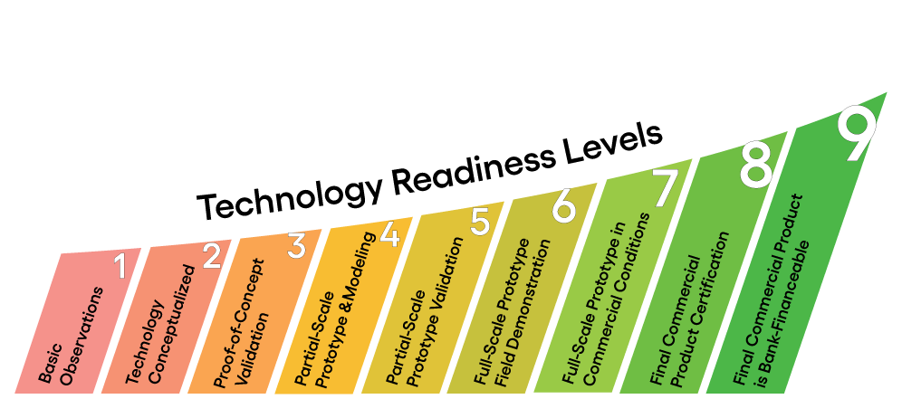
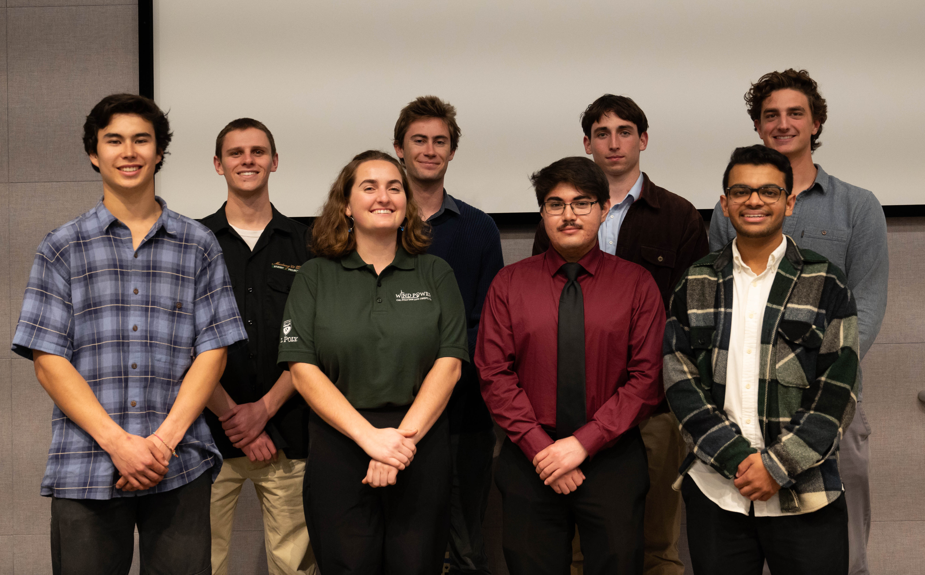
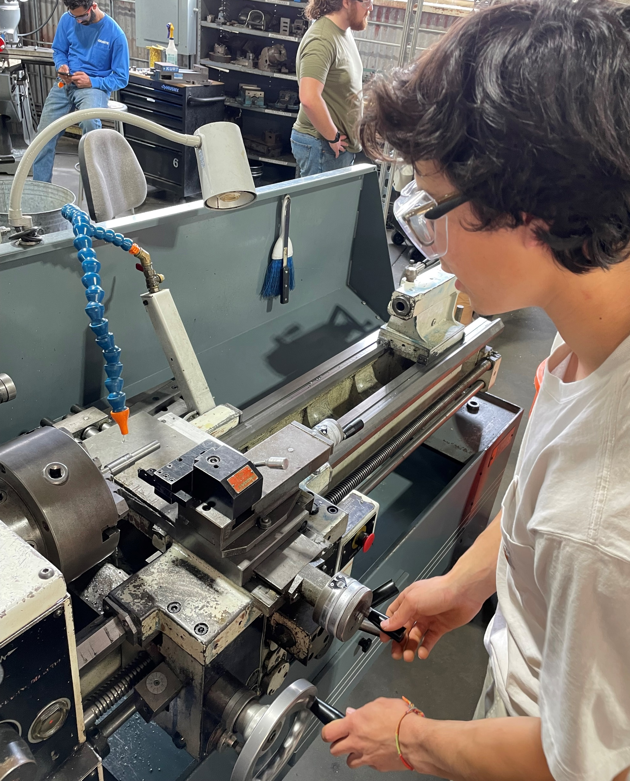
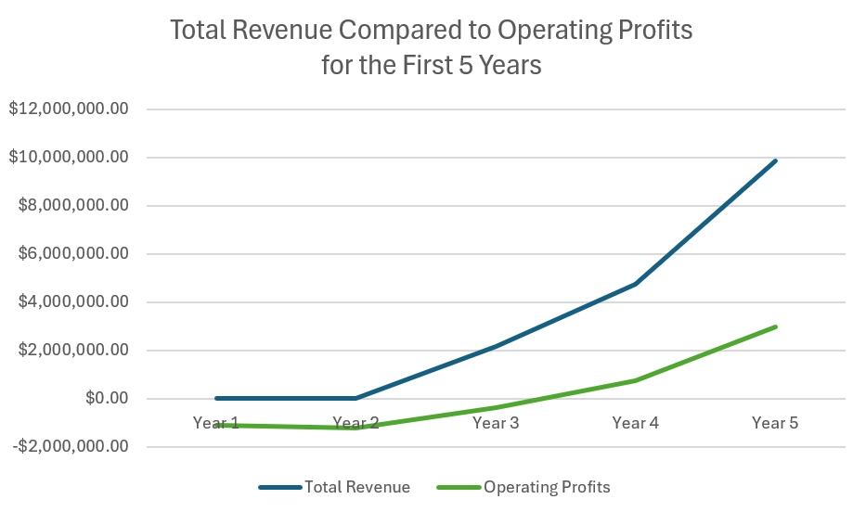
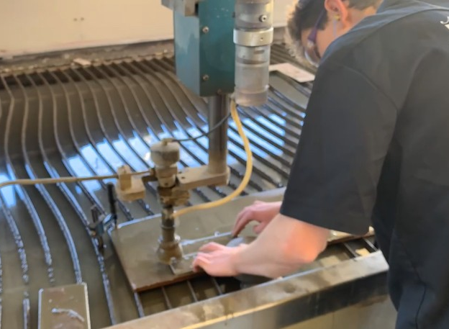
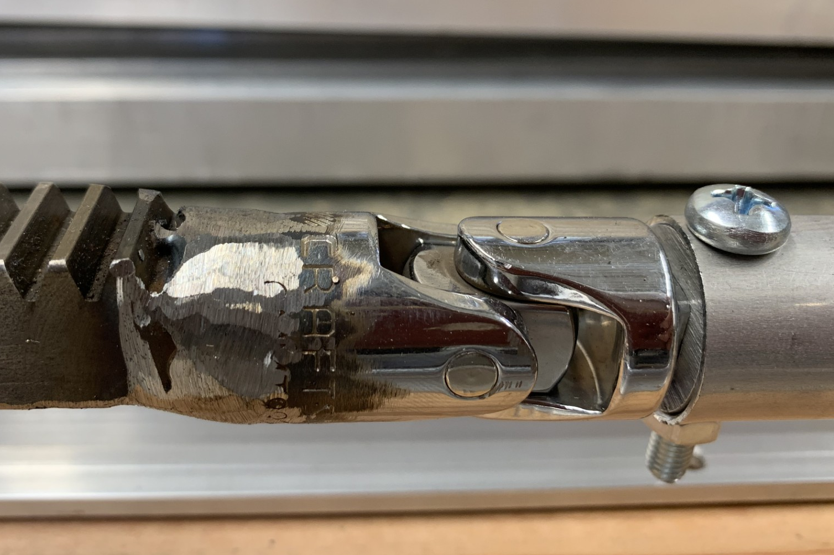
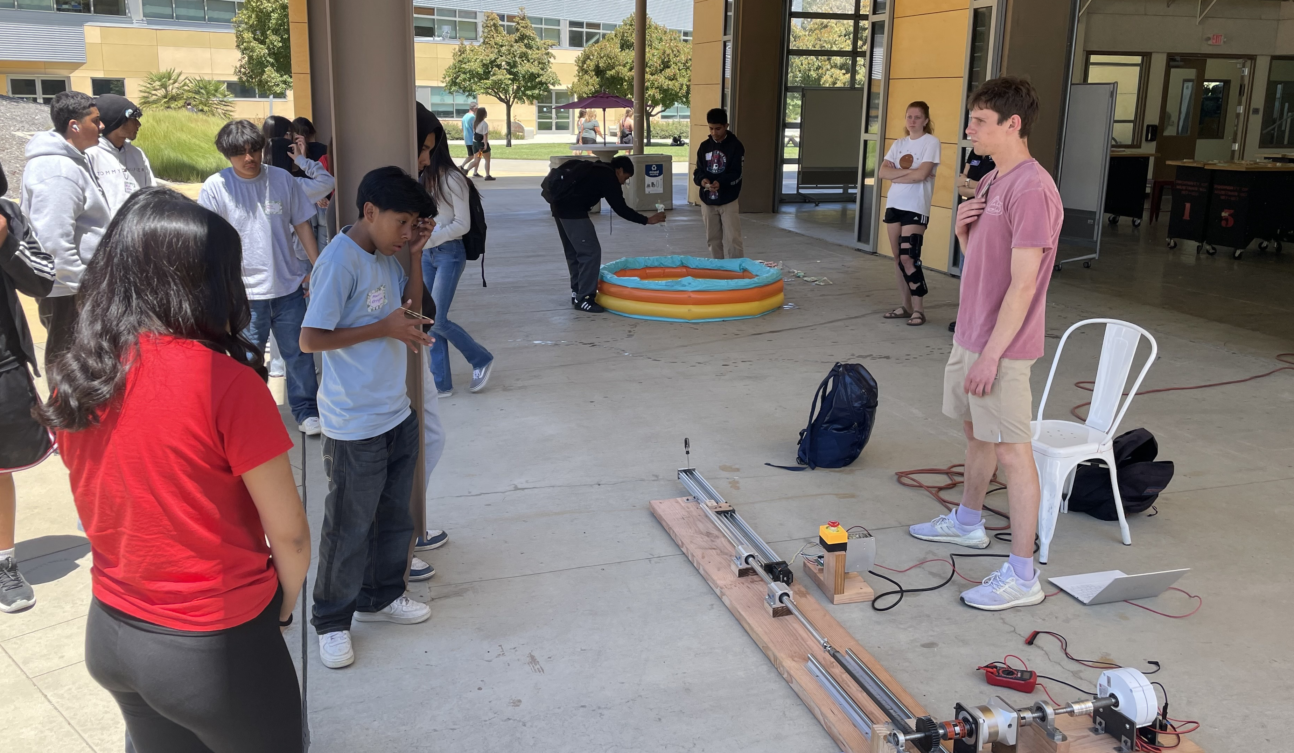
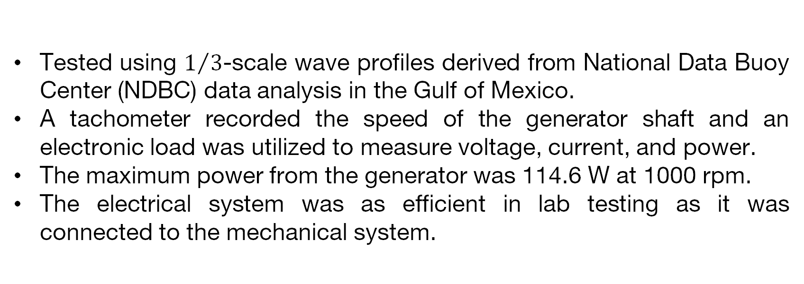
PolyWave Energy
Nora Riedinger, Brendan Stratford, Miles Mikkelsen, Derek Tom, Harmon Yanikian-Sutton, Zach Kwast, Kennedy Urcelay, Tori Thomas, Brady Caron
Community Connection
Technical Design, Build, and Test
Business Plan
Team Story
Executive Summary
Business Operations
We are PolyWave Energy from California Polytechnic State University in San Luis Obispo, California. This is the second year Cal Poly SLO will compete in the MECC. The MECC provides opportunities for students to connect with working professionals in the marine energy industry. We hope to use the valuable connections, mentorships, industry knowledge, and networking skills we will gain as we pursue our early careers.
PolyWave Energy has dedicated many months to design, build, and test a marine power device tailored for autonomous underwater vehicle (AUV) charging. Focused on addressing concerns related to carbon emissions and fossil fuel depletion, our sustainable energy solution targets companies within the oil and gas industry. Our rack and pinion wave energy converter harnesses vertical wave motion to generate electricity for AUV charging. Through rigorous testing and iterative prototyping, we have demonstrated the device's reliability and effectiveness. PolyWave Energy aims to establish itself as a leader in renewable energy solutions, driving positive change and ensuring sustainable growth. Our outreach efforts, including presenting to local middle school students, has raised awareness of marine energy and inspired passion for sustainable technologies among future generations. PolyWave Energy's team aims to revolutionize AUV charging within the oil and gas industry with our wave energy converter, leading the way towards a more sustainable and prosperous future.
Market Opportunity
AUV market is projected to reach $6.4 billion by 2030 with a CAGR of 22.4%.
Primary drivers of this expansion are increasing capital expenditures by offshore oil and gas companies, rising demands for ocean data and mapping, and escalating defense spending worldwide.
Oil and gas companies rely heavily on AUVs for exploration and production activities.
Our device offers a renewable and cost-efficient alternative to traditional AUV charging methods.
Governments are prioritizing maritime security and defense capabilities.
There are 2,366 offshore oil rigs in the Gulf of Mexico
About 1,300 AUVs out in market, with average of 50 built per year.
Visual of offshore oil rigs in the Gulf of Mexico.
In the first 5 years of operation, we aim to access 10% of the offshore oil rigs in the Gulf of Mexico.
Early Adopters/Stakeholders
Early adopters: offshore drilling rigs used by oil and gas companies.
Have a history of pioneering subsea exploration.
AUVs are charged by diesel generators which pose environmental and cost challenges.
Our device extends AUV mission duration, reduces operational costs, and demonstrates environmental responsibility.
Pressure to convert to clean energy from public.
Stakeholders: governmental agencies, investors, environmental organizations, oil and gas companies, AUV companies.
Development and Operations
At technology readiness level (TRL) 6, after research, proof of concept validation, and successful prototype testing.
Next step: TRL 7 with operational prototype.
Business model: direct sales of WEC to oil and gas companies along with maintenance contract fees per unit as recurring revenue.
We will stay a strong competitor with this model.
We stand out through reliability, cost-effectiveness, and environmental benefits.
Industry Interviews
Technical Design
Thank you to the following industry professionals for their help with our technology and primary market research.
Lance McMullan: Founder/CEO of Sitkana (Tidal energy).
Bill Toman: Former Director of the California Wave Energy Test Center (CalWave) Project, current Energy Manager at Vandenburg Space Force Base.
Jose Beltran: CEO of Beltra Energy Corporation
Curtis Rusch: Senior Research Engineer at Applied Physics Laboratory, UW (R&D).
Chris Malzone: Senior Account Executive at Advanced Navigation (AUV).
Curtis Anderson: Environmental Engineer at the Pacific Northwest National Laboratory
Design Choices
Energy stored in battery for AUV charging.
Mounted to fixed, pre-existing platform such as an oil rig.
Kept entire system above waterline to limit environmental impact and to decrease costs of maintenance and waterproofing.
Community Engagement
Initial concept for point absorber WEC mounted to a pier piling.
Progression of rack and pinion prototypes during ideation phase
Completed assembly as tested. Bench testing allowed for horizontal mounting and eliminated any waterproofing need.
Social Media
@calpolymecc
Mechanical System
Point absorber rack and pinion mechanism converts linear motion into rotational motion.
1-way needle roller bearing ensures system only spins in 1 direction, during upheave of the wave.
10:1 gearbox increases angular velocity of output shaft.
Flywheels store rotational inertia to smooth output power.
Electrical System
100W Generator and bridge rectifier connected to the output shaft of the gearbox.
Charge controller determines at what rate the battery charges or if energy goes to the dump load instead.
Microcontroller flips different relays depending on the state of the battery and AUV status.
MECC Cal Poly SLO
Top Post
Build
Test
Events
All parts were either purchased or modified by our engineering team in the Cal Poly machine shops. Fabricated parts and the respective machines used are listed below.
Shafts: Manual lathe and mill.
Pole adapter: Manual lathe and mill.
U-Joint: MIG welded to rack.
Mounting plates: Waterjet and drill press.
Rack: Drilled and tapped mounting holes.
Wooden Base: Jointer, planer, and table saw.
Tested using $1/3$-scale wave profiles derived from National Data Buoy Center (NDBC) data analysis in the Gulf of Mexico.
A tachometer recorded the speed of the generator shaft and an electronic load was utilized to measure voltage, current, and power.
The maximum power from the generator was 114.6 W at 1000 rpm.
The electrical system was as efficient in lab testing as it was connected to the mechanical system.
Presentation to 8th grade AVID class about marine energy technologies and career paths at Fesler Junior High in Santa Maria, CA.
U-joint to pole adapter: milled slot, turned outer diameter.
Sea State Test Case | Average Generator Speed (rpm) | Average Power (W)
Low Energy | 350 | 22.4
Average | 540 | 58.1
Survival | 900 | 106.8
Mechanical team and Cal Poly HCC (hydropower collegiate competition) team attending the Energy Innovation Conference hosted by the Cal Poly Wind Power Club, the Power and Energy Society, and Future Fuels.
Financials
Selling cost of one unit: $72,596.42
Maintenance
contract fee for one unit: $12,828
Breakeven by Year 4
Recruitment efforts for Cal Poly Water Power Club, which was founded in collaboration between the Cal Poly MECC and HCC teams.
Our test data was not consistent enough to accurately predict efficiency based on raw wave power. We know that the efficiency will be low because our device only captures one direction of the wave’s energy.
Mounting plates: cut on an abrasive CNC waterjet.
U-joint welded to rack, bolted to pole using machined adapter (top right).
Shafts: turning grooves for shaft components.
Notes:
Cal Poly style guidelines

