Slide 1


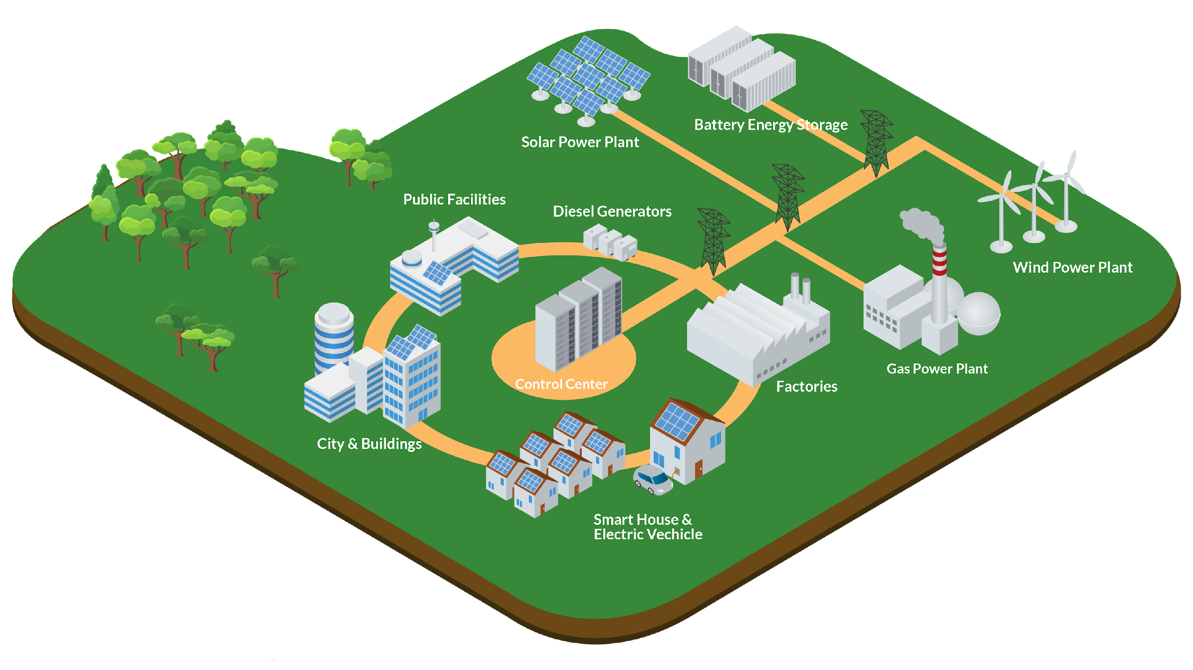
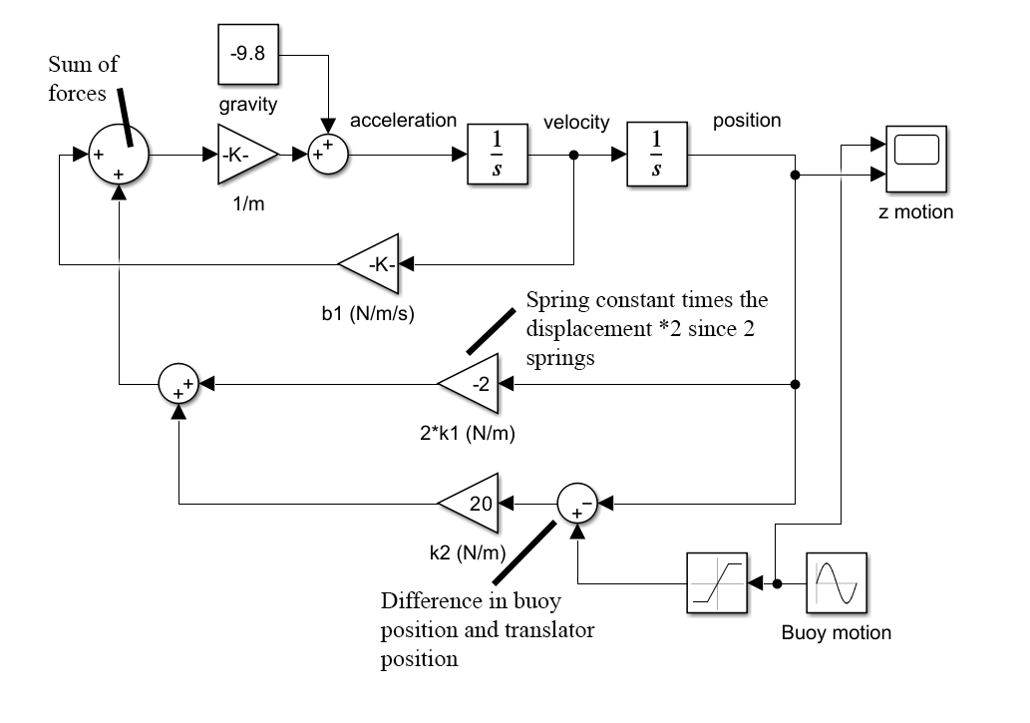
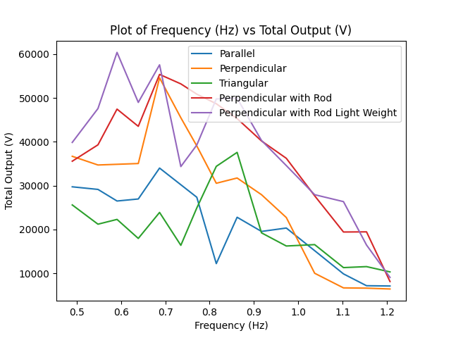
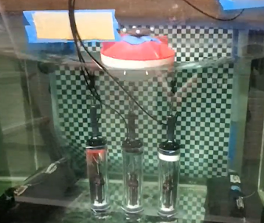
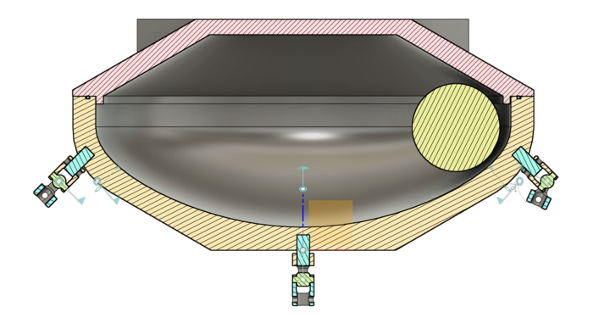
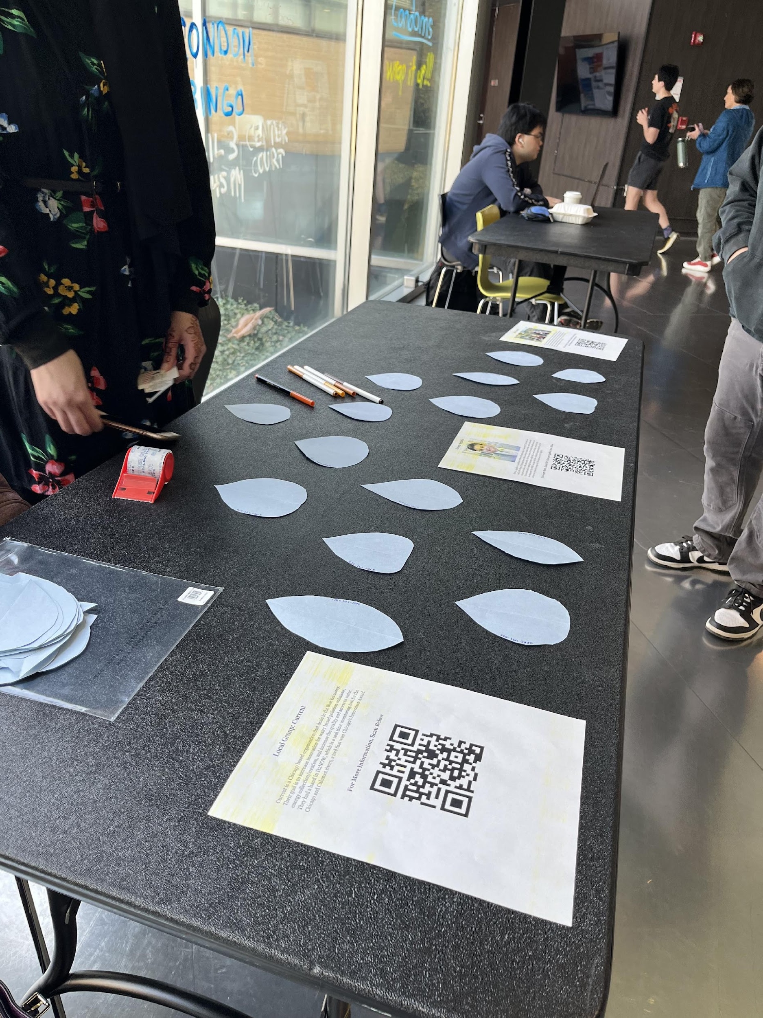
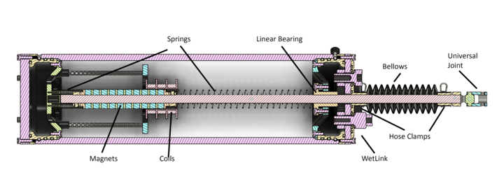
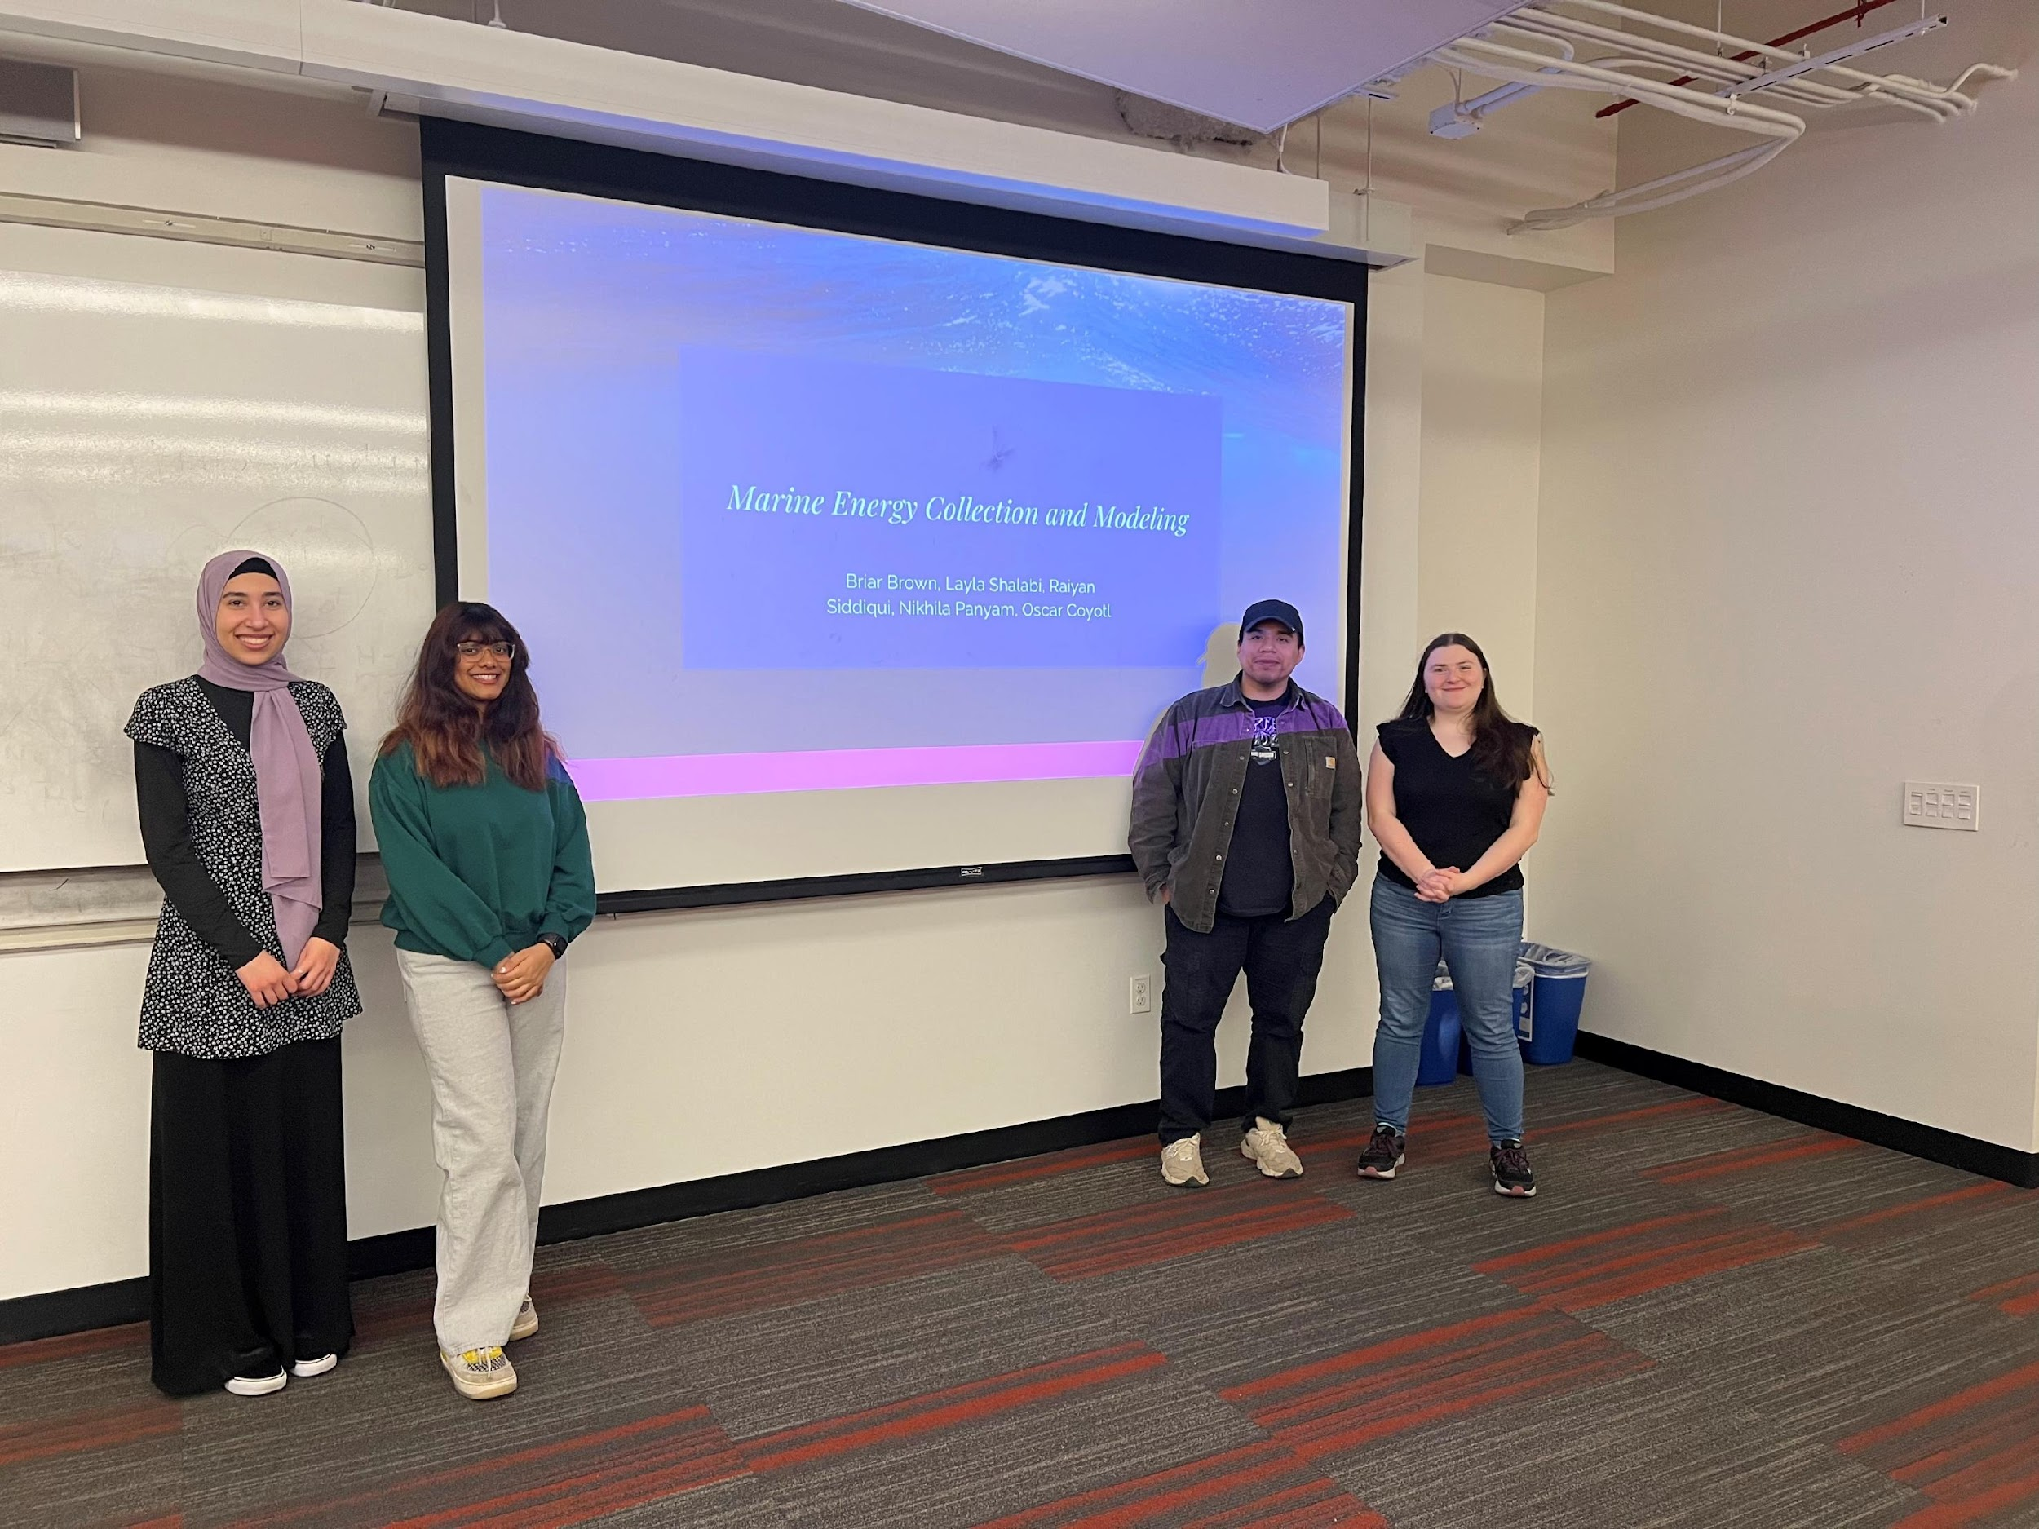
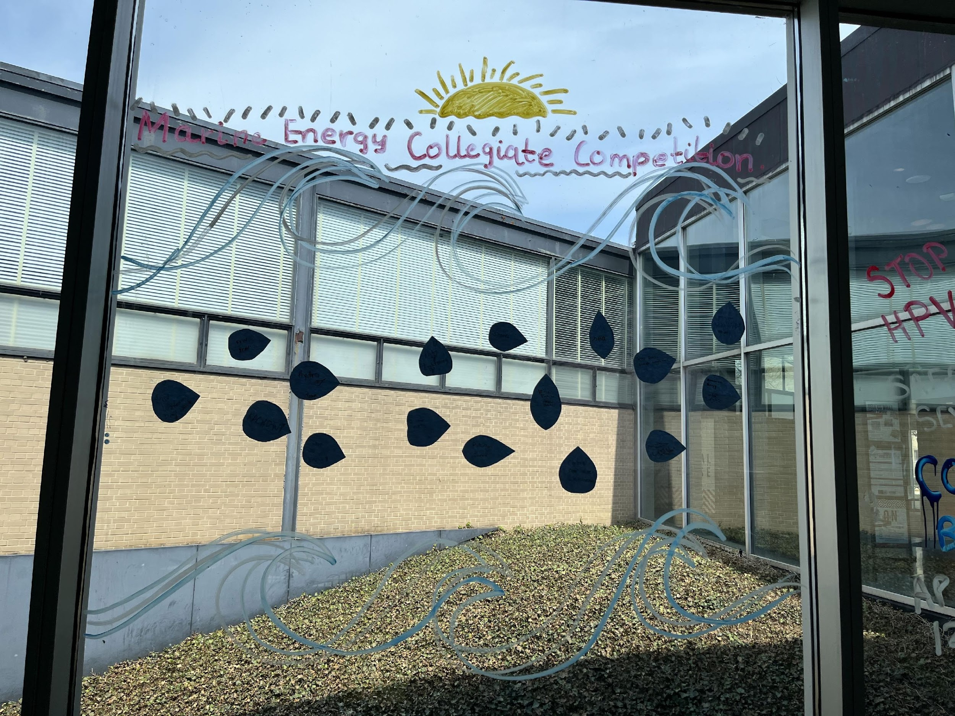
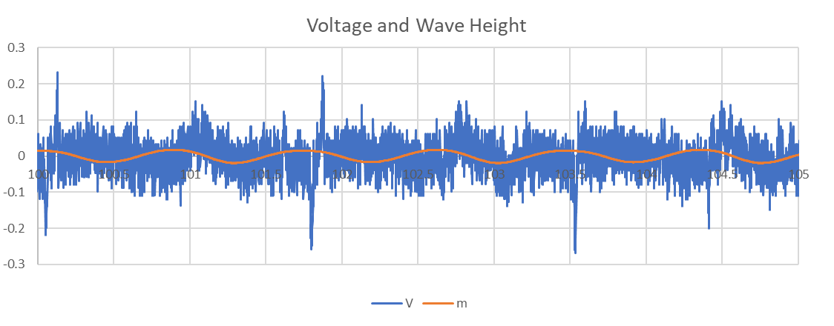
Our team's purpose is to create a marine energy solution for the Great Lakes. We have worked to create a viable business plan, develop and test our design as well as engage the community and educate people about the marine energy industry.
Customer Discovery
Last year the team decided that the best area to deploy our product initially was in the steel industry. We have since further expanded the scope in where we would like to introduce our product to the microgrid space.
The microgrid space has expanded rapidly and self ownership of energy will be beneficial for environmental, legal, and technological reasons.
Wave energy provides greater benefits to the renewables on the market today and is a great investment opportunity for renewable energy portfolios.
Technical Design
System Design
Prototype Testing
Design philosophy was to maximize movement of the linear generator
Initially modeled in Simulink
Tests with an initial linear generator design showed it could successfully produce voltage output.
Final prototype sent to the University of Michigan Marine Hydrodynamics Laboratory for testing.
Testing allowed us to identify the best configuration for the device and identify ways to improve the device in the future.
Prototype Construction
Community Connections
Constructed using a combination of custom 3D-printed and standardized parts.
Key challenges were waterproofing, reducing friction, electrical output, and buoy production
Used feedback from experts for iteration in the rapid prototyping phase
Our team connected with and interview four energy professionals.
                Mr. Olivier Bourdin, CEO and Founder of WaveX
                Shannon Ricles, National Oceanic and Atmospheric Administration
                Kelley Ruehl, Sandia National Laboratories
  Francisco Ruiz, Illinois Tech
We also held two events on campus. One that aimed to teach students about marine energy and another that focused on better understanding their perceptions of marine energy and providing resources for further learning

