Slide 1
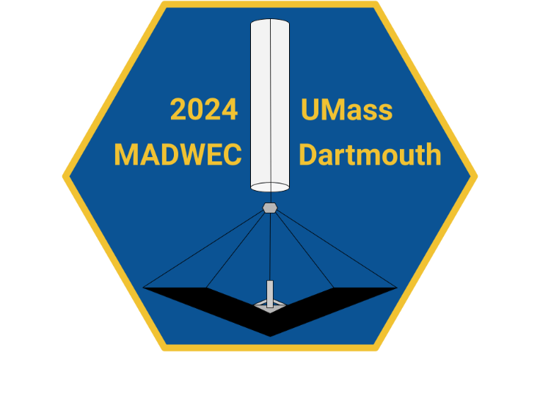
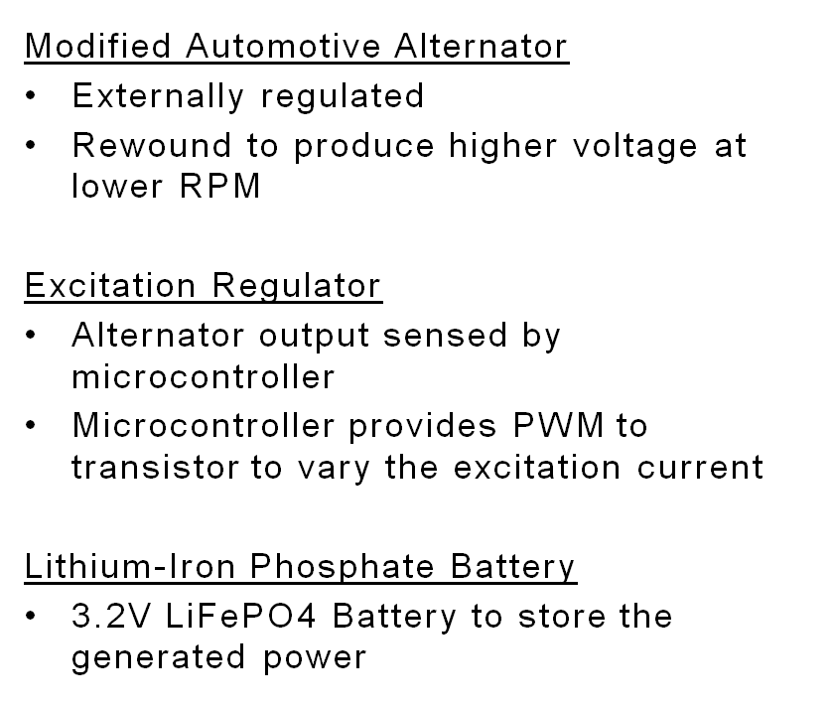
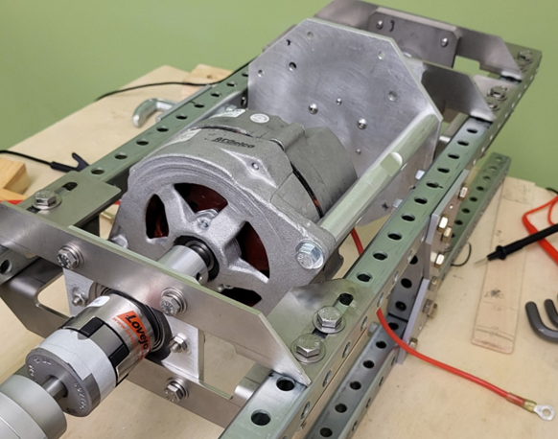
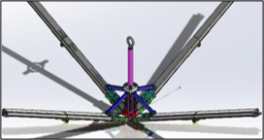
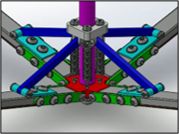

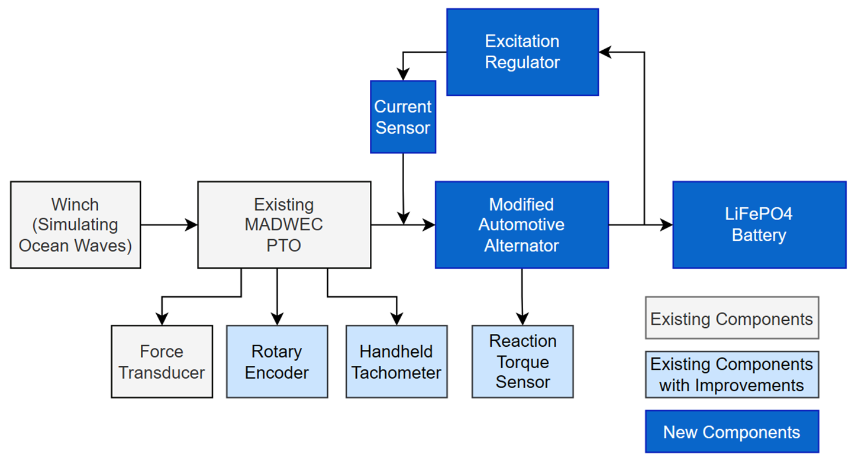
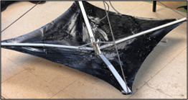
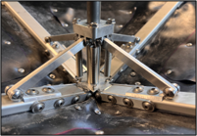

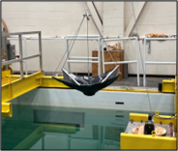

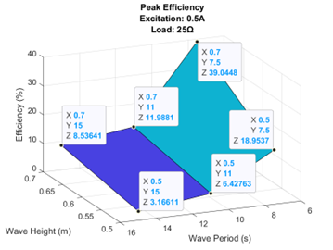
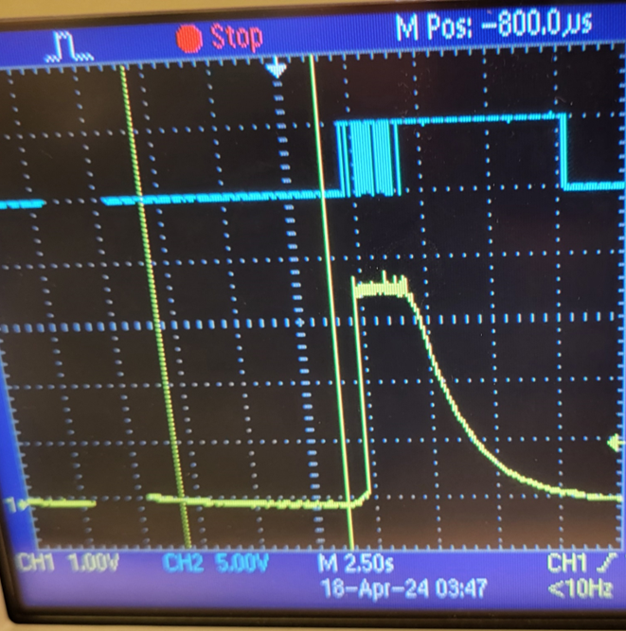
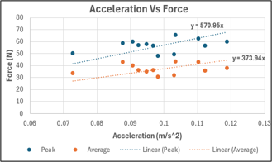
The University of Massachusetts Dartmouth
TEAM SMADWEC
Team Members: Logan Martelly, Brian Rawson, Jonathan Galvin, Leah Greene, Jordan Tavares
Team Sponsors: Dr. Mehdi Raessi, Dr. Dan MacDonald, & Mr. Peter Karlson
Business Plan
Electrical Engineering - Technical Design
Mechanical Engineering – Technical Design
Business Model:
Our business model revolves around commercializing SMADWEC. The business teams’ focus is on providing reliable power solutions for critical functions such as communication and desalination in maritime settings, particularly for lifeboats and offshore emergencies. We intend to engage closely with maritime stakeholders, utilize direct sales, partnerships, and online channels for distribution, and generate revenue through licensing agreements with lifeboat manufacturers. Key partners include the Office of Naval Research (ONR), UMass Dartmouth, and lifeboat manufacturers. Our vision is to deploy SMADWEC alongside lifeboats to enhance survival capabilities, offering industries such as government agencies, the shipping industry, cruise lines and oil/gas companies an advanced solution for exceeding safety standards.
Value Proposition:
In the event of a large vessel emergency, such as sinking, lifeboats play a vital role in ensuring the safety of survivors. Electricity is indispensable for necessary survival devices. SMADWEC would facilitate power generation post-deployment, thereby prolonging the operational life of these devices. Access to fresh drinking water is essential in such scenarios. However, current desalination methods for saltwater rely on battery power, leading to limited drinking water availability for survivors. SMADWEC would provide means to significantly extend survival time by enabling continuous drinking water production.
Revenue Model:
Revenue generation for SMADWEC would be through a licensing model. With a lifeboat manufacturer on board, the SMADWEC technology and intellectual property would be licensed for manufacture distribution and sold by the third party. This model significantly lowers many risks that would be inherent in attempting to manufacture, distribute and sell the technology as its own item. Licensing also allows these third parties to integrate the technology more easily into their preexisting product lines and generate sales through add-ons.
Our distribution methods will include direct sales to maritime operators, partnerships with maritime service providers, and collaborations with emergency response organizations. We will also use online channels and marketing initiatives to reach a larger audience and increase awareness of the SMADWEC device for offshore emergency applications. In addition, we will participate in industry conferences, trade shows, and networking events to promote this technology and establish beneficial partnerships in the maritime industry.
Relevant Stakeholders
UMass Dartmouth leads the development of SMADWEC, engaging a diverse team to innovate marine energy solutions. Collaboration with industry leaders enriches research and enhances market readiness. Strategic conversations with life-saving appliance retailers and manufacturers drive commercialization efforts. Despite challenges, efforts persist to secure key partnerships. Targeting sectors like oil and gas and government agencies, SMADWEC aims to meet specific offshore emergency needs, ensuring compliance and operational efficiency.
The objective of the of this SMADWEC ballast project is to design, construct, and test a ballast system that can be deployed from a Class A sonobuoy and integrated into the S-SMADWEC platform. Class A sonobuoys measure 4 & 7/8-inch diameter and 36 inches in length. The ballast must generate the maximum possible drag and added mass as the buoy it is tethered to rises on the upstroke of ocean waves. To function most efficiently, the tether connecting the ballast system to the PTO must remain in tension, requiring the system to be able to sink rapidly as the buoy & PTO sinks with the downstroke of the wave. These characteristics result in the drag the device creates when moving in up and down to be asymmetric. Due to the space available for such a device being limited to approximately 1/3 of the interior volume, it must also be collapsable and capable of independently deploying. Due to these strict size requirements, this design will also work perfectly within the context of a lifeboat.
The final design can be seen in the images above pictured in a SolidWorks assembly, which was used to create the drawings needed for manufacturing the components. It was determined through theoretical calculations and from multiple design iterations that the best use of space required a design that would extend outward twice. The ballast system would be deployed and held open using a combination of springs and support cables connected to the main tether..
Mechanical Engineering – Build & Test Challenge
Using the SolidWorks models shown above, parts were ordered and sent off to be manufactured. Once the parts had come in, the design was fully assembled, which can be seen below. Once the ballast was fully built it was time to move onto testing.
Test 1:​
The first test focuses on determining the added mass achieved by the design upon the upstroke. The ballast system is suspended vertically from the ceiling of SMAST over the test tank using a pulley which is connected to a winch. The operator raises and lowers the ballast while the force cell and pressure sensor record data for the simulated upstrokes. Results from this test can be seen on the bottom left.
Test 2:
The second test will simply be a drop test where the tether is initially slack. This test will utilize the pressure sensor to determine how quickly the system can sink on the downstroke. Results shown on the bottom right.
Electrical Engineering – Build & Test Challenge
Trial​ | Peak V (m/s)​
1​ | 1.22​
2​ | 1.27​
3​ | 1.30​
4​ | 1.34​
5​ | 1.33​
Average​ | 1.29m/s​
 | 4.24 ft/s​
Results of Test 2: Terminal velocity of 1.29 m/s.
Note: Actual terminal velocity could be higher. However, tests were limited to the depth of the tank.
Results of Test 1: Peak added mass of 570.95 kg and an average added mass of 373.94 kg. Twelve upstrokes from three different trials were measured.

