Slide 1

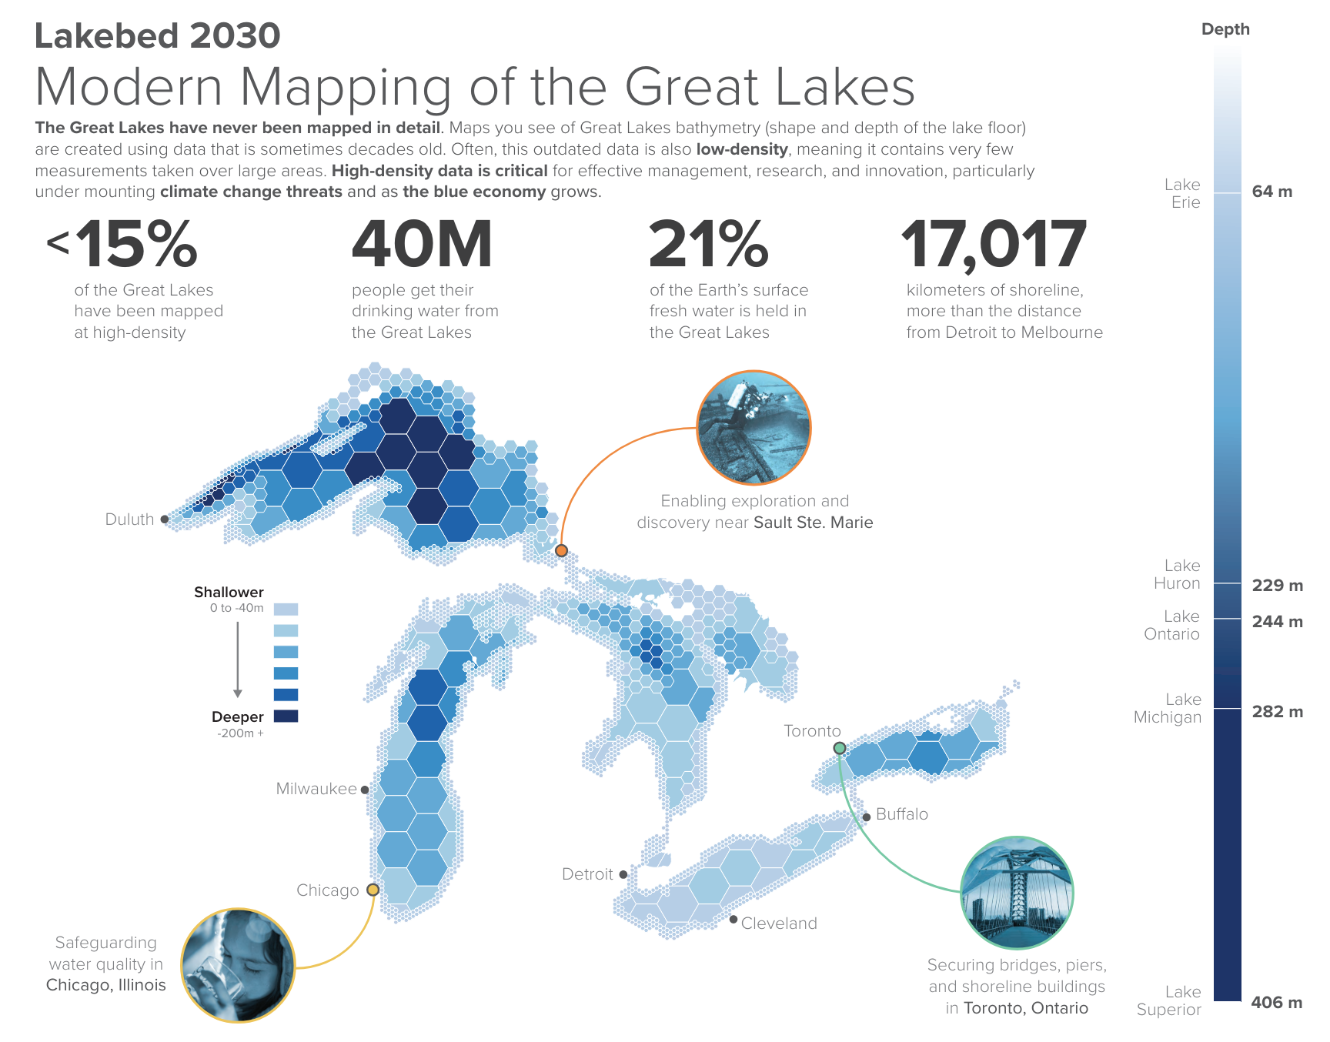
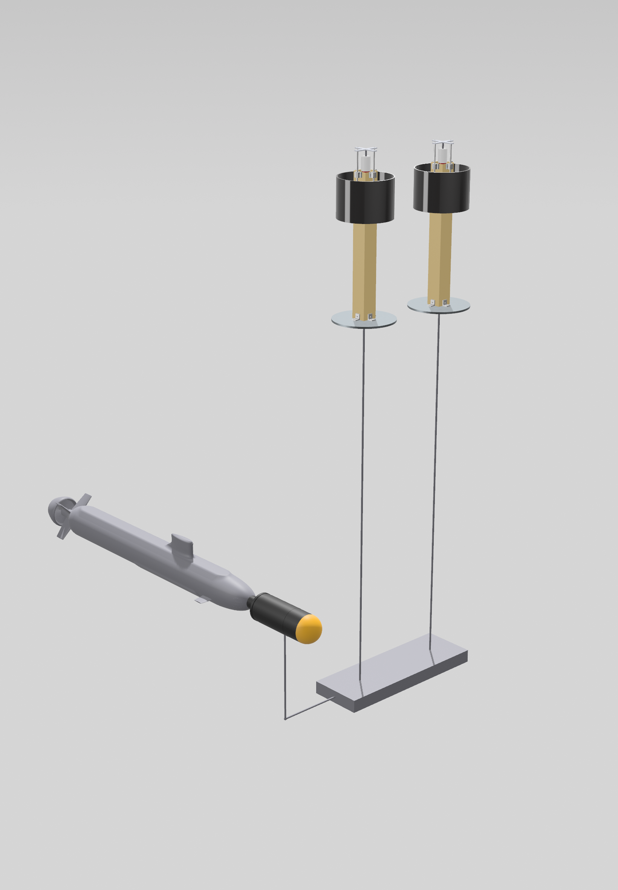
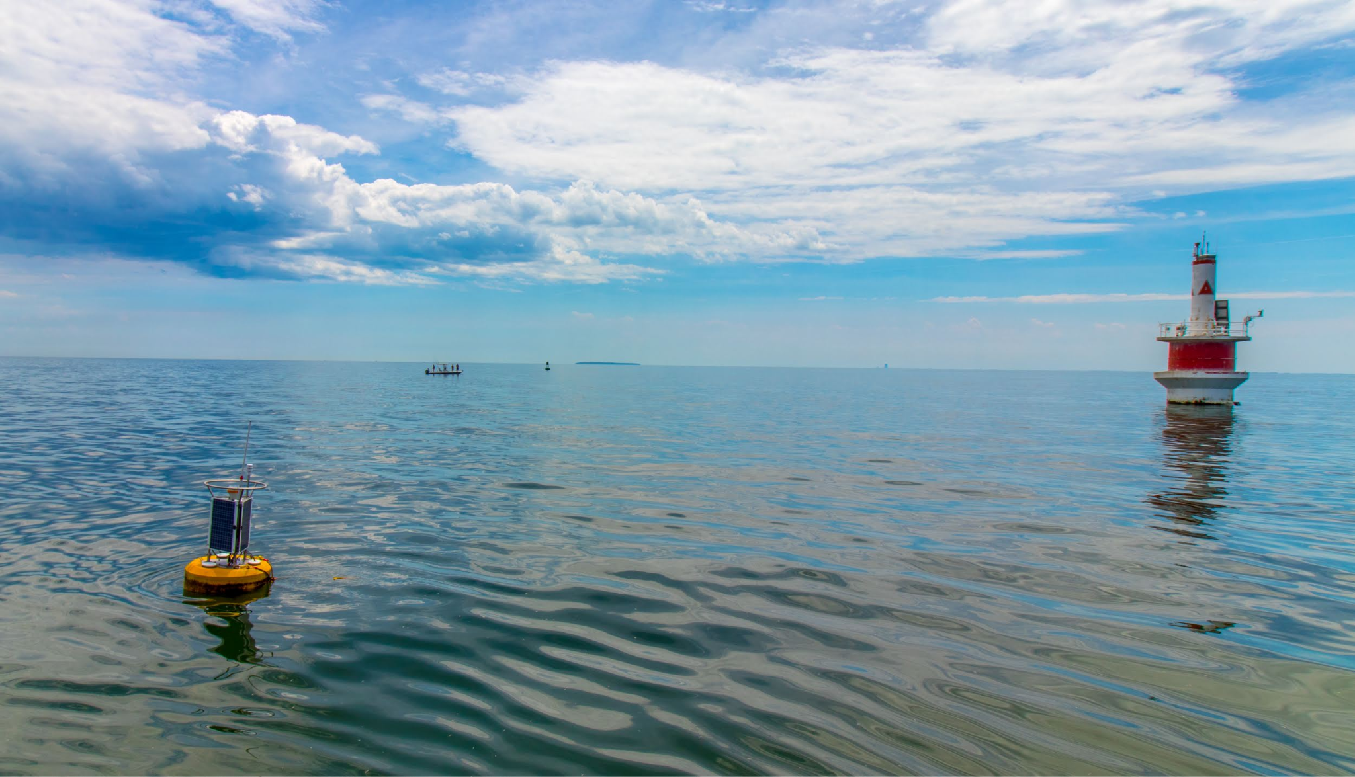
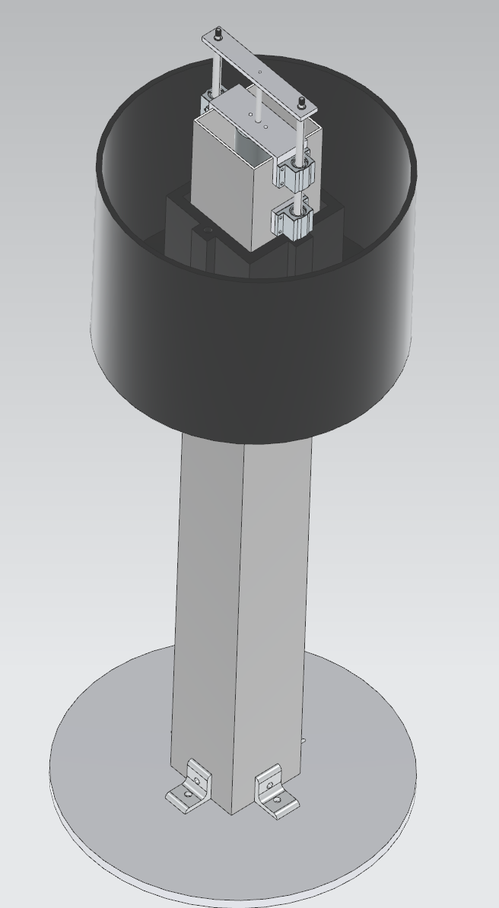
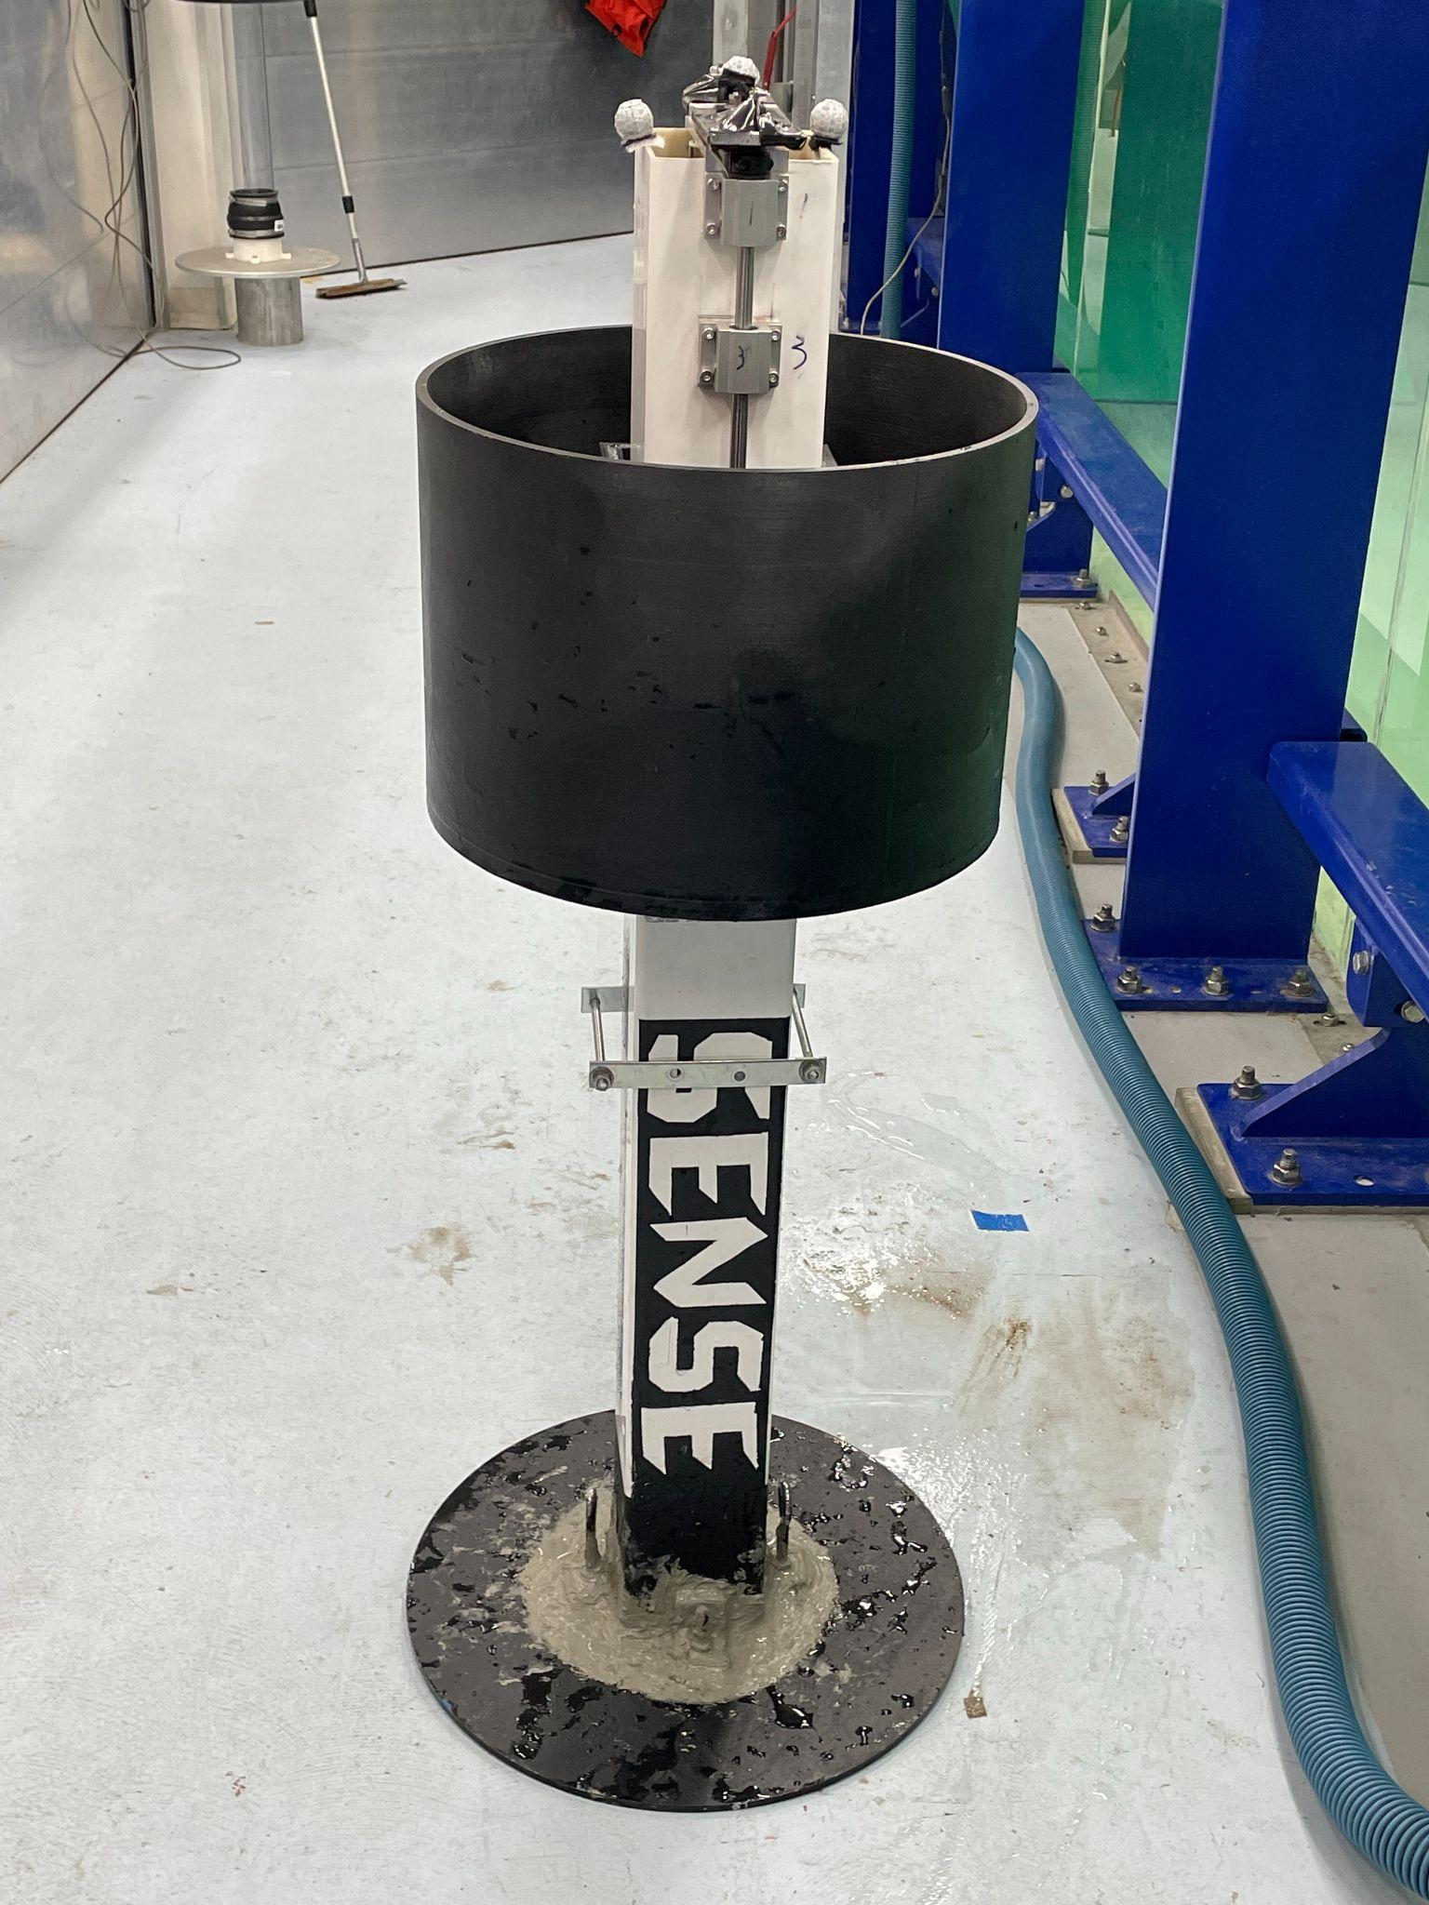
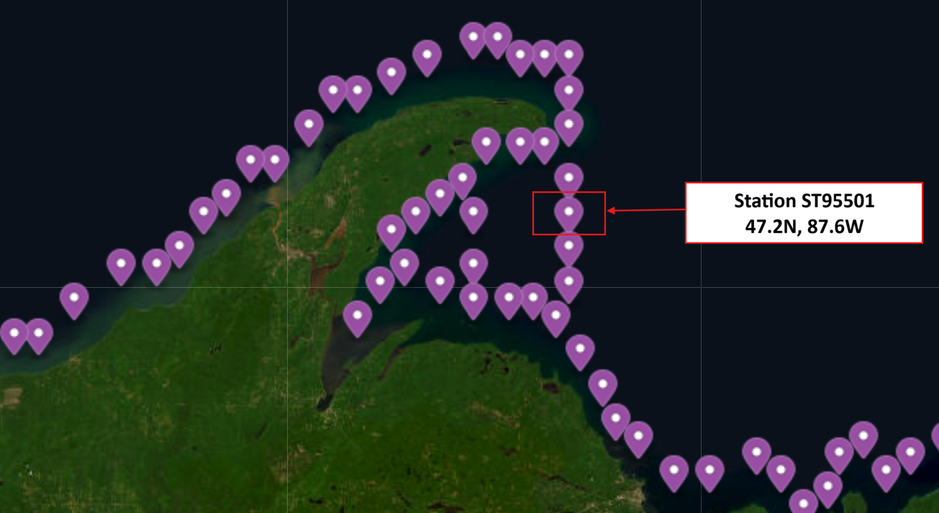
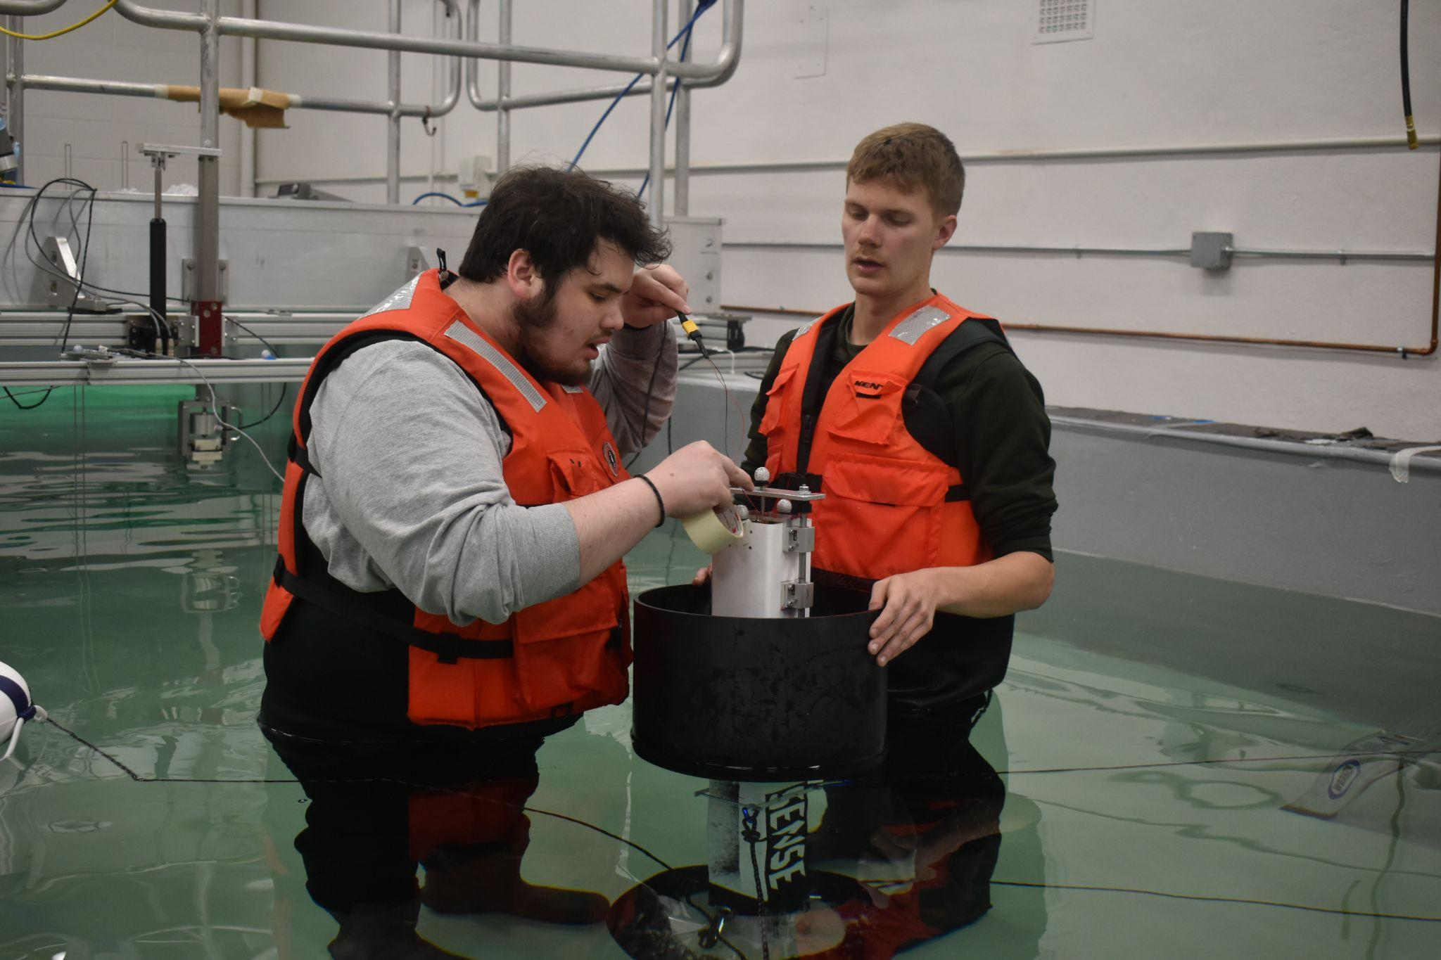
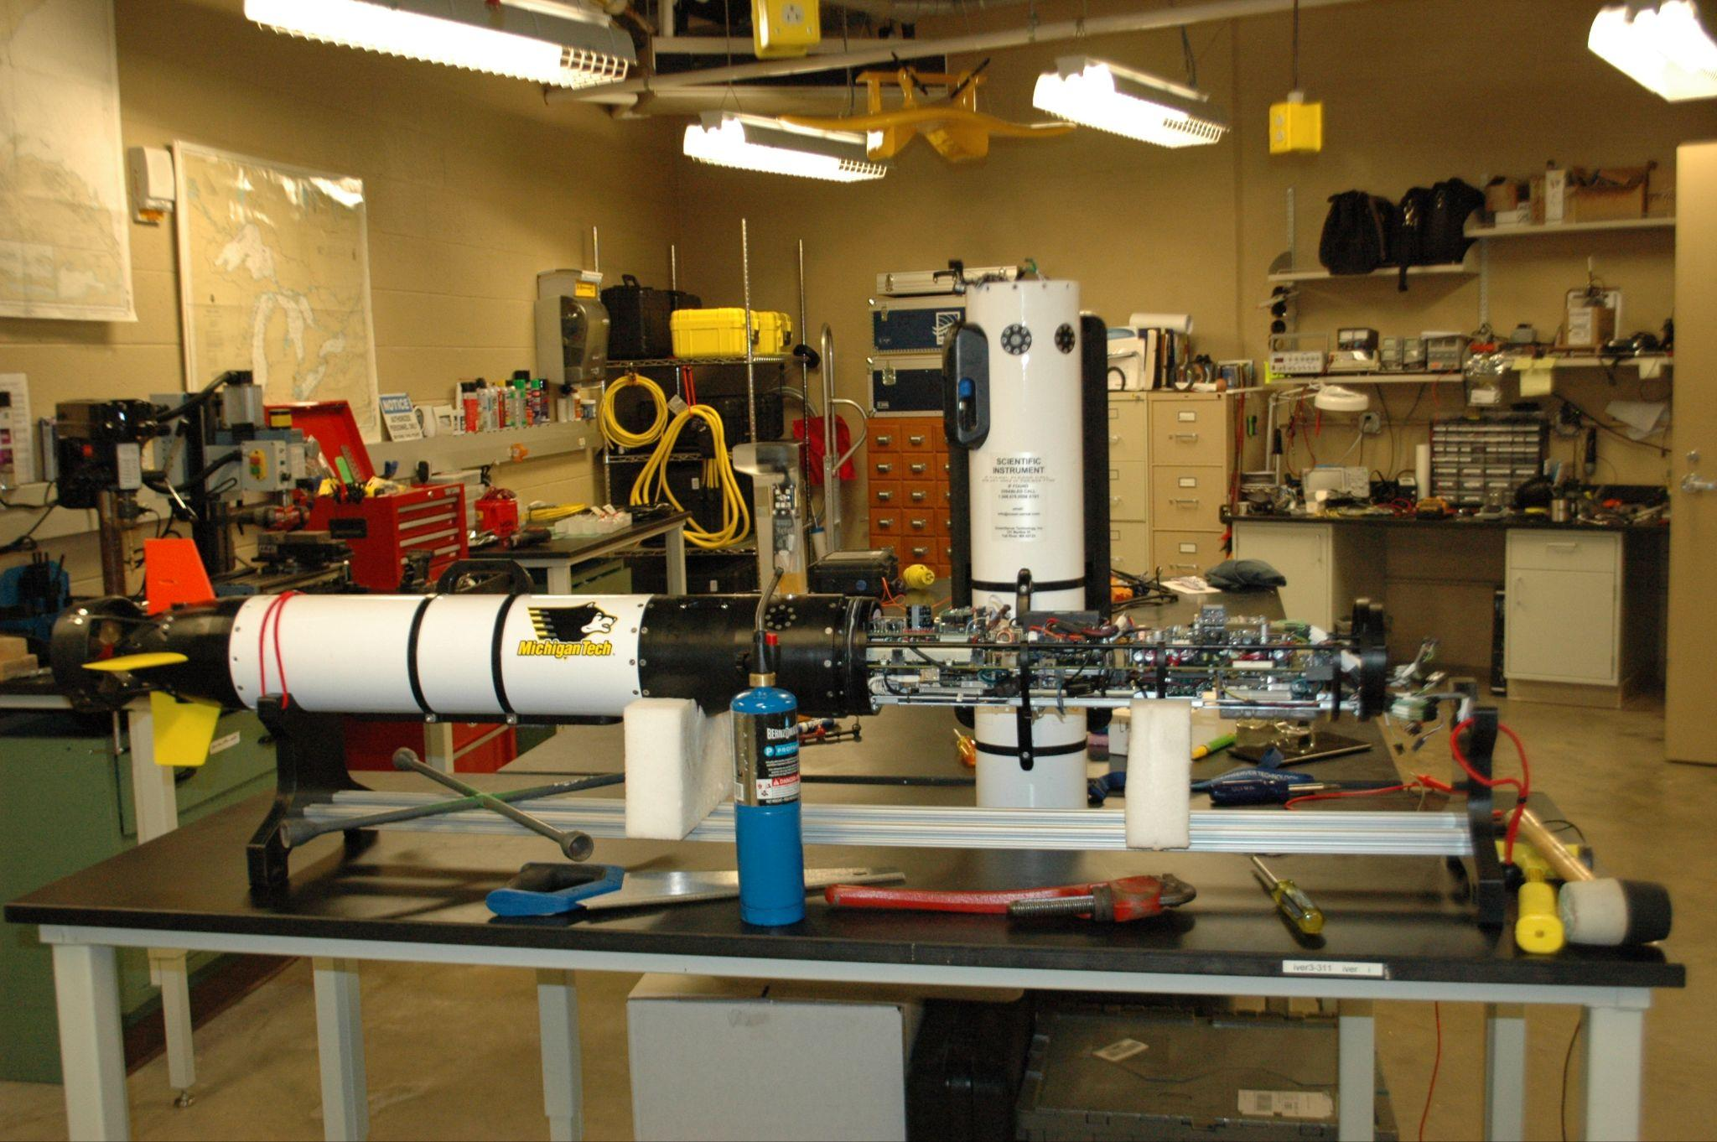
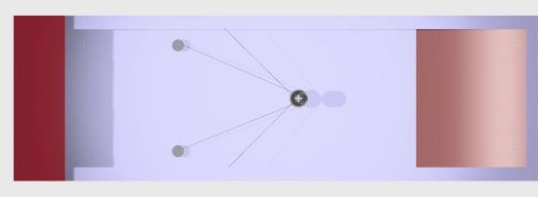
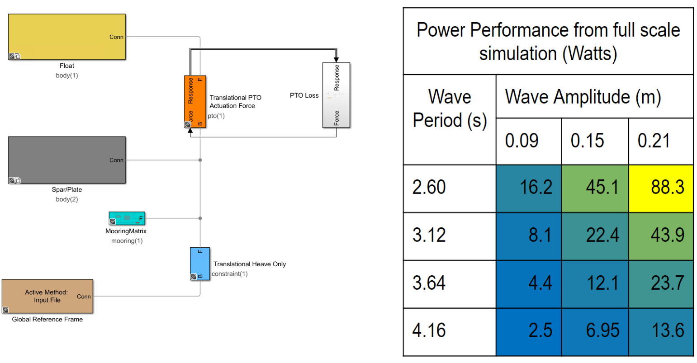
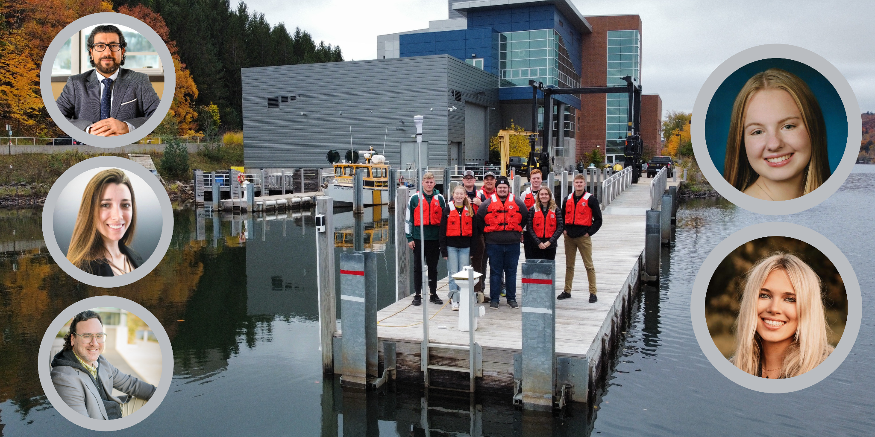
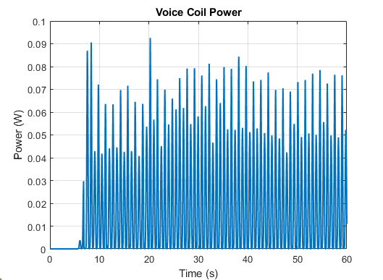
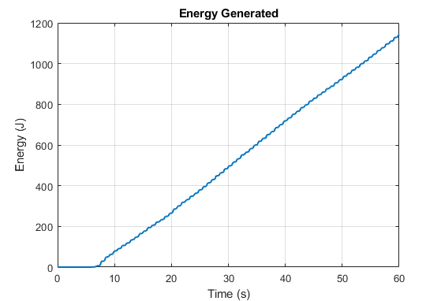
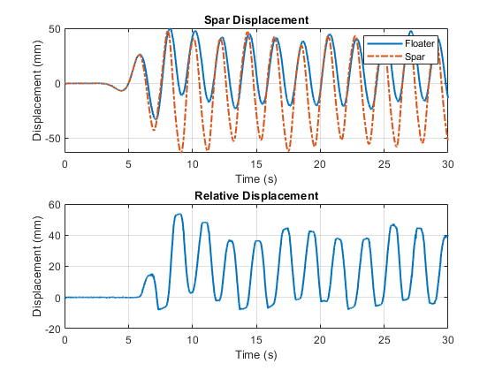
  Point Absorber Wave Energy Converter
  Michigan Technological University
Project Statement: The 2024 SENSE MECC Team embarked on a mission to design a two-body heaving point absorber conceptually capable of being scaled to charge AUVs offshore in the Great Lakes!
Design Purpose
4. Assessing Opportunity
A two-body heaving point absorber utilizes the vertical oscillations induced by ocean waves to generate mechanical energy, which is then converted into electricity through a power take-off system. This design would allow for energy in the waves to be used to charge a AUV.
Our goal is to allow for renewable energy to be used to charge AUVs in the Great Lakes to allow for a better understanding of some of our most critical water bodies.
There exists great opportunity in the AUV industry. Offshore charging stations would accelerate various critical efforts, such as environmental assessments, military exploration, lakebed mapping, and water quality monitoring by advancing initiatives such as Lakebed 2030!
2. Design Initiative
Design Details:
Machined Components:
  Motor Mount
  Bearing Spacers
  Heaving Mount
Buoy: Designed by Braeden, 3D-printed by Signature Research Inc.
Voice Coil Motor: Purchased from Moticont.
Bearings, Rods, Plate: McMaster-Carr
Fasteners: Ace Hardware
Spar:
  Initially a Grainger fiberglass tube, due to safety concerns it was discarded
  Sourced composite deck post from Lowe’s that fit design dimensions
5. Technical Feasibility
We used both WECsim performance analysis and Linear Wave Theory to assess the feasibility of charging AUVs in Lake Superior with wave energy. All data inputs were taken from Lake Superior weather buoys.
Testing:
Successfully tested the prototype in the MTU Wave Tank for performance results.
Potentials:
Further testing with different heave plates.
Controlling the voice coil motor to optimize performance and improve survivability andsafety
An IVER3 was repeatedly used as the reference model AUV for this feasibility study. Both by simulation and empirical calculation we concluded that the power requirements are very capable of being met.
3. Performance Simulations and Testing Results
The figure on the right illustrates the Simulink model used for the eventual WECsim simulation of our full-scale model. The table to the right of the figure illustrates the power-performance results of the simulation
The three figures below represent the prototype’s power performance and hydrodynamic performance during a specific iteration of the overall performance test.
Faculty: Dr. Timothy Havens, Dr. Hassan Masoud, Dr. Gordon Parker (not photographed)
PhD Advisor: Tania Demonte-Gonzalez
Senior Design: Mason Mariuzza (Civil), Emily Bauman (ME)
Project Engineers: RJ Slater (MET), Kevin Hoefer (OSM), Kate Sorbie (ME), Max Beard (MET), Braeden Colberg (ME), Grace Garnett (Environmental), Corbin Haischer (Mechatronics), Emily Roth (EE)

