Slide 1
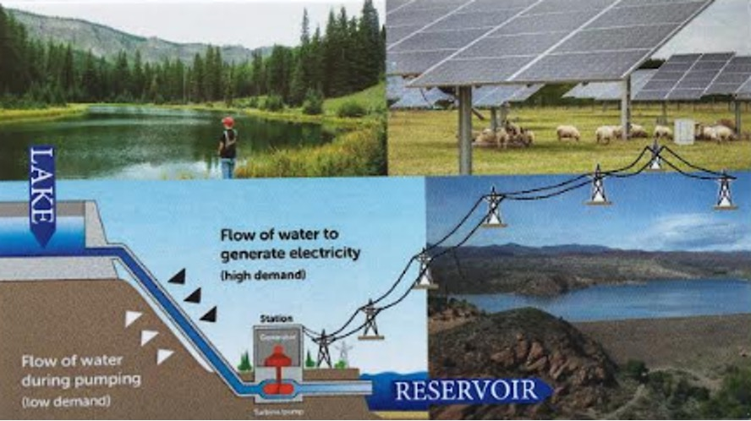
The Rural Hydro Network
Promoting and Enabling Clean Hydro Power in Southwest Utah
A team of professionals with technological, environmental, community, government, policy, and commercial expertise that aims to:
create a demo pumped-hydro project in rural Southwest Utah
create a larger network of resources for other communities that would like implement similar clean energy projects.

