Slide 1
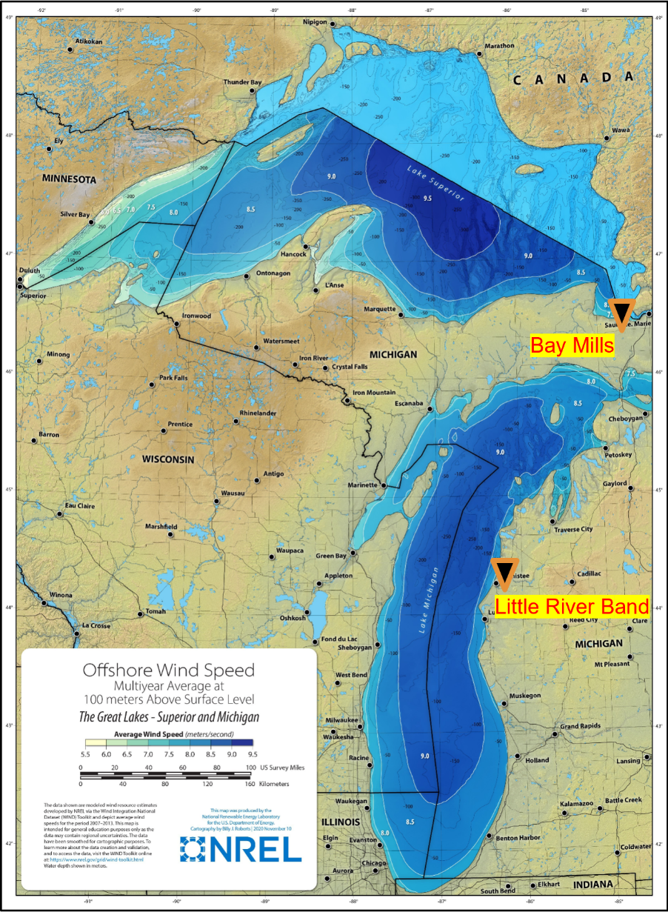
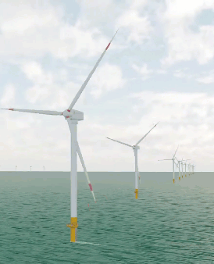
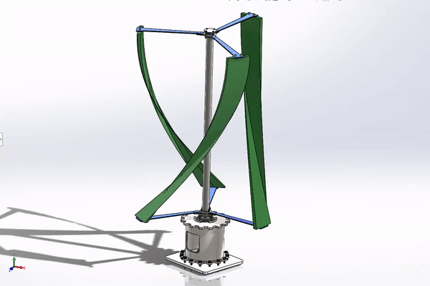
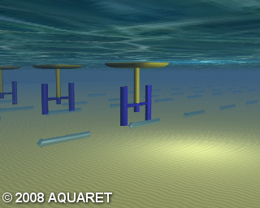
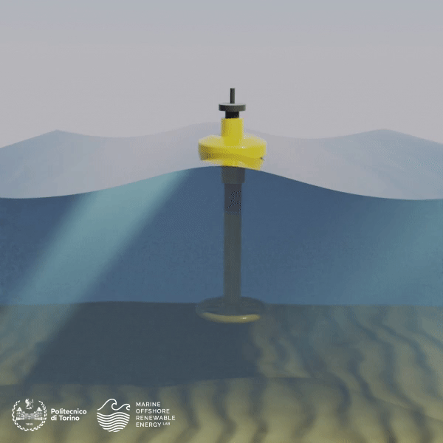
OUR TECHNOLOGICAL EXPERTISE
Our Community Focused Solution
Community engagement and education programs.
Technical Feasibility Assessment
Design and engineering support
Horizontal axis (left, credit vmts ) and Vertical Axis (right, credit Credit: Fasial, 2021) Wind Turbines for Wind Energy Harvesting
Financial modeling and funding strategies
Regulatory and permitting assistance
Current Turbines,
Credit: Aquaret
Point Absorber, Credit: MORE
Innovations for Great Lakes Marine Renewable Energy

