Slide 1
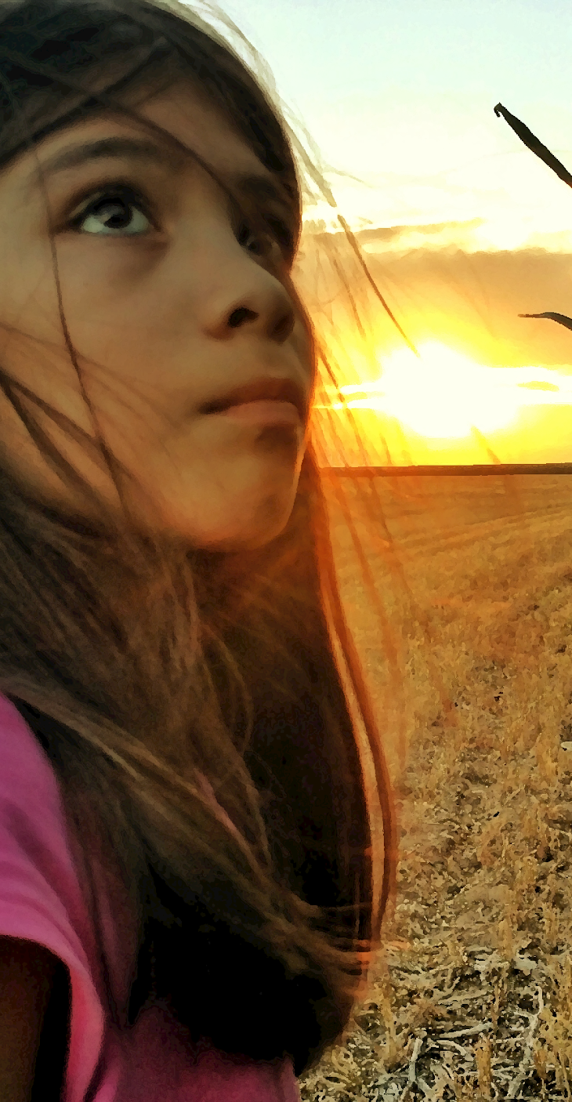


STEERING SOUTH TEXAS TOWARD SOLAR SUCCESS
Develop a strong network of energy stakeholders who can collaborate for an equitable clean energy transition and demonstrate a project that can be used to inspire the region’s energy stakeholders.
Advancing affordable, reliable, and clean energy for underserved communities

Slide 2
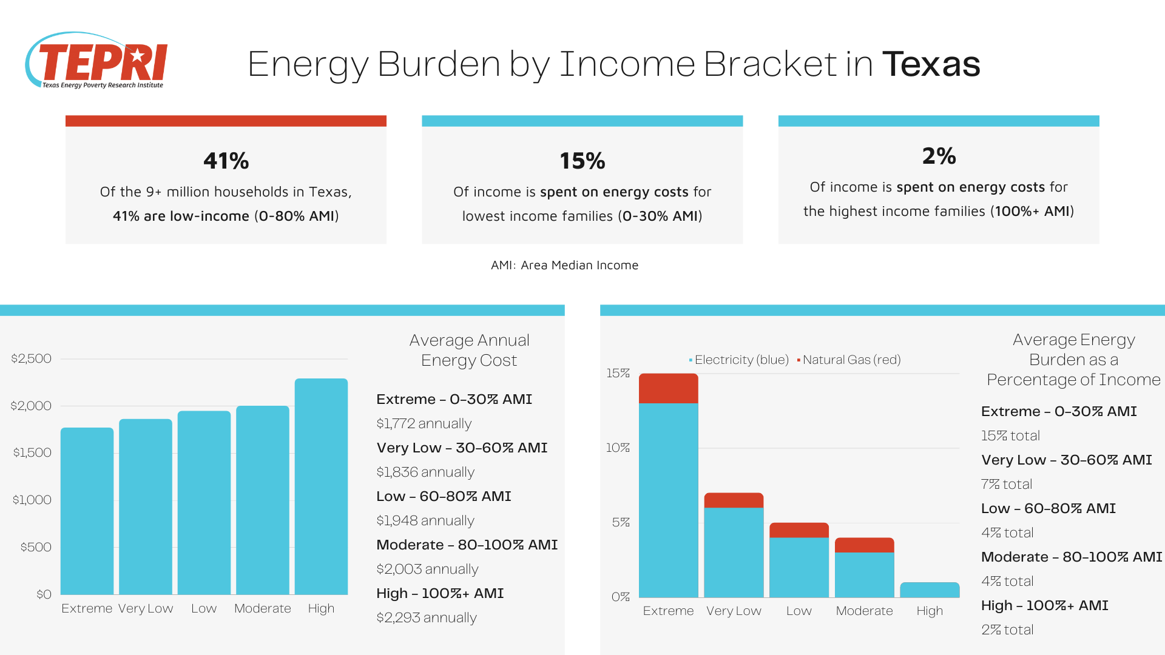
Energy Burden in Texas
Texas has one of the highest poverty rates in the United States at 13.60% [1]
  37% of households live below 200% of the Federal Poverty Level (FPL)
There are over 3.8 million Low-Moderate Income households disproportionately burdened by high energy costs
Source (TEPRI, 2022)
Notes:
Texas has one of the highest poverty rates in the United States with 37% of households living below 200% of the federal poverty guideline.
Looking at multi-year averages for Texas, the state's official poverty rate for 2018-2020 of 12.9% (3.7 million people) is significantly worse than the national average of 11.2% (36.5 million people) for the same time period. https://everytexan.org/2021/09/14/new-census-data-show-federal-investments-kept-millions-out-of-poverty-but-texas-needs-bold-action/

Slide 3
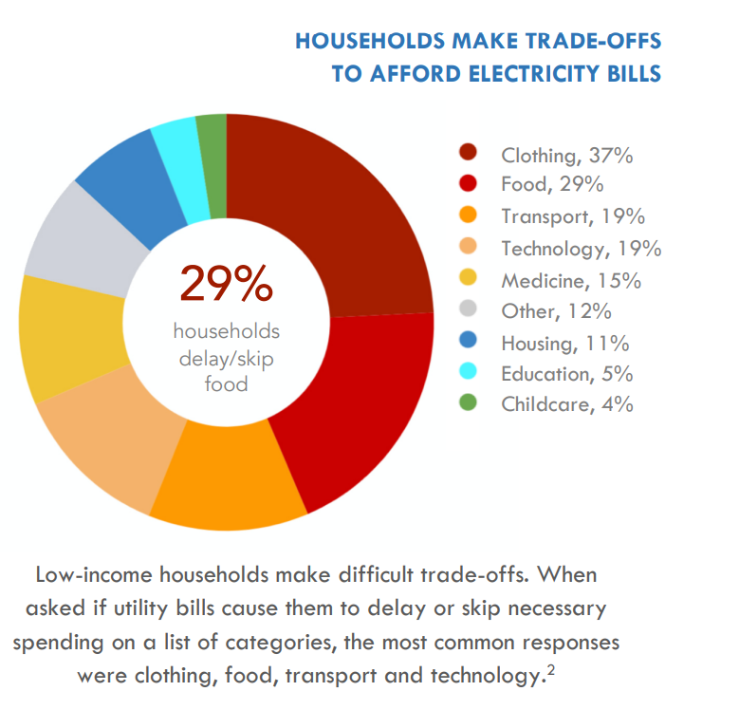
LMI Households Make Trade-Offs
26% of households in Texas keep their homes at an unsafe and unhealthy temperature [4]
(national average is 18%)
29% of households buy less food to keep the lights on or put off purchasing clothing or medicine to afford using heating and/or cooling.
Source (TEPRI, 2019)
Notes:
https://texassignal.com/texas-leads-the-nation-in-households-unable-to-pay-energy-bills/
Energy-burdened poorer Texans have been forced to buy less food to keep the lights on one month, or put off purchasing clothes another month to keep the heat going.

Slide 4
The Geography of Energy Burdens
Notes:
[2] Pecan Street Inc., 2020
https://texassignal.com/texas-leads-the-nation-in-households-unable-to-pay-energy-bills/

Slide 5
Overview of Milestones
State included roof-top solar as an acceptable use of funds for roof-top solar in the LIHEAP State Plan
Engaged grassroots community organizations and local utilities in the vision and implementation
Installed first roof-top solar using HUD Funds in Carizzo Springs area
Began process off identifying Travis County funds to pilot in Austin

Slide 6
Looking Forward
Install solar on households using public funding streams
Educate households with low-incomes about solar benefits and opportunities to participate
Develop case studies for the Texas Department of Housing and Community Affairs (TDHCA)
Work with TDHCA to use WAP and LIHEAP Funds for Roof-Top Solar
Create How-To Guide for Others to use

Slide 7
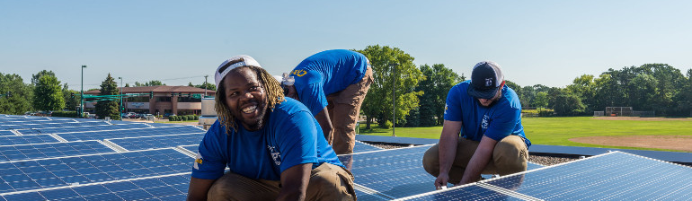
NEW PATHWAYS FOR EQUITABLE
SOLAR IN TEXAS
4/13/23
Thank You

