Slide 1
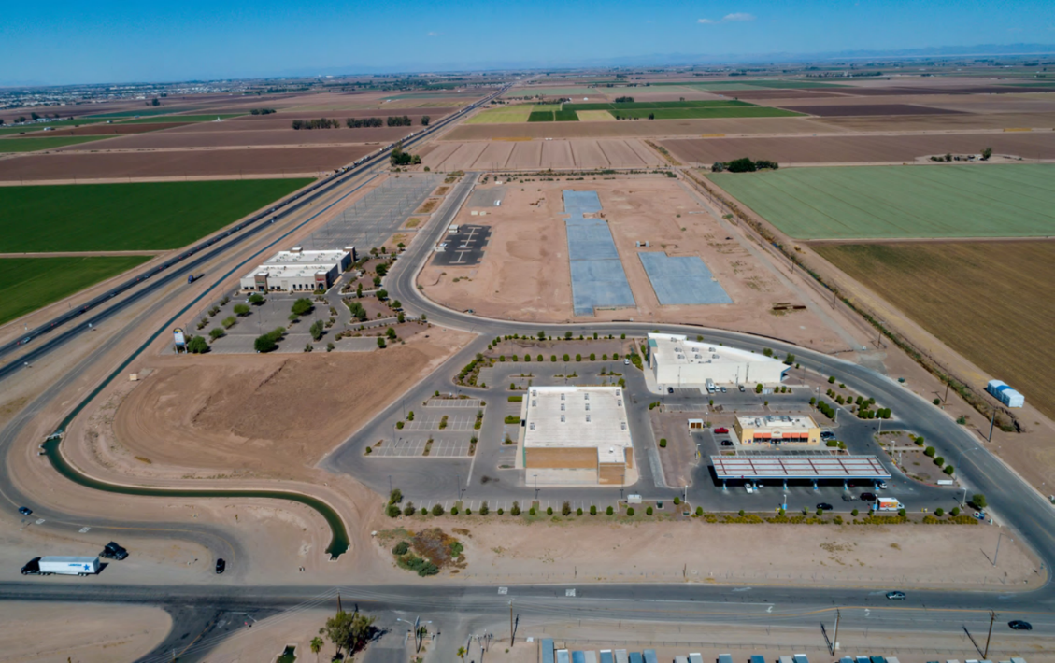
Lithium Valley R4
Rural & Remote Renewable Energy Replicator
2 MW Community Solar/Wind/Battery/Microgrid
LMI Modular Housing Location
LVR4 Manufacturing Center
Restaurant and Retail Space
Professionals from solar, wind, battery, microgrid and finance fields have created a low-cost renewable energy solution for rural and remote communities. Our system includes a manufacturing center to produce the renewable and modular housing components, making this system replicable for any rural or remote community.
We provide the whole package: Renewable Energy, LMI Housing and Clean Energy Jobs!
LD/HD EV Charging Station with Solar Canopy

