Slide 1
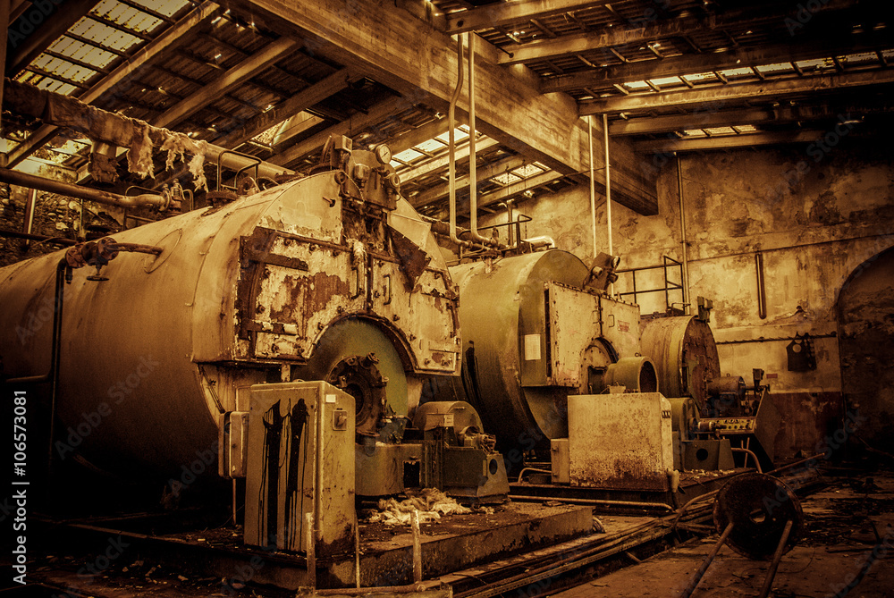
BANYAN TEAM – DECARBONIZING RURAL AMERICA
RURAL UNIVERSITIES NEED SUPPORT TO MODERNIZE THEIR ENERGY SYSTEMS
UPGRADES WILL CREATE FINANCIAL AND CLIMATE IMPACT FOR THEIR COMMUNIITES
PRIOR LIMITATIONS INCLUDED LACK OF ENDOWMENTS AND INSUFFICIENT PROFITABILITY OR SCALE FOR ENGINEERING PARTNERS
OUR COLLABORATION BRINGS THE TECHNOLOGY AND SKILLS NEEDED TO DEVELOP AND SERVICE NEW ENERGY UPGRADES FOR RURAL UNIVERSITIES
AVERETT UNIVERSITY - A MODEL TO REPLICATE:
NEW LED LIGHTING, HEAT PUMPS, AND SOLAR CREATE UP TO 80% SAVINGS FOR THE UNIVERSITY AND SIGNIFICANT CARBON REDUCTION, ALL WHILE LEVERAGING MODERN TOOLS TO KEEP ENGAGEMENT HIGH AND SAVINGS TRANSPARENT

