Slide 1
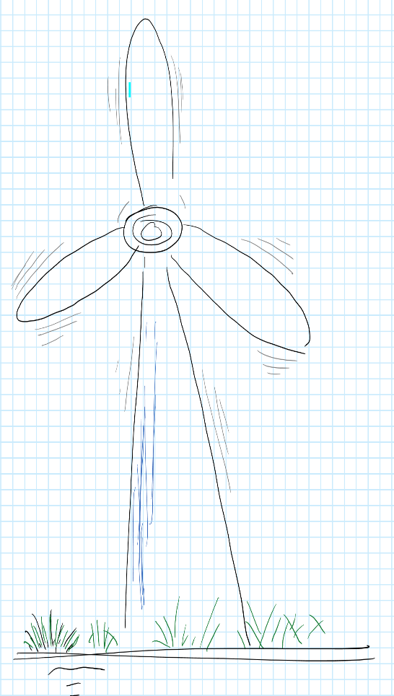
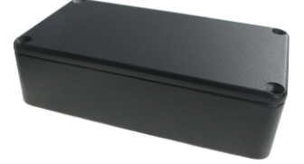
Concept of Operation | Functionality | Physical Architecture
Undetected vibrations in Distributed Wind Turbine Generators (DWEG) increase LCOE | A small instrument that fits in most commercial DWTG | Windpower LifeLine
 | Low cost (<$100 Cost of Materials) Vibration and speed monitoring Self-learning, machine-specific health signature Cellular Network data connection Cloud and on-board data storage IoT compatible Graphical interface High fidelity (low false alert rate) User-configurable alert levels for vibration and speed Firmware remotely upgradable Batteries auto charged on-site | Footprint comparable to smartphone Robust default interface (no need to configure anything, if desired) Web and Cellphone accessible, with two way communication Tested on Bergey 15kW, Pecos 85kW and Cal Poly 3.5kW turbines Cost of manufacture ~$46/unit
Phase 1 TRL: 2 Phase 2 TRL: 6 Post-Phase 2 TRL: 8-9
2018-2022
July 2023-July 2024

