Slide 1
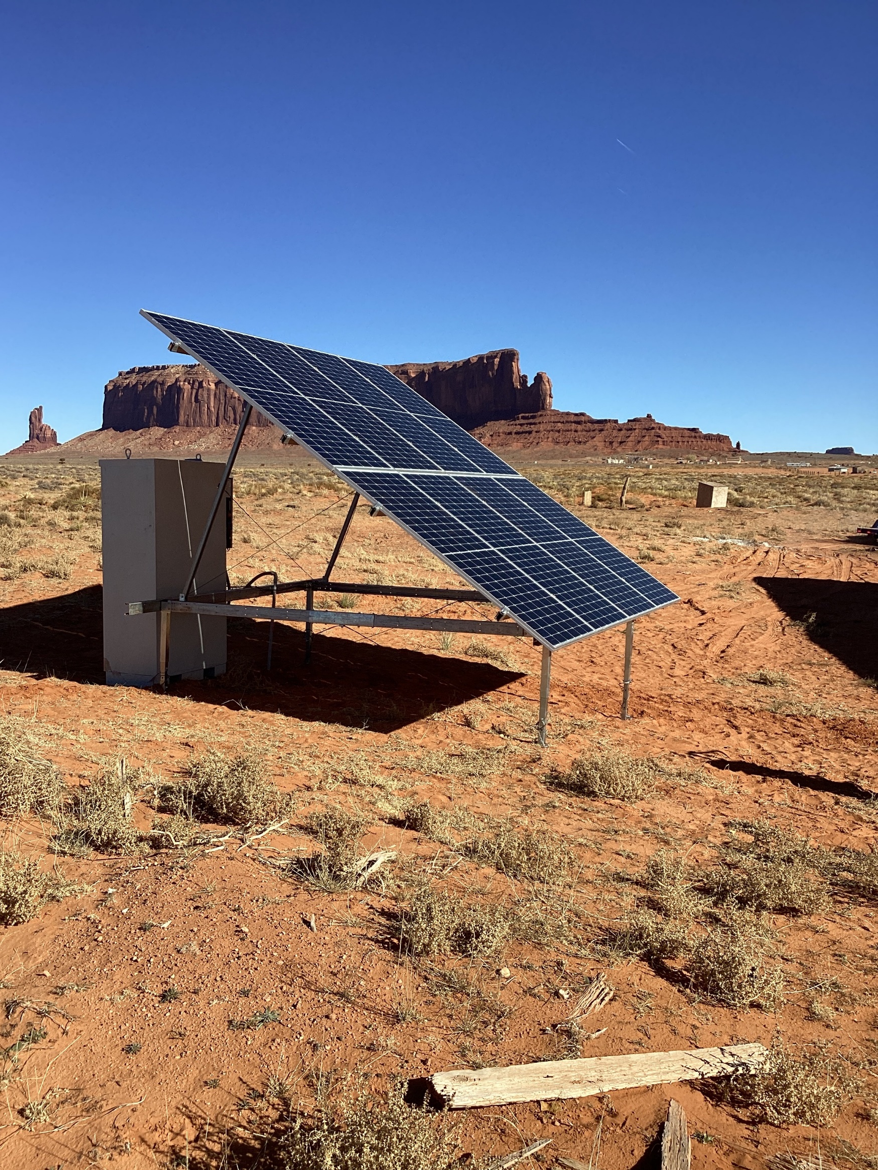

ISC Statement of Core Values
At Industrial Solar Consulting, we have a commitment to affirm a high standard of ethical business practices from the owner to the partner, to the vendor, to the customer. Our company was founded to benefit the lives of others by bringing clean reliable power and communications to those who need it most. We continually strive to ensure this purpose by making our values and ethics aligned and transparent. We strive to manifest this ideology in every employee and in every relationship, from the largest to smallest. Even as the world around us evolves, we stay true to this ideology as a company. We continually work to maintain a diverse, sustainable, reputable, considerate, and inclusive organization while aiming to exceed industry standards and improve the world around us.

