Slide 1
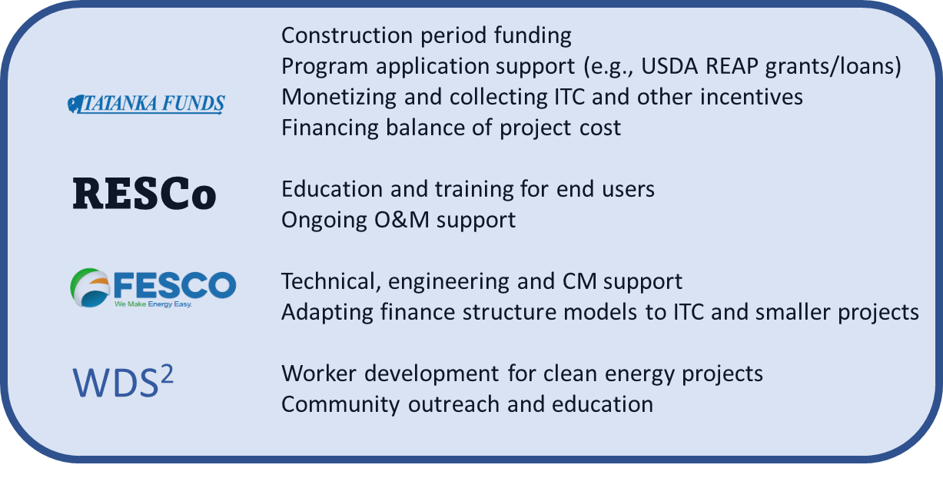
Rosebud Sioux Tribe
Tatanka Funds Clean Energy Bank
Submitted by: Funding Sicangu Energy Team
Project Summary
Key Partners
Recent legislation provides a unique opportunity to integrate our Lakota Culture into clean energy efforts that will directly benefit our community and economy. Generous incentives address the threat of climate change and align with our Lakota beliefs in a way to become a catalyst for action that will address climate change, revitalization of our Lakota culture and expansion of economic activity in our area. Our proposed project overcomes what we see as the last barrier for small business and individuals in rural America to implement clean energy projects, the initial funding required to build the project. We will adapt proven business strategies to maximize tax credits and other incentives, apply our seven generation thinking to choose solutions on long term performance, not first cost and provide a resource for up front funding to implement the projects that is paid when incentives are collected. This project integrates with other sustainability efforts by the Tribe, including establishing a job accelerator to train our youth in clean energy technologies, building our first community microgrid and accessing our geothermal resource for district heating.
Budget
Staff Budget for Phase 1 activities: $90,000
Training and travel for Phase 1: $22,000
Project Outcomes
Our project will result in wider adoption of clean energy projects in our rural community. We envision 10 projects in the first year. The financial, technical and administrative support for these projects will result in 2 to 3 times the prize award amount being injected into our local economy in the first year AND keep that money working within our economy.
Our project will provide a model to make the IRA and BIL investments work in Rural America.

