Slide 1

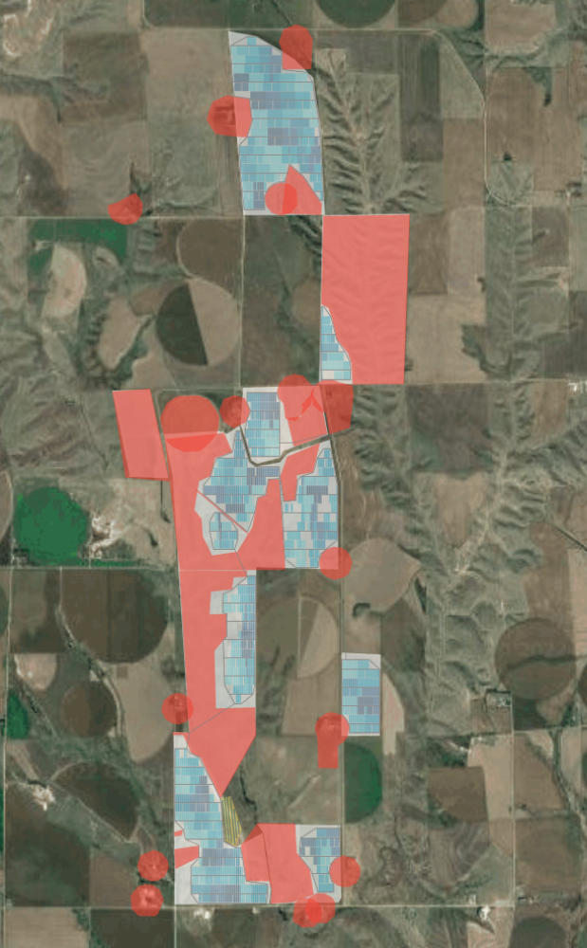

George Norris - McCook Solar Plant:
Community Partnership and Project Development
Premier Energy, LLC will develop partnerships necessary to achieve a 40 MW-ac, 200 MW-dc solar and 130 MW / 520 MWh energy storage plant in a disadvantaged Nebraska community. Development of this high-capacity factor project, with ready access for interconnection, depends on the success of an innovative local stakeholder process to optimize community benefits and reach a win-win solution to points of local resistance.

