Slide 1





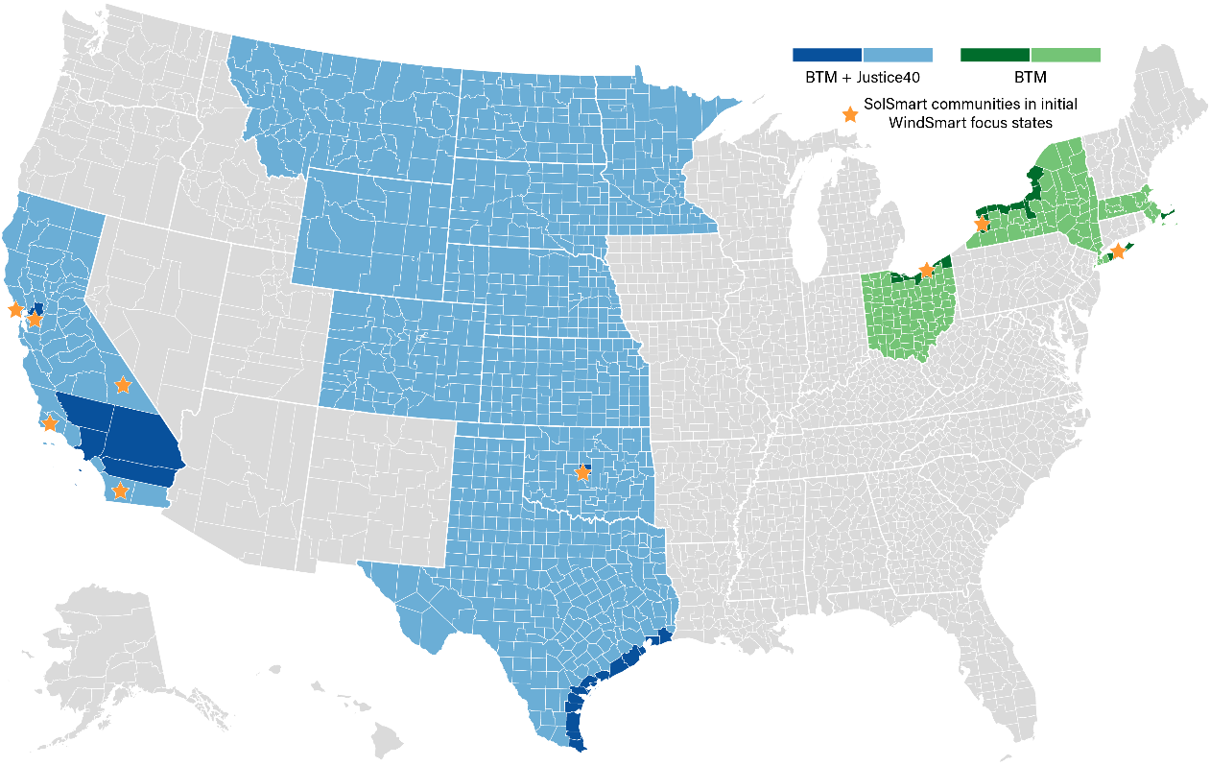
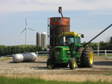

Qualifying Rural & Remote AgWind Projects
Technical Assistance to Jumpstart DW Development
Team: AgWind Qualifiers
Partnership
Key Project Members
Heather Rhoads, eFormative Options, Lacey, WA
Margo Weisz, TEPRI, Austin, TX Megan Amsler, Self-Relance, North Falmouth, MA
To pilot and scale AgWind technical assistance, DWEA will utilize Justice40 tools and existing partnerships to identify stakeholders and consult a diverse group of industry sector representatives, community-based organizations and individuals, including those from underserved, underrepresented, under-invested, and disadvantaged communities, to provide input and guidance on protocols, processes, and documenting environmental and distributive wealth justice impacts.
Program Activities
Early 2023: Establish AgWind consultancy
7/2023-6/2024: Pilot in Sinton, TX, evaluating sites such as San Patricio County Fairgrounds
7/24 onward: Identify and pre-qualify sites in other rural & remote communities across the U.S. (TX, CA, NY, MA, OH, OK) with high dWind potential
Mission and Impact
The Distributed Wind Energy Association's mission is to promote and foster all aspects of the industry sector installing distributed wind turbines.
Expected impacts include reduced project costs and better overall performance, shorter permitting wait times, faster installation turnarounds, and increased consumer awareness and credibility, all resulting in greater adoption.
Decreasing first-cost barriers to entry for Distributed Wind

