Slide 1





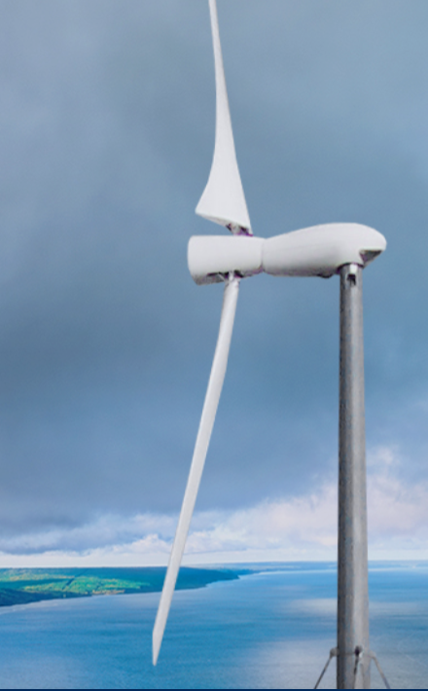
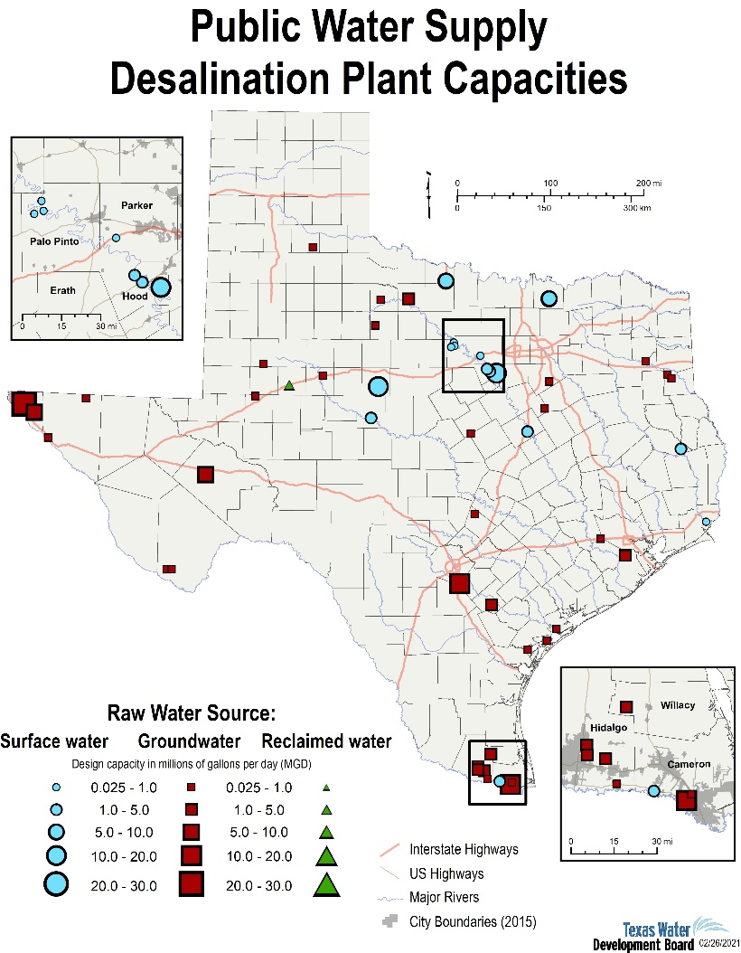

Wind Powering Cleanup of
Polluted Community Water Supplies
CWT Water-Smart Solutions Team
Partners
Key Project Members
Carter Wind Turbines
(CWT) is committed to
championing J40 goals by building partnerships to engage local communities and labor unions in meaningful ways including negotiating community benefit agreements. CWT has identified many stakeholders across government, educational, and community-based organizations and is exploring workforce development and DEIA opportunities.
Matt Carter, Carter Wind Turbines, Wichita Falls, TX
Margo Weisz, TEPRI, Austin, TX
Tim Olsen, Advanced Energy Systems, CO
Program Activities
Phase 1: Engage with water treatment facilities
Phase 2: Prepare for certification, deployment, and larger state-of-the-art manufacturing facility
Phase 3: Install CWT-300 at or near Seymour, TX desalination plant; expand to other rural water plants
Mission and Impact
CWT is a manufacturer of next generation wind turbine technology that is self-erecting, portable, and designed for distributed and micro-grid power generation applications in remote, extreme environment locations that are not practical with conventional large wind turbine technologies.
Our technical approach leverages fleet experience from 800+ wind turbines deployed in the 1980s-90s with a modernized design, focused on remaining accessible and easily deployable.
Rural and remote desalination, reverse osmosis, and wastewater treatment

