Slide 1

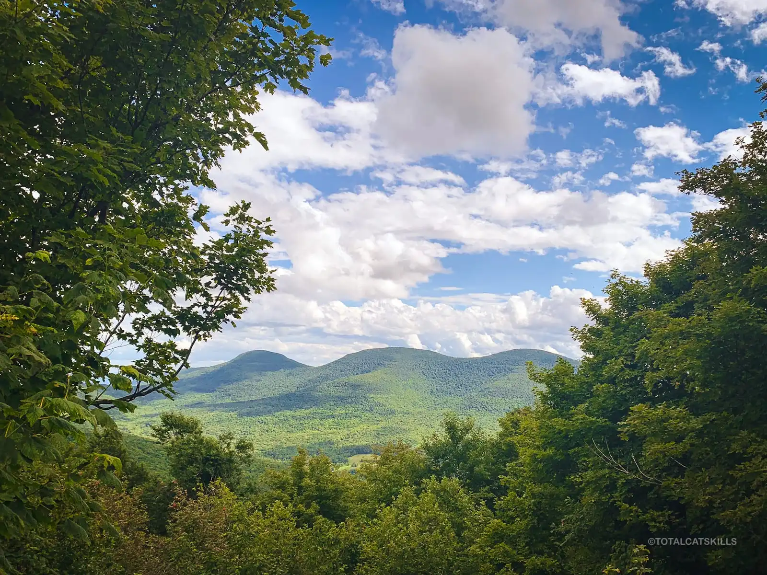




OhmGrid and SunMoksha are partnering with the Marbletown Environmental Conservation Commission to deliver resiliency and clean energy to this mountainous community. This remote area struggles with resiliency of power delivered to their homes and businesses. Residents experience regular outages that can last for multiple days. Our mission is to create a project development and finance plan to drastically increase resiliency for its residents and implement the town’s 100% Renewable Energy Action Plan.

