Slide 1
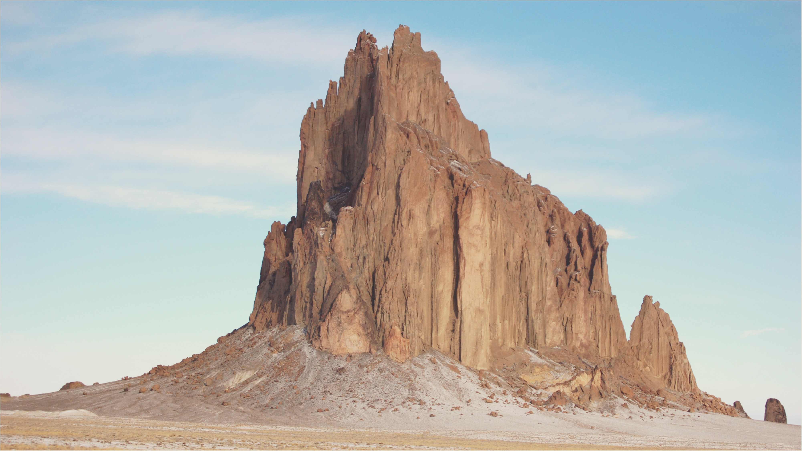
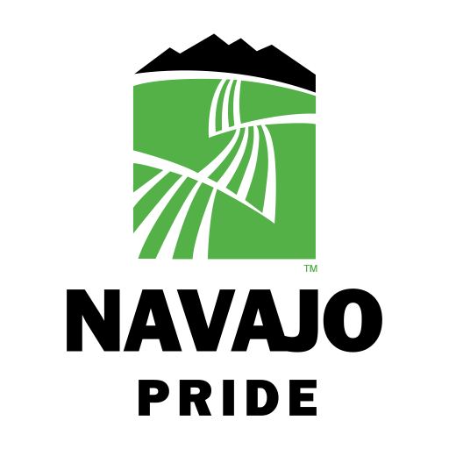
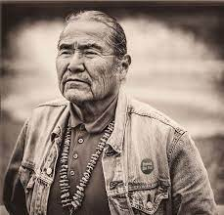



Chili’s Clean Crusaders
SunMoksha and BlueSky Power are partnering with the Navajo Nation community of Shiprock and its Traditional Farmers led by “Chili” Yazzie to achieve their sustainability goals. We will develop a plan to preserve their natural resources, while bringing clean energy through solar and solar thermal, as well as delivering resiliency to areas of this Navajo community that have limited access to reliable power.

