Slide 1

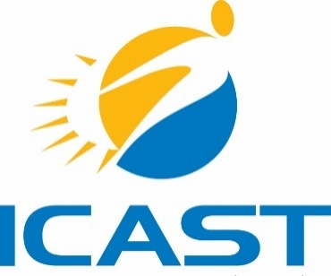
Proposed Projects
Utilization of MFA WAP funds ($9 million) to electrify buildings currently using propane, and develop energy efficiency workforces in each Tribal Nation.
Founding of a New Mexico Tribal WAP Agency: Through weatherization efforts, NMTEC will create a Tribal WAP agency to serve the state of NM.
Over 30MW of solar on Tribal land. ICAST estimates that significant economic development, utility cost savings, job creation, and long-term sustainable revenues can be achieved for the Tribes via this project.
A NM Tribal Utility Authority – providing Tribes the opportunity to form their own utility, or join an existing Tribal Utility (such as Acoma Pueblos) rather than being served primarily by electric cooperatives.
The development of a New Mexico Tribal Energy Council, (NMTEC) which encourages the sharing of relevant resources between participating Tribal Nations.
A developed Resource Guide for other Tribal Nations who are looking to accomplish the same things.
Proposed and Existing/Leveraged Partnerships
Taos Pueblo, New Mexico (proposed)
Pueblo de Cochiti, NM (proposed)
Zia Pueblo, NM (proposed)
Jemez Pueblo, NM (proposed)
Mescalero Apache Pueblo, NM (proposed)
Acoma Pueblo, NM (proposed)
Isleta Pueblo, NM (proposed)
Note: All of the Tribes are considered rural by 2020 Census Bureau data and the USDA.
NM Indian Affairs Department (leveraged)
NM Mortgage Finance Authority (leveraged)
NM Alliance of Health Councils (leveraged)
NM Department of Health (leveraged)
Santa Fe Community College (leveraged)

