Slide 1
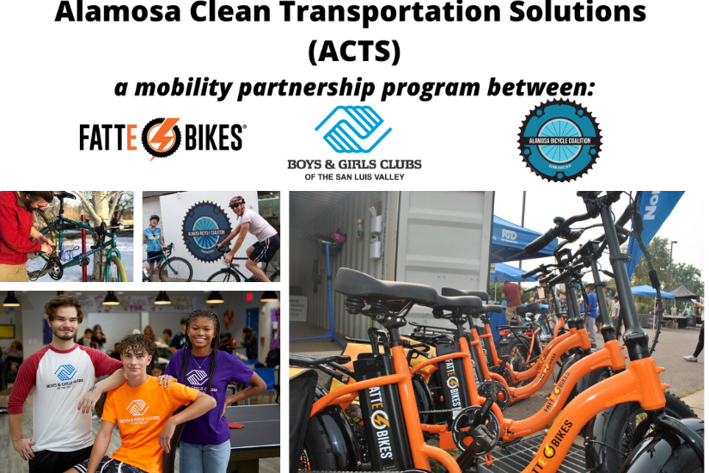
A clean energy mobility partnership between FattE-Bikes, Boys & Girls Club of the San Luis Valley, and the Alamosa Bicycle Coalition to create electric bike libraries for underserved communities in the City of Alamosa, a rural based area in Colorado.

