Slide 1
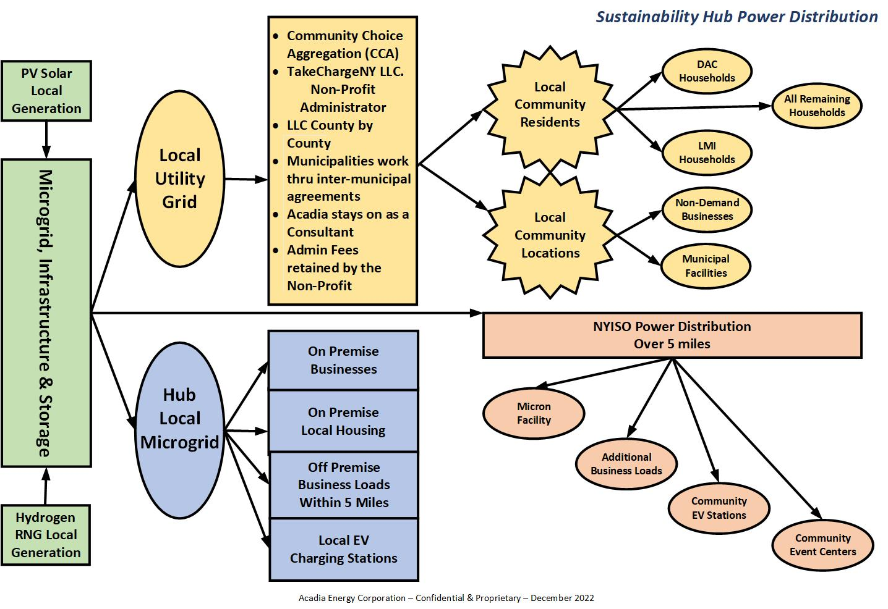

ACADIA
ENERGY CORPORATION
TakeCharge Cayuga LLC. (TCC)
Utilize county/municipal properties for renewable generation sites (landfills) to form Sustainability Hubs, working hand and glove on local DAC and LMI communities.
TCC benefits the local community residents and businesses directly - with no power earmarked for the regional utility grid – total community support.
Sustainability Hubs are innovative business models focusing on wealth creation for the community.
A consortium of communities become a CCA (community choice aggregation) administrator, thus enabling the purchase of wholesale energy and establish pricing to county constituents.
TCC would provide technical and engineering support to local communities unable to afford these services individually due to financial hardship and deteriorating infrastructure conditions.
Green denotes clean energy generation sources..
Beige denotes the local community receiving discounted power from NYS CCA programs.
Pink denotes bulk power distribution for remote sites within the designated community.
Blue denotes behind the meter, direct distribution to local businesses for job creation.

