Slide 1
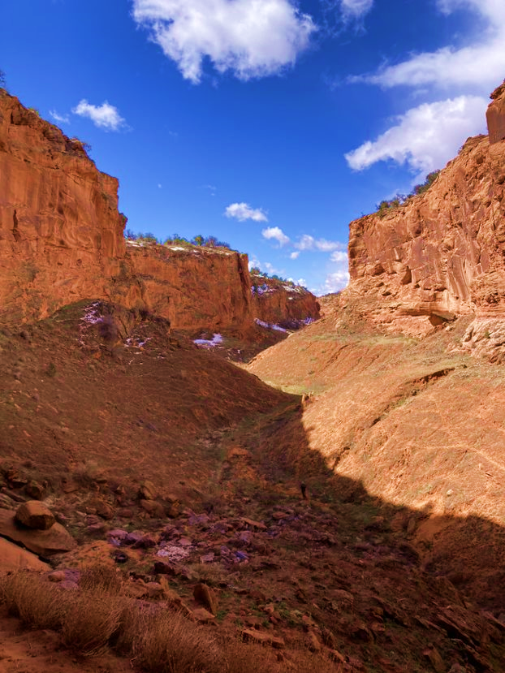
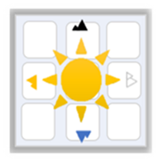
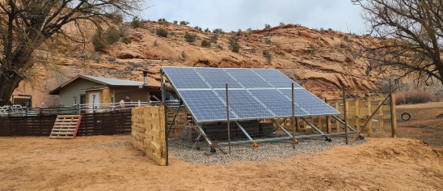
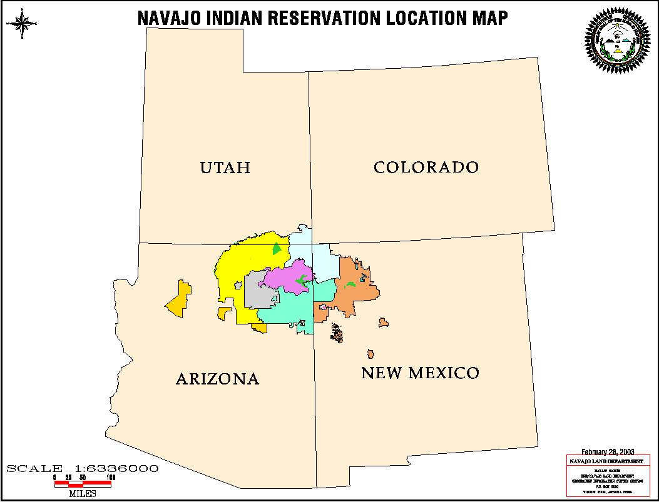
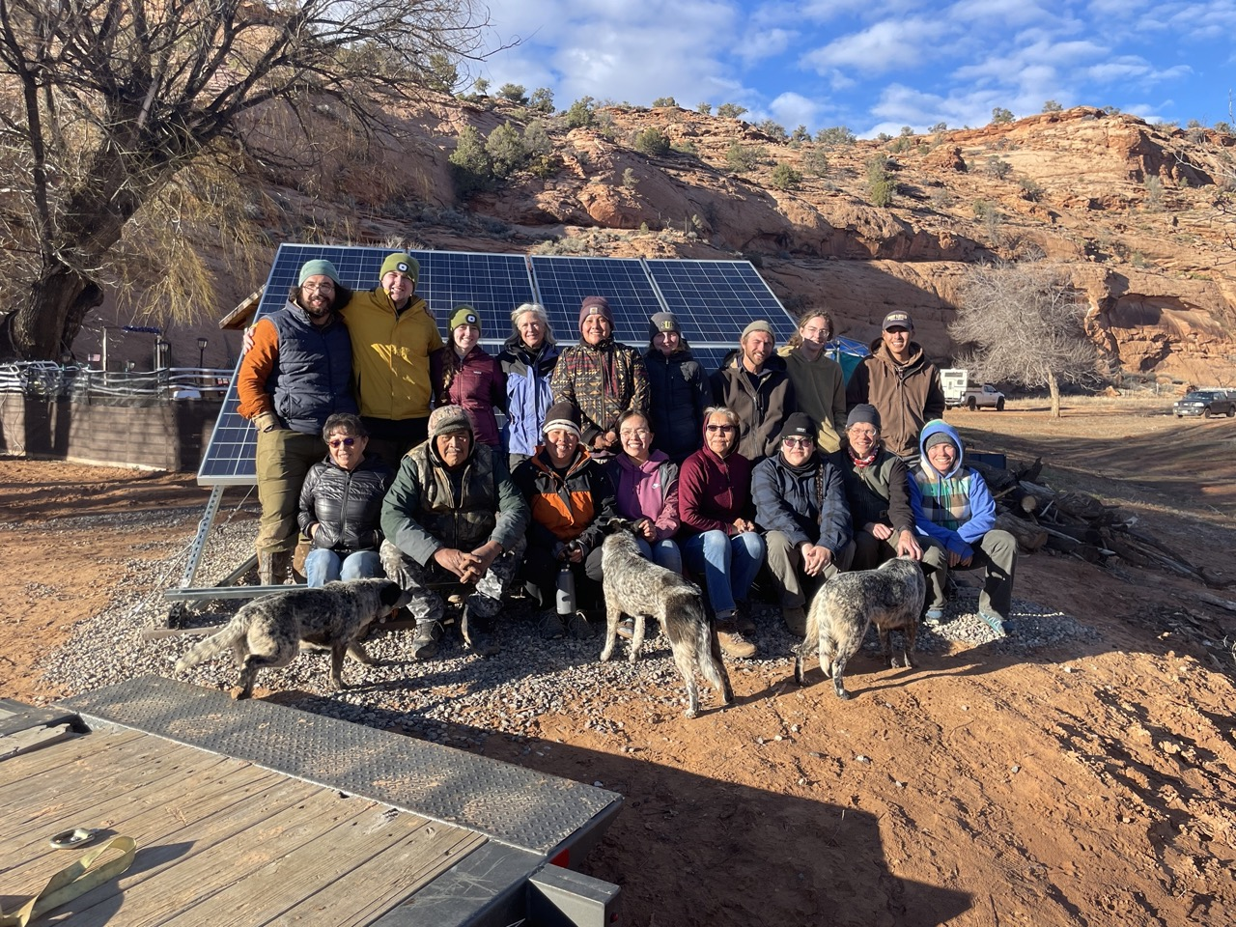
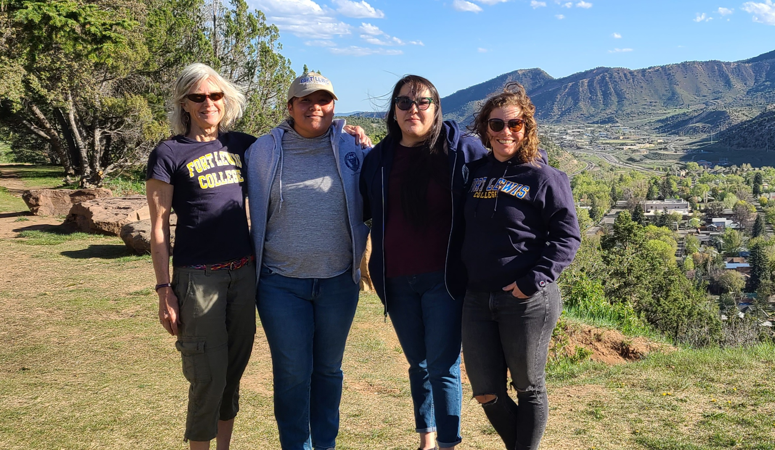
Navajo Nation Solar Initiative
PROJECT INTRODUCTION
The Navajo Nation Solar Initiative (NNSI) is located in the Four Corners region and is positioned to help individuals and families on the Navajo Nation gain access to renewable energy.
OUR MISSSION
Our mission is to empower individuals and families on the Navajo Nation by facilitating access to renewable energy, specifically solar power.
OUR PARTNERS
Through partnerships and comprehensive community engagement, we aim to develop a sustainable energy strategy that addresses home electrification, off-grid solar solutions and workforce development by providing training on operation and maintenance of the systems.
By collaborating with the Shonto Chapter and the Fort Lewis College VAP Solar Initiative, we are dedicated to improving energy access, promoting environmental sustainability, and fostering economic opportunities for the Navajo Nation.
PROJECT GOALS
Homesite Assessment Database
Develop a comprehensive community home site assessment database which will include home locations, electric transmission lines, electrification status, home readiness for electric service, homesite lease status, and interest in electric service
Workforce Development
Contract with local electricians to ensure adequate home wiring.
Sustainability
Provide PV system operation and maintenance training to local chapter members.
Partnering with the local Shonto chapter on the Navajo Nation, the NNSI team and the chapter representatives will create an energy sustainability plan.
WHO WE ARE
We are the NNSI team comprised of Fort Lewis college professors’, alumni , grants advisor and an off grid solar professional expert. We are positioned to increase energy availability and accessibility, promote renewable energy, build clean energy knowledge, establish a clean energy workforce, and shape community energy sovereignty.
CONTACT INFORMATION​
Dr. Laurie William - WILLIAMS_L@Fortlewis.edu​
Camille Keith - CRKEITH@Fortlewis.edu​

